Slide 2
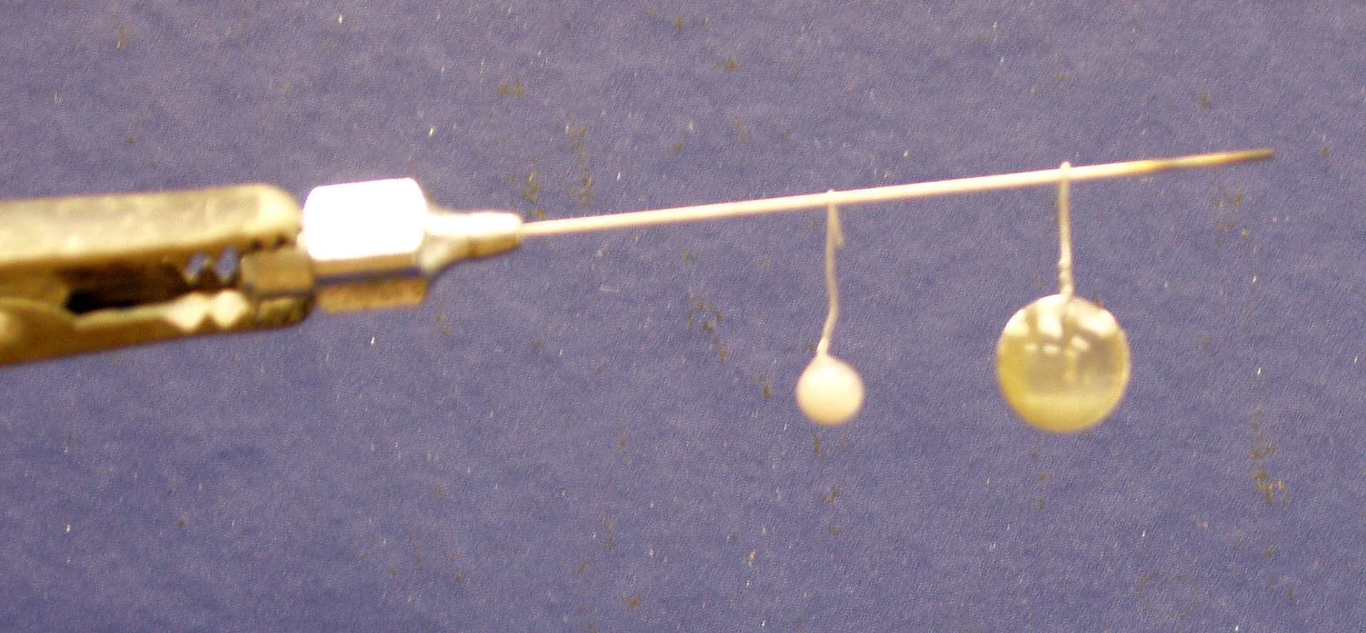
Hashimoto Vacuum Furnace
at the University of Chicago
Experimental conditions:
T=1600˚-1900˚C
P<10⁻⁶ Torr

Slide 3
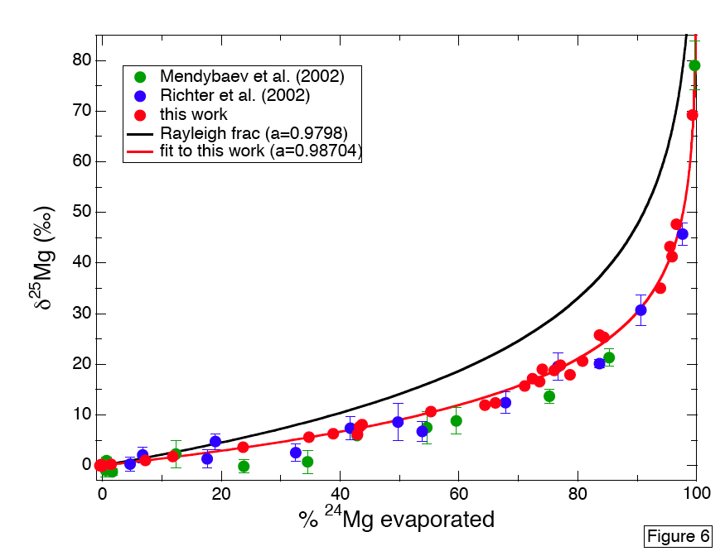

Slide 4
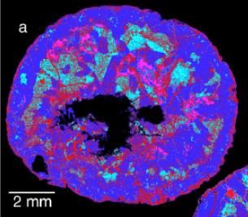
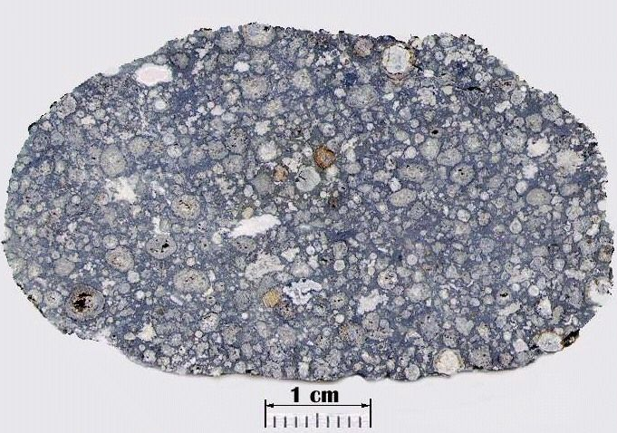
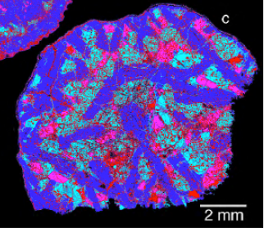
False color images of two Ca-Al-rich inclusions (CAIs) from the Allende meteorite
Note their igneous texture
CAIs are the oldest known objects to have formed in protostellar disk that became our solar system

Slide 5
Chemical Diffusion in Geological Materials
FLUX
Concentration
FLUX
Distance
One can assume that like heat, chemical fluxes are proportional
to concentration gradients
The constant of proportionality is then called an
Effective Binary Diffusion Coefficient: D_{EBDC}.

Slide 6
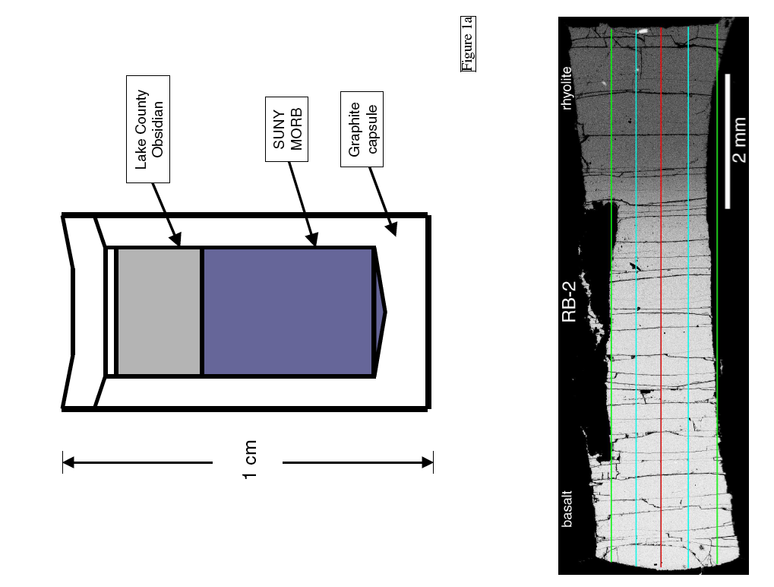
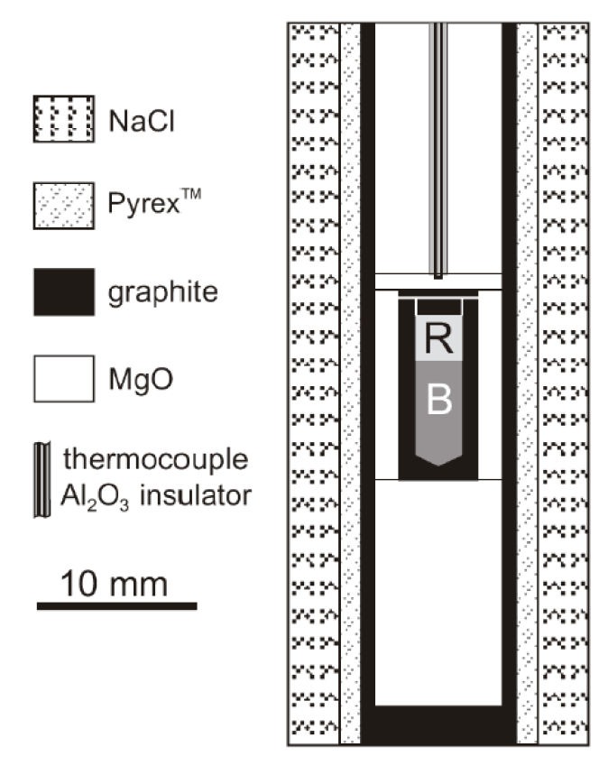
Chemical Diffusion in molten silicates

Slide 7
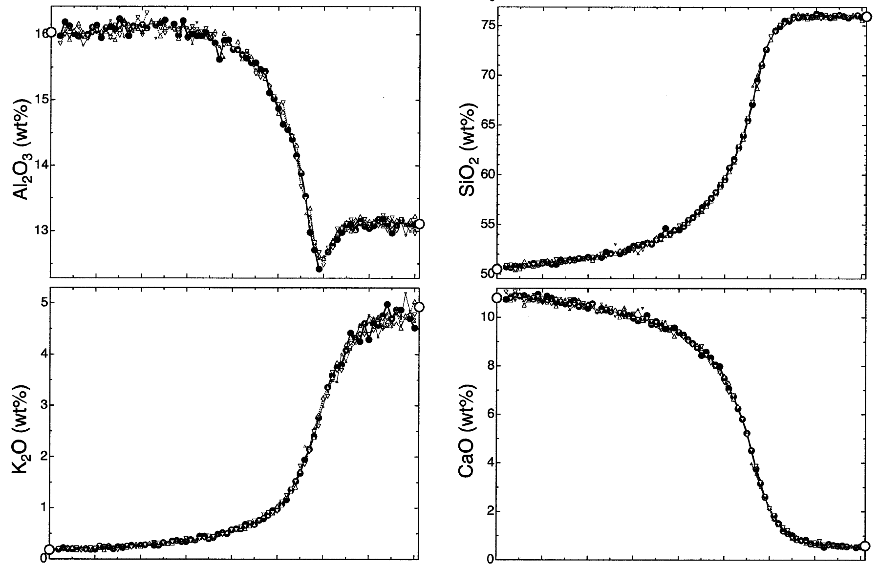
15 hours at 1400˚C, 1.0 GPa
RB-2

Slide 8
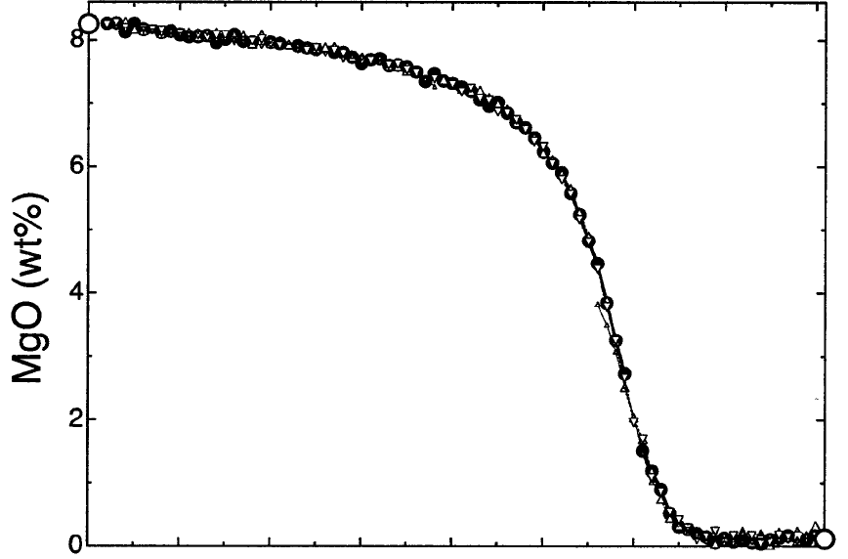
15 hours at 1400˚C, 1.0 GPa
RB-2

Slide 9
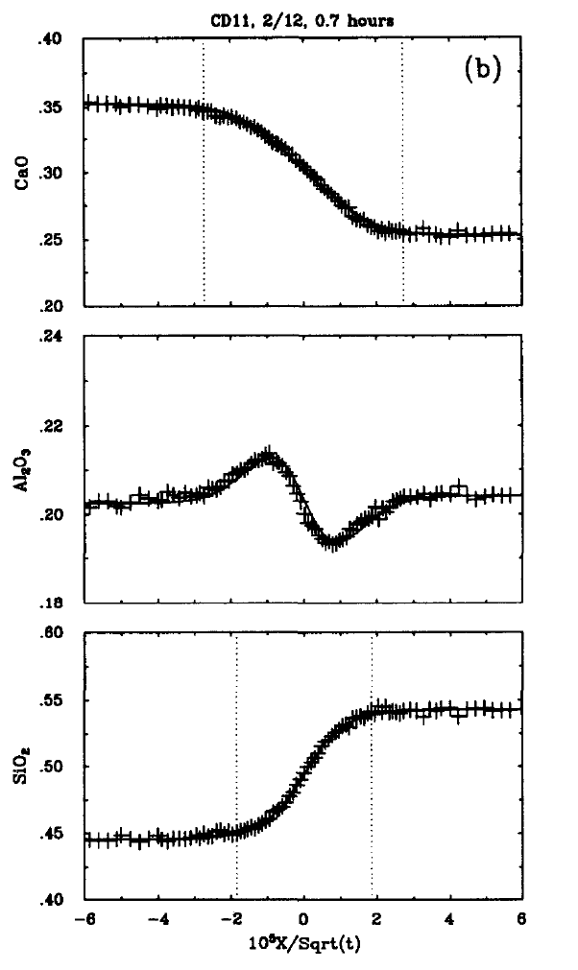
CaO
Al₂O₃
SiO₂
Molten CAS System
CaO-Al₂O3-SiO₂
Distance

Slide 10
CaO
Al₂O₃
SiO₂
Molten CAS System
CaO-Al₂O3-SiO₂
Distance

Slide 11
N=3 component system
CaO-Al₂O₃-SiO₂
CaO
Al₂O₃
SiO₂
Distance

Slide 12
N=3 component system
CaO-Al₂O₃-SiO₂
CaO
Al₂O₃
SiO₂
Distance

Slide 13
“Incompressibility”
Thermodynamics
CaO
SiO₂
Al₂O₃
High SiO₂ Low SiO₂
Al₂O₃ concentration
μAl₂O₃

Slide 14
15 hours at 1400˚C, 1.0 GPa
RB-2

Slide 15
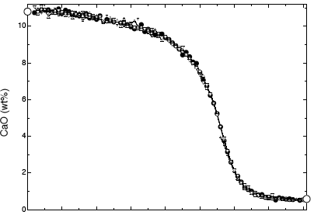
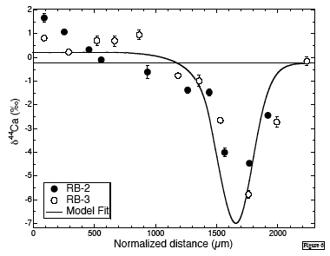
RB-2
Evidence that ⁴⁰Ca
diffuses measurably
faster than ⁴⁴Ca

Slide 16
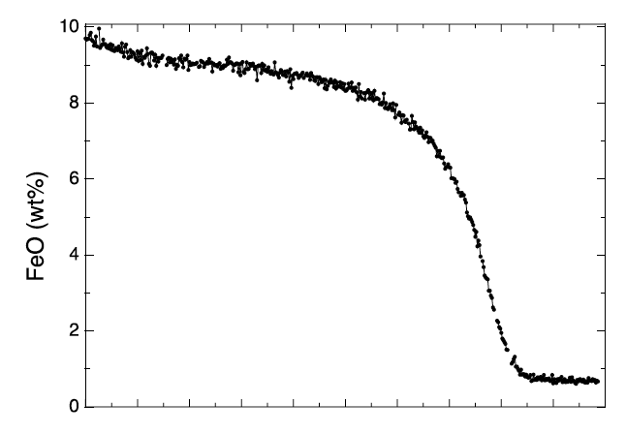
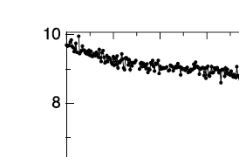

Slide 17
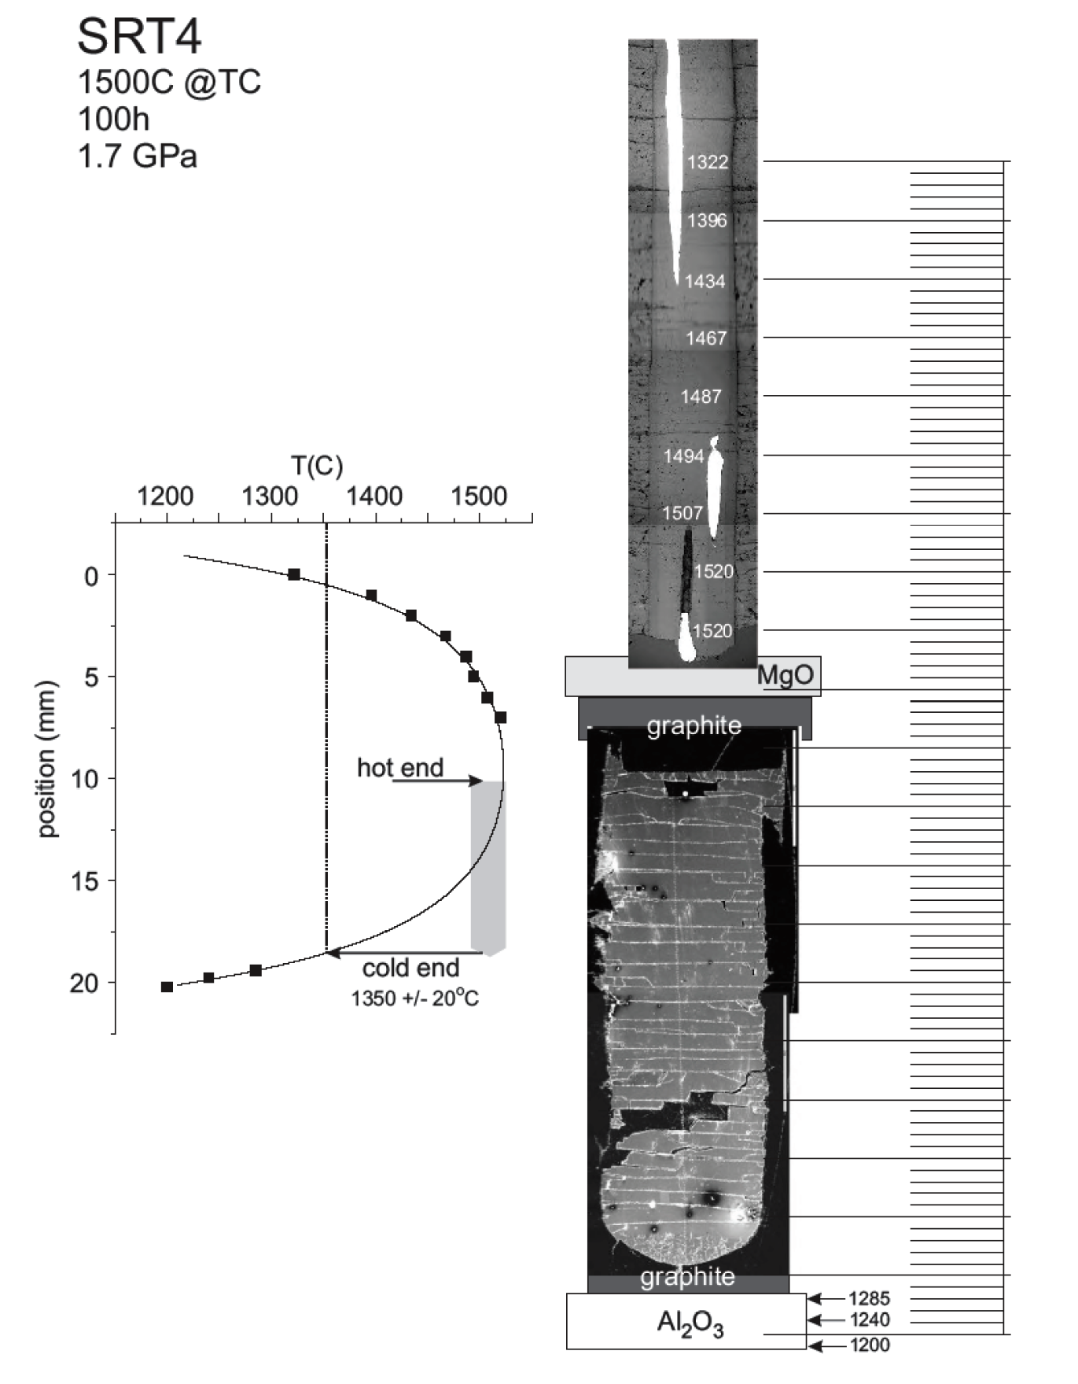
Soret Experiment SRT 4
material: SUNY MORB
ΔT=170˚C P=1.7GPa
Temperatures determined using
Watson’s spinel thickness method

Slide 22
For most geological applications
Bowen in 1921 argued that thermal fractionation is not relevant
for igneous petrology because and thus temperature
differences will dissipate much to fast for chemistry to respond.
Possible exception: Double-diffusive boundary layers.

Slide 23
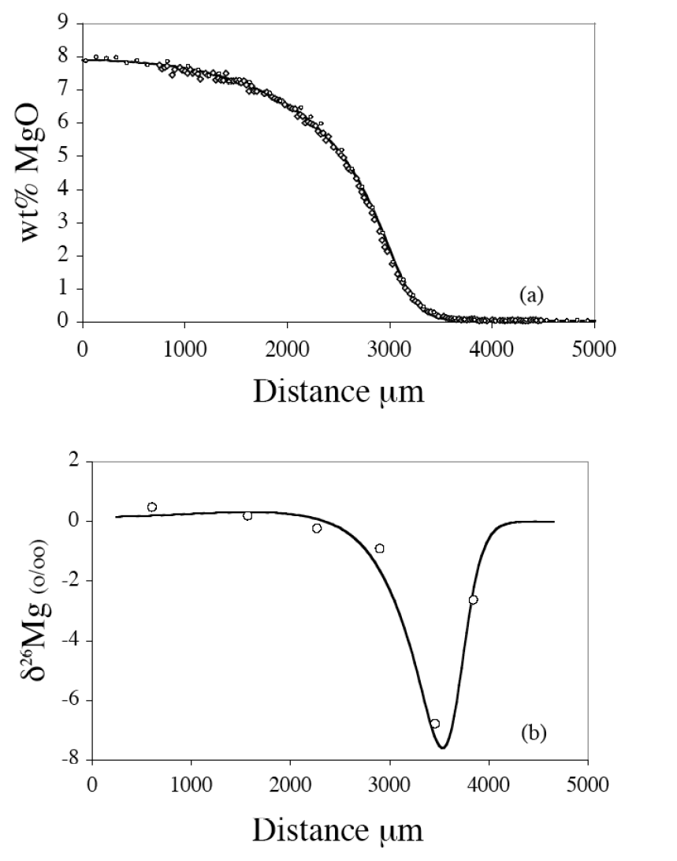
Basalt Rhyolite
2
0
-2
-4
-6
-8
Typical precision
~ 0.2‰

Slide 24
15 hours at 1400˚C, 1.0 GPa
RB-2

Slide 25
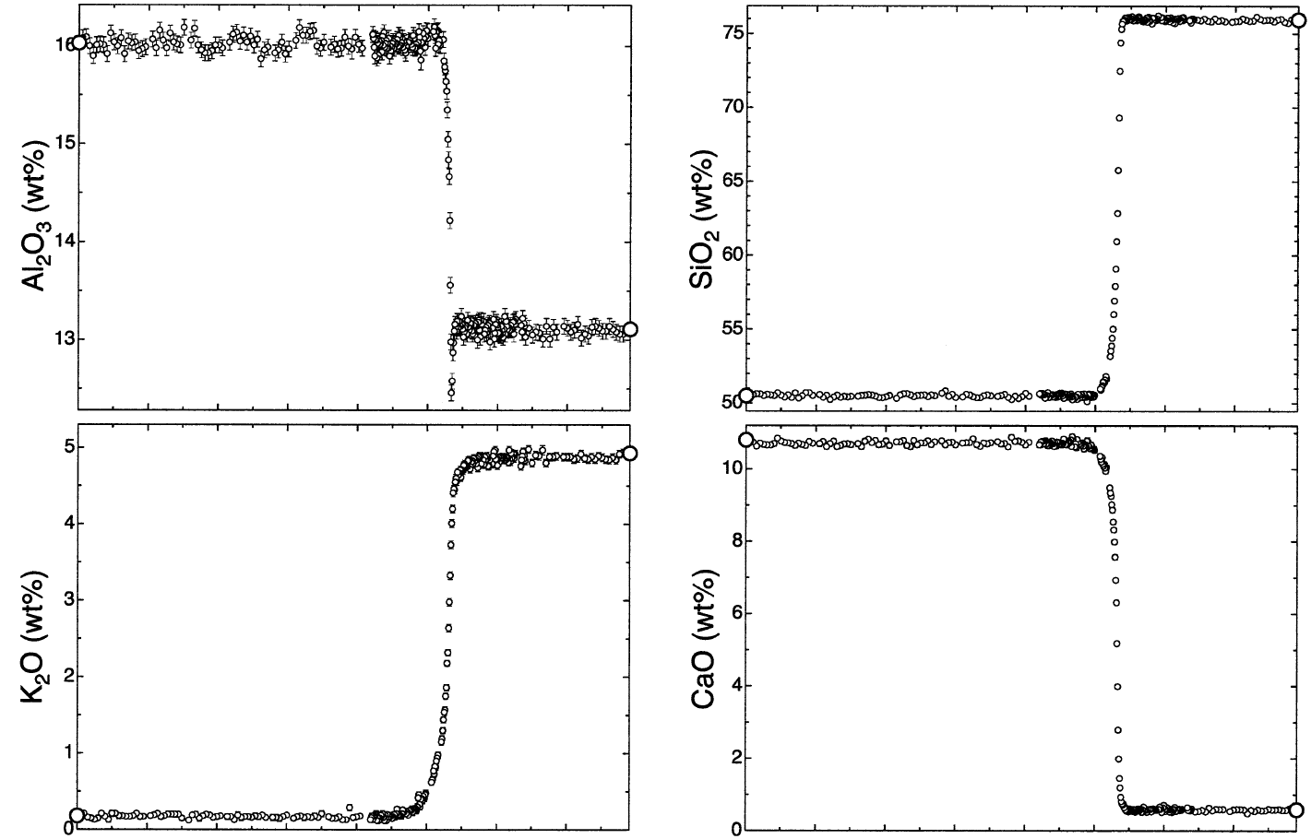
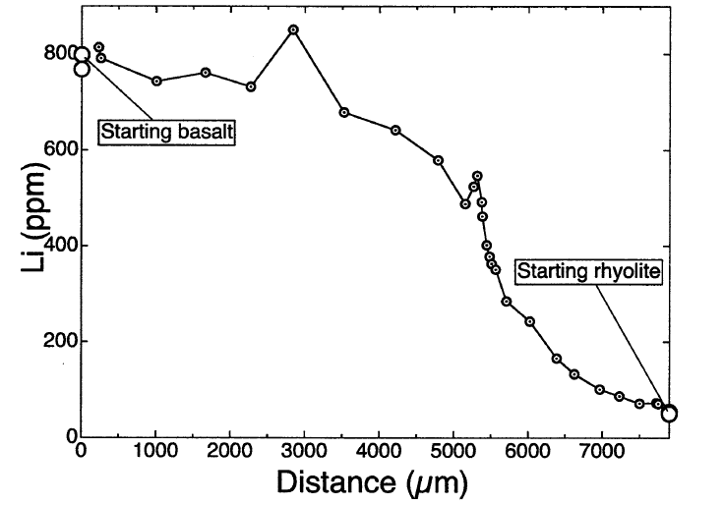
RB-5
6 minutes at 1400˚C

Slide 26
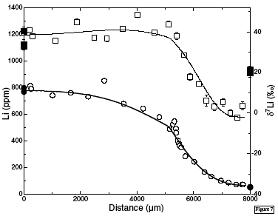
0
-20
-40
δ⁷Li ‰
1000
800
400
200
0
Li (ppm)

Slide 27
Summary of Key Ideas from Experiments with Silicate liquids:
The constitutive equation for chemical fluxes involves both
a diffusion matrix D_{ij} and a thermal diffusion coefficient D_{T.}
2. When used for isotopes the chemical diffusion coefficients D_{ij}
depend on the isotope mass in such a way that the light isotope
diffuses faster.
3. The thermal diffusion coefficient D_{T} depends on isotope mass
in such a way that the heavier isotope always goes to the cold end.

Slide 28
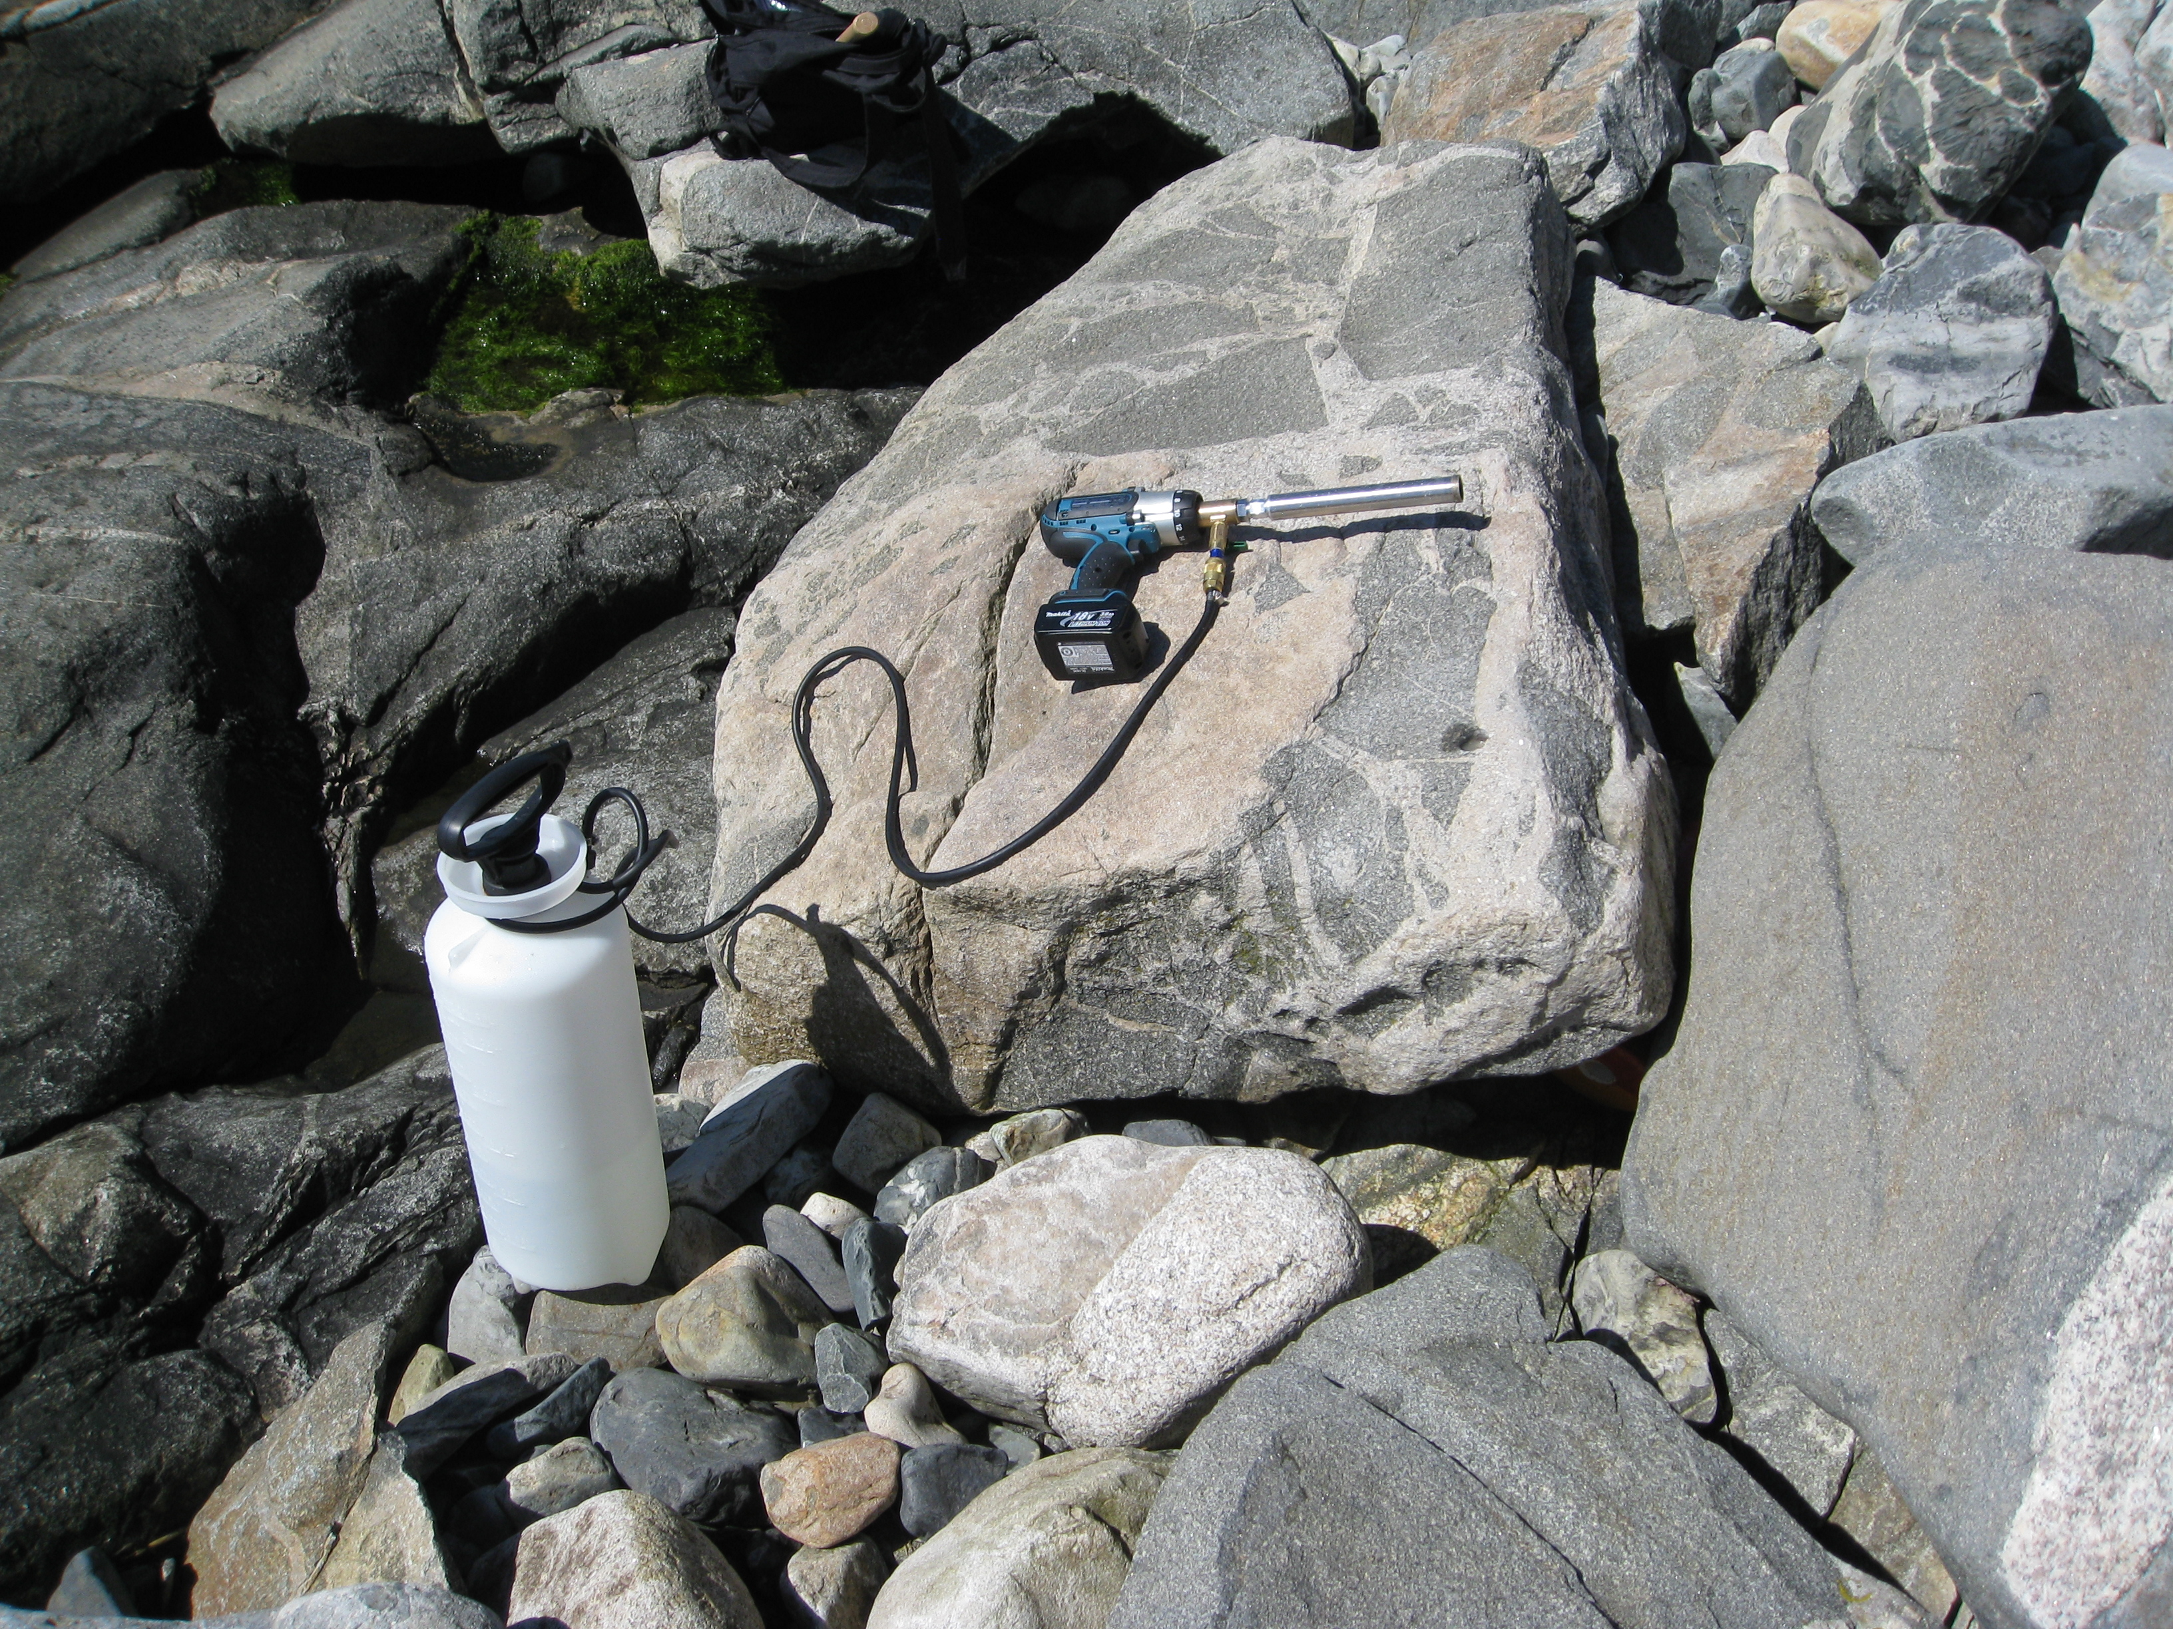
Does one find similar kinetic isotope
fractionation by diffusion in natural
settings ?

Slide 29
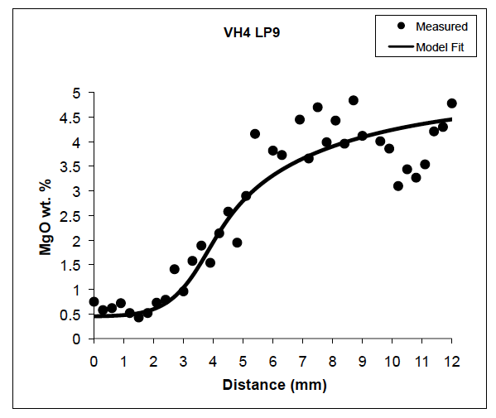
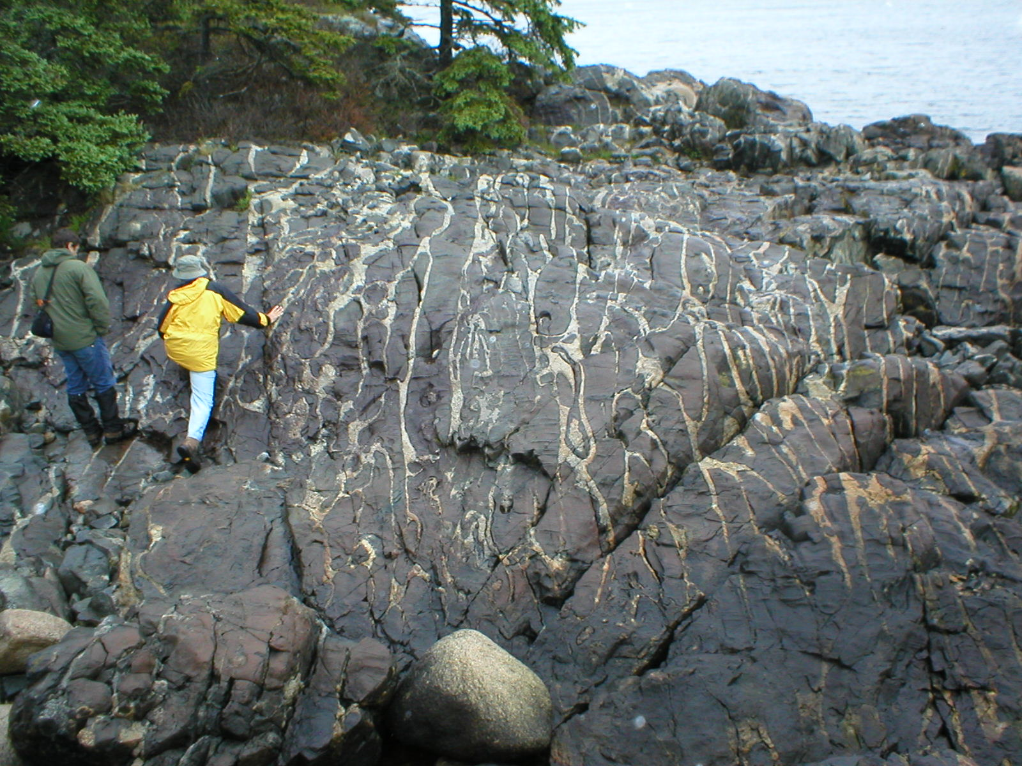
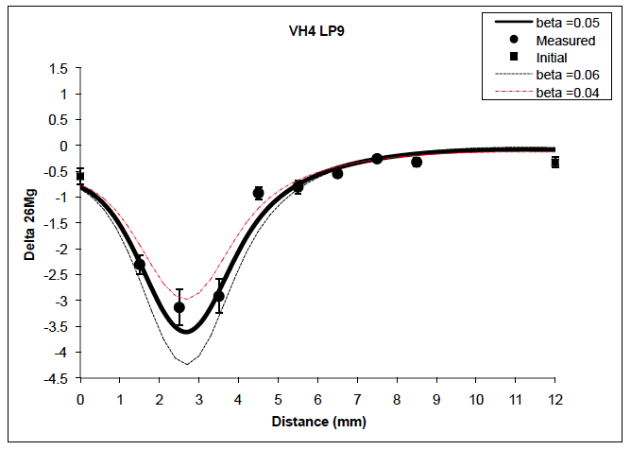
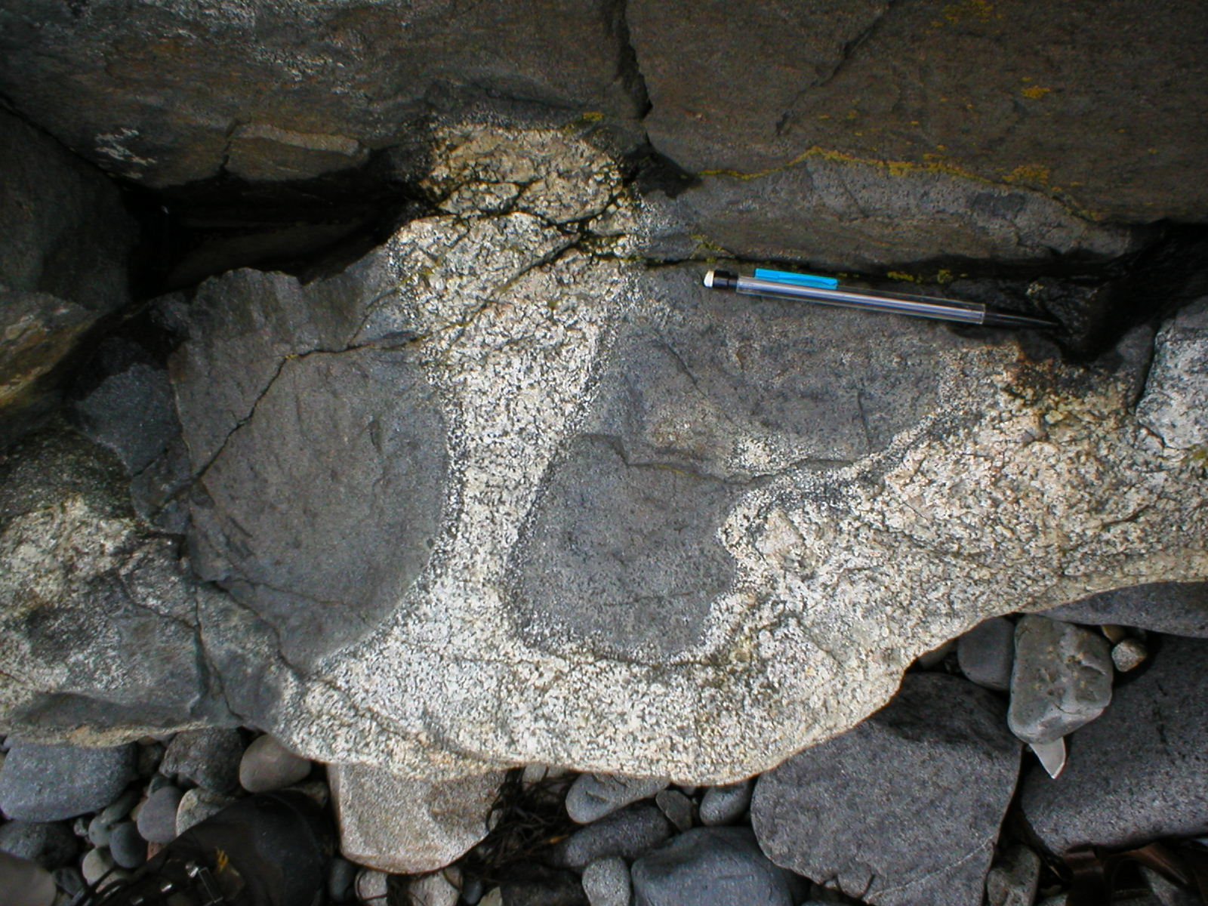
Vinal Cove, Vinalhaven Island in
Penobscot Bay, Maine
Fit using same
β as lab case

Slide 30
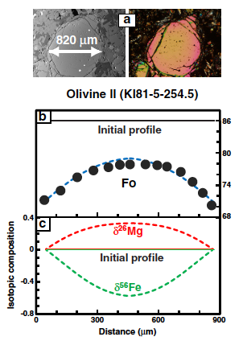
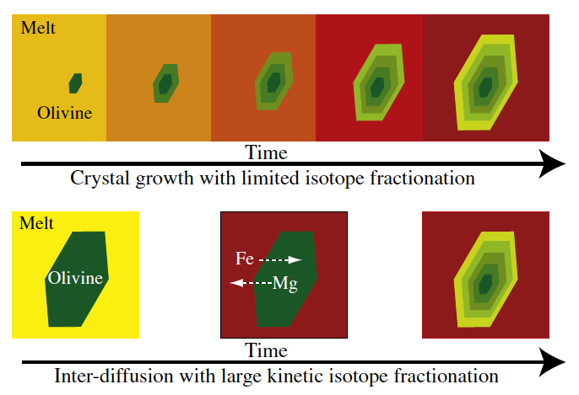
Olivine: Mg₂SiO₄ +Fe₂SiO₄
_{(forsterite) (fayalite)}

Slide 31
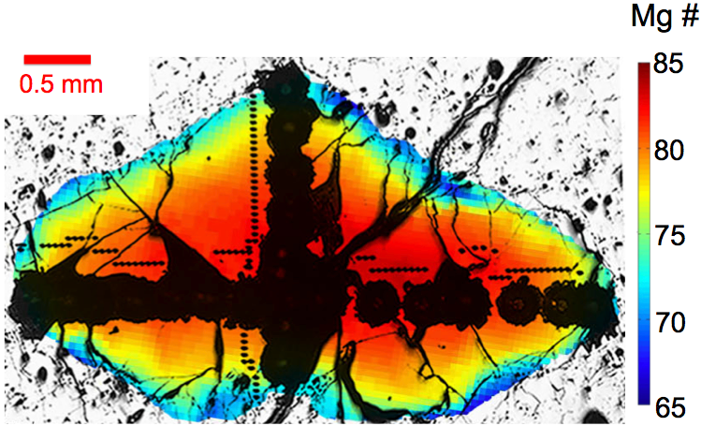
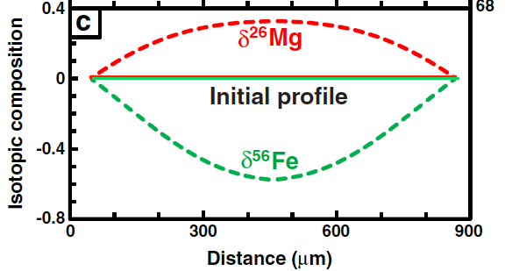
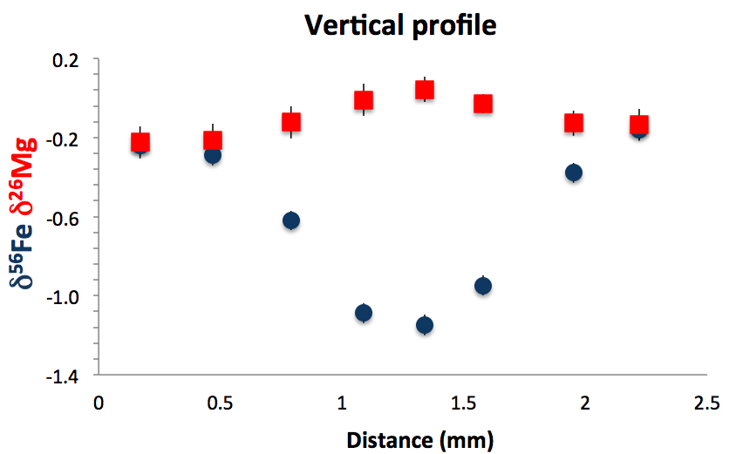
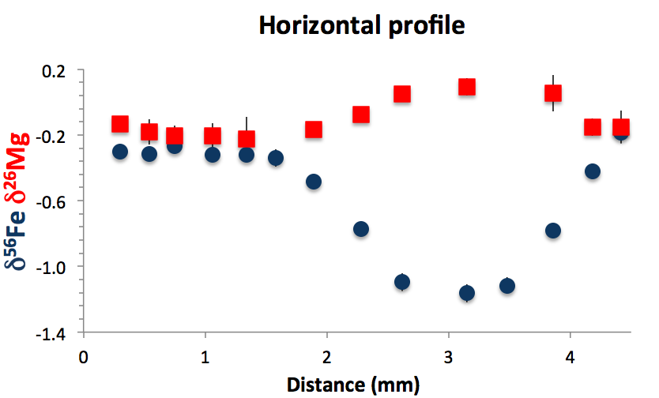

Slide 32
Olivine: Mg₂SiO₄ +Fe₂SiO₄
_{(forsterite) (fayalite)}

Slide 33
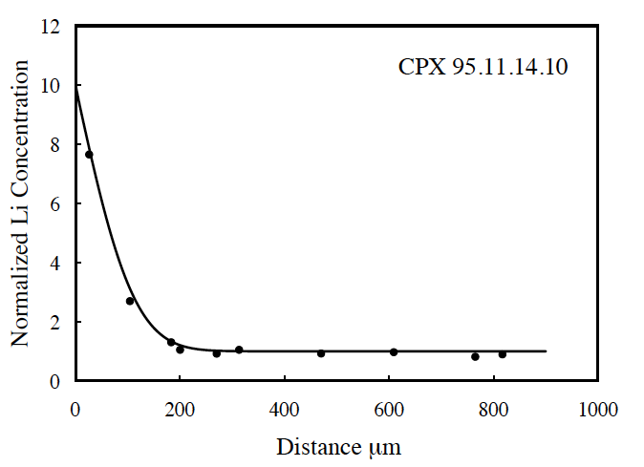
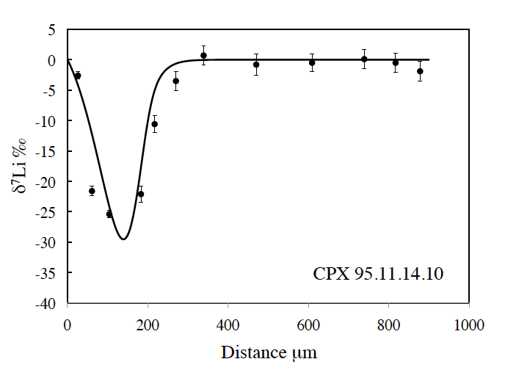
Parkinson et al. (2007)
Clinopyroxene grain from
A lava flow
Western Solomon Is.

Slide 34
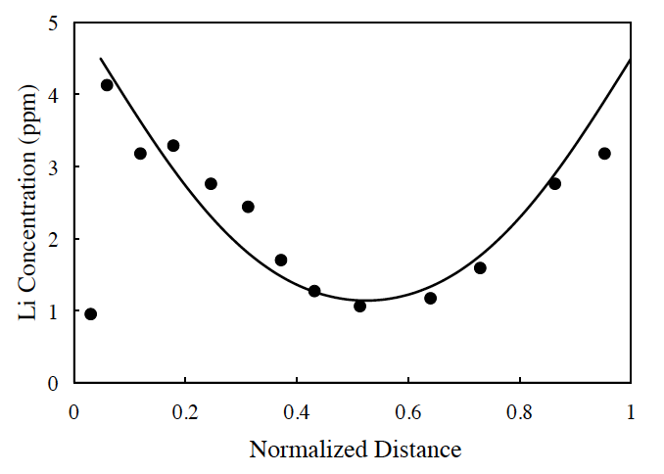
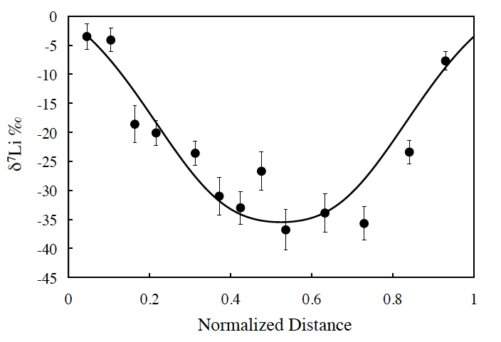
Clinopyroxene grain from a San Carlos zenolith
(Jeffcoate et al., 2007)

Slide 35
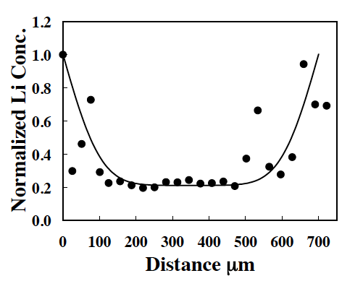
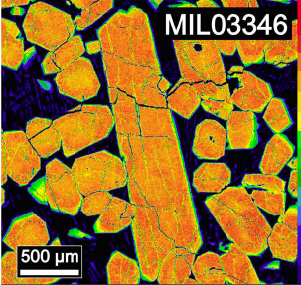
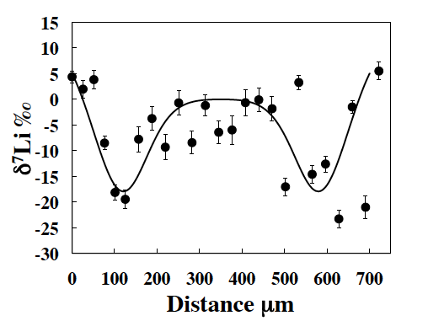

Slide 36
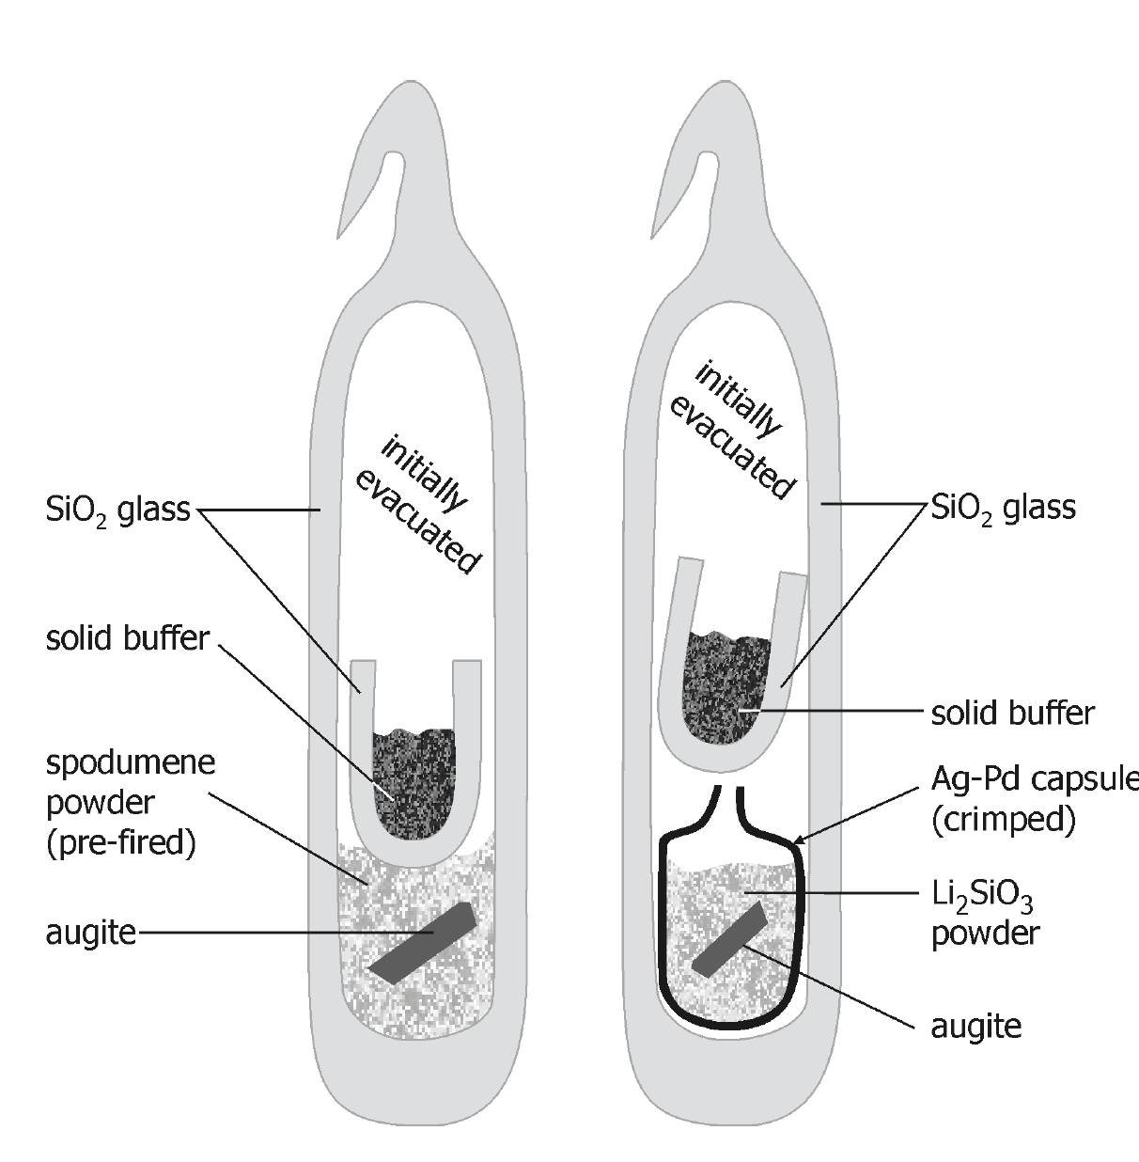

Slide 37
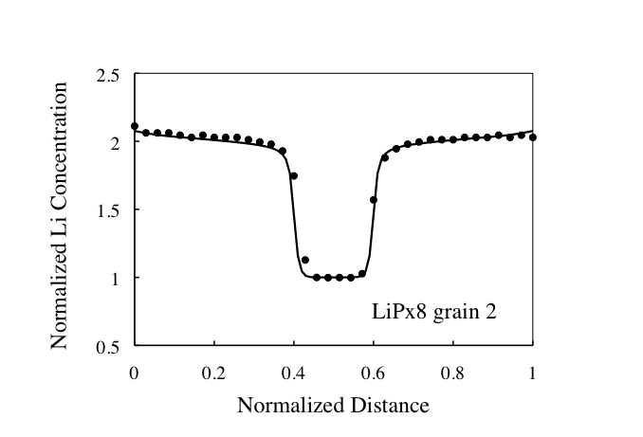
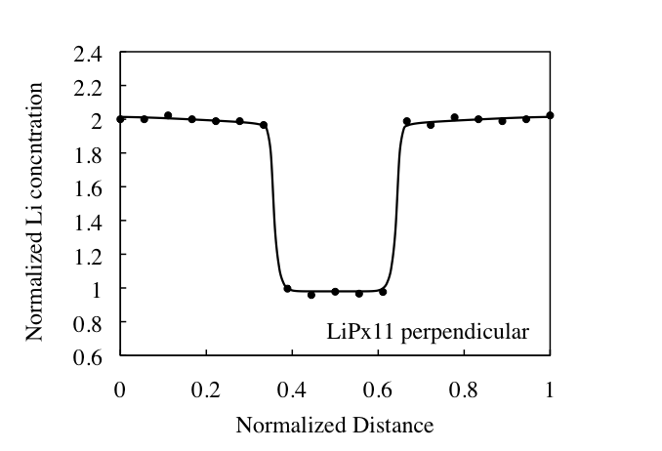

Slide 38
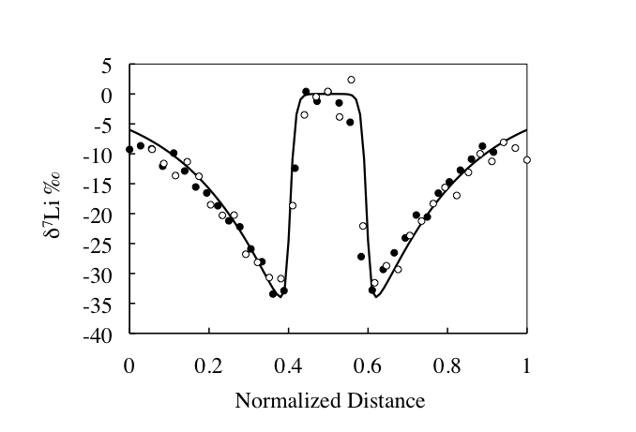

Slide 39
overgrowth
overgrowth
core

Slide 41
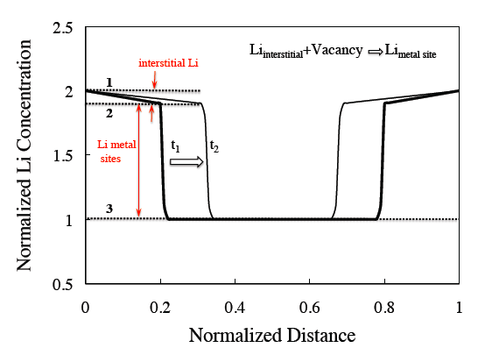

Slide 42
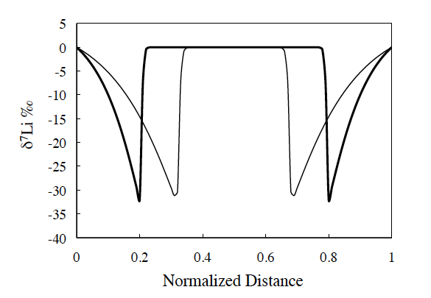
⁶Li
⁷Li

Slide 43
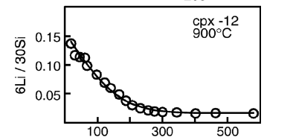
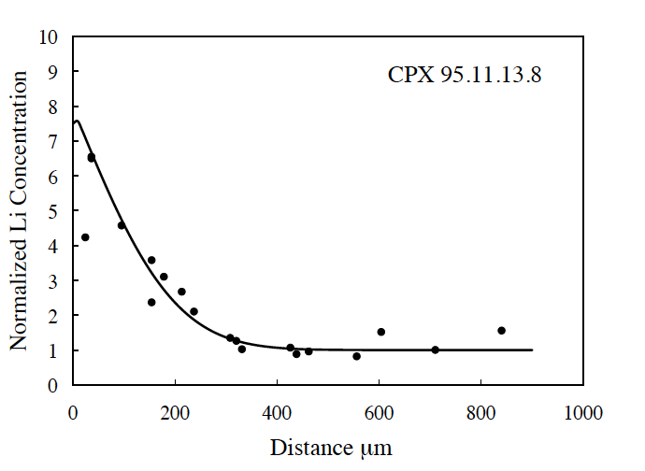
Flux of Li into the grain
with no concentration
Gradient ?
Richter et al. 2013
Coogan et al. (2005) experiment Parkinson et al. (2007) natural sample

Slide 46
Vinal Cove, Vinalhaven Island in
Penobscot Bay, Maine
Fit using same
β as lab case

Slide 47
Olivine: Mg₂SiO₄ +Fe₂SiO₄
_{(forsterite) (fayalite)}

Slide 49
The Overall Punch Line:
Kinetic isotope fractionations are an essential
tool for determining the process responsible
for quenched chemical gradients or mineral zoning.
and
Only when the gradients or zoning are shown
to be due to diffusion can they be used to give
a measure of time and cooling rates.

Slide 50
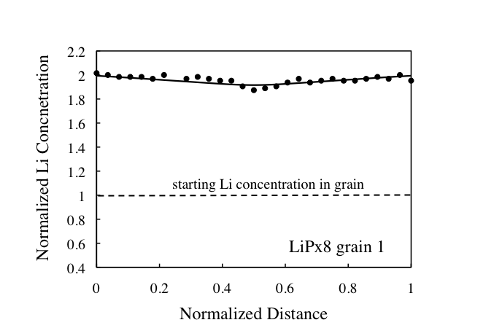
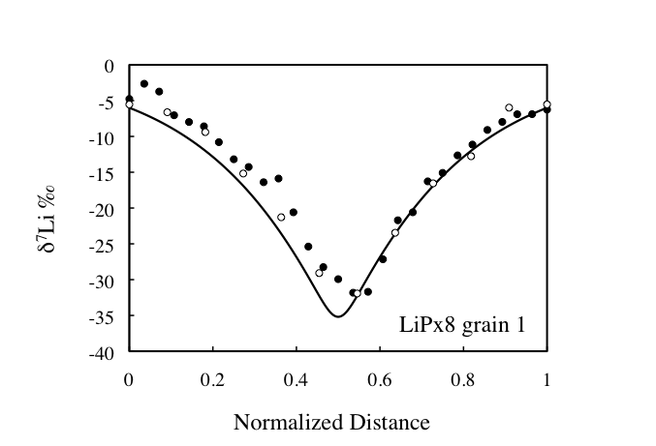
“Here I present experimental data showing that, between and basic and acidic silicate melt,
Isotopic exchange proceeds much more quickly than chemical homogenization.”
Richter F.M. (1993) A method for determining activity-composition relations using chemical
diffusion in silicate melts, Geochim. Cosmochim. Acta 57, 1-14.

