Slide 1
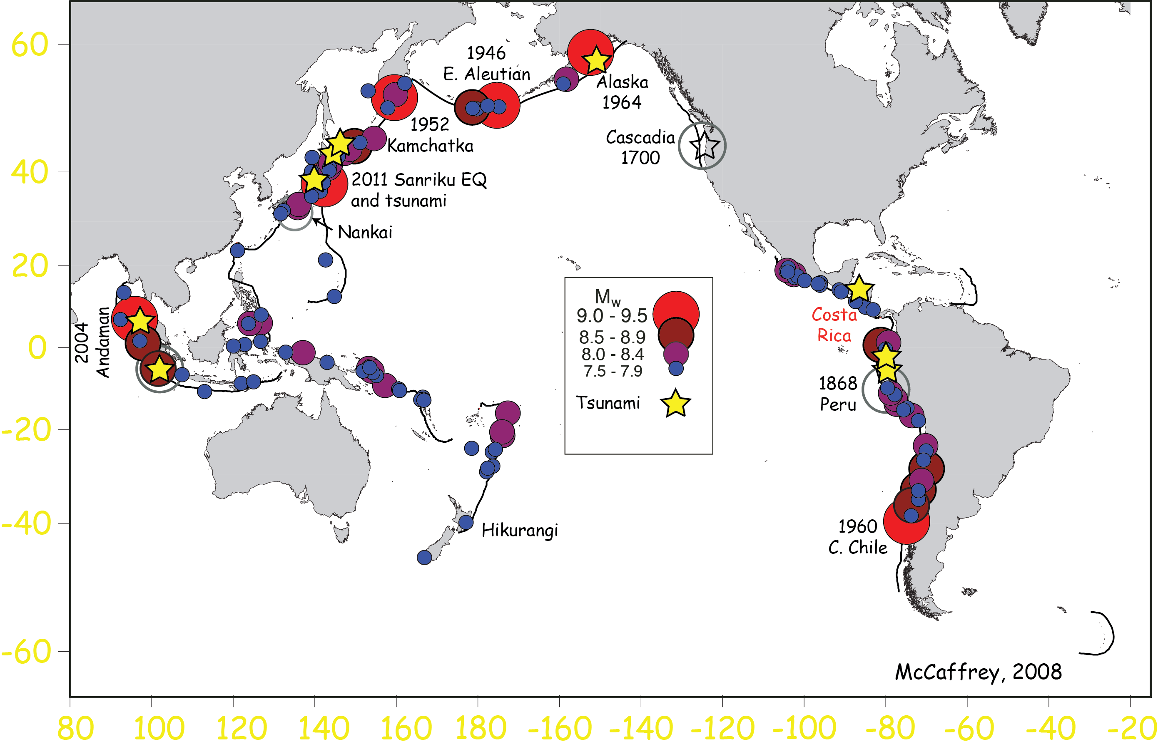
Subduction Zones:
Heat Flow, Fluid Flow, and Earthquakes
Robert N. Harris, College of Earth, Oceanic, and
Atmospheric Sciences, Oregon State University

Slide 2
Subduction Zones:
Heat Flow, Fluid Flow, and Earthquakes
Robert N. Harris, College of Earth, Oceanic, and Atmospheric
Sciences, Oregon State University
Outline
The seismogenic zone of the subduction thrust
Marine heat and fluid flow
Thermal state of incoming crust and subduction
at Middle America Trench, Costa Rica
4. Correlation between temperature and seismicity
5. Conclusions

Slide 3
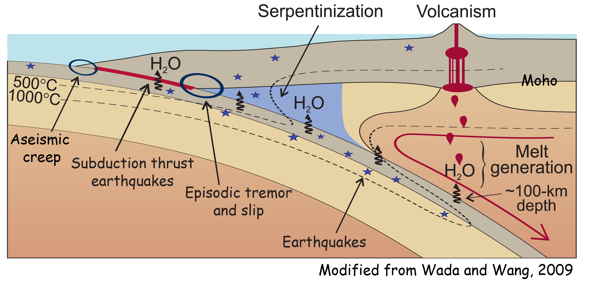
Subduction Zone Processes
Importance of subduction thermal regime
Shallow
updip and downdip limits of seismicity
plate locking, patterns of deformation
sediment alteration and dewatering
metamorphic dehydration reactions
Deep
melt generation and
volatile recycling
Want to understand
processes influencing
seismogenesis

Slide 4
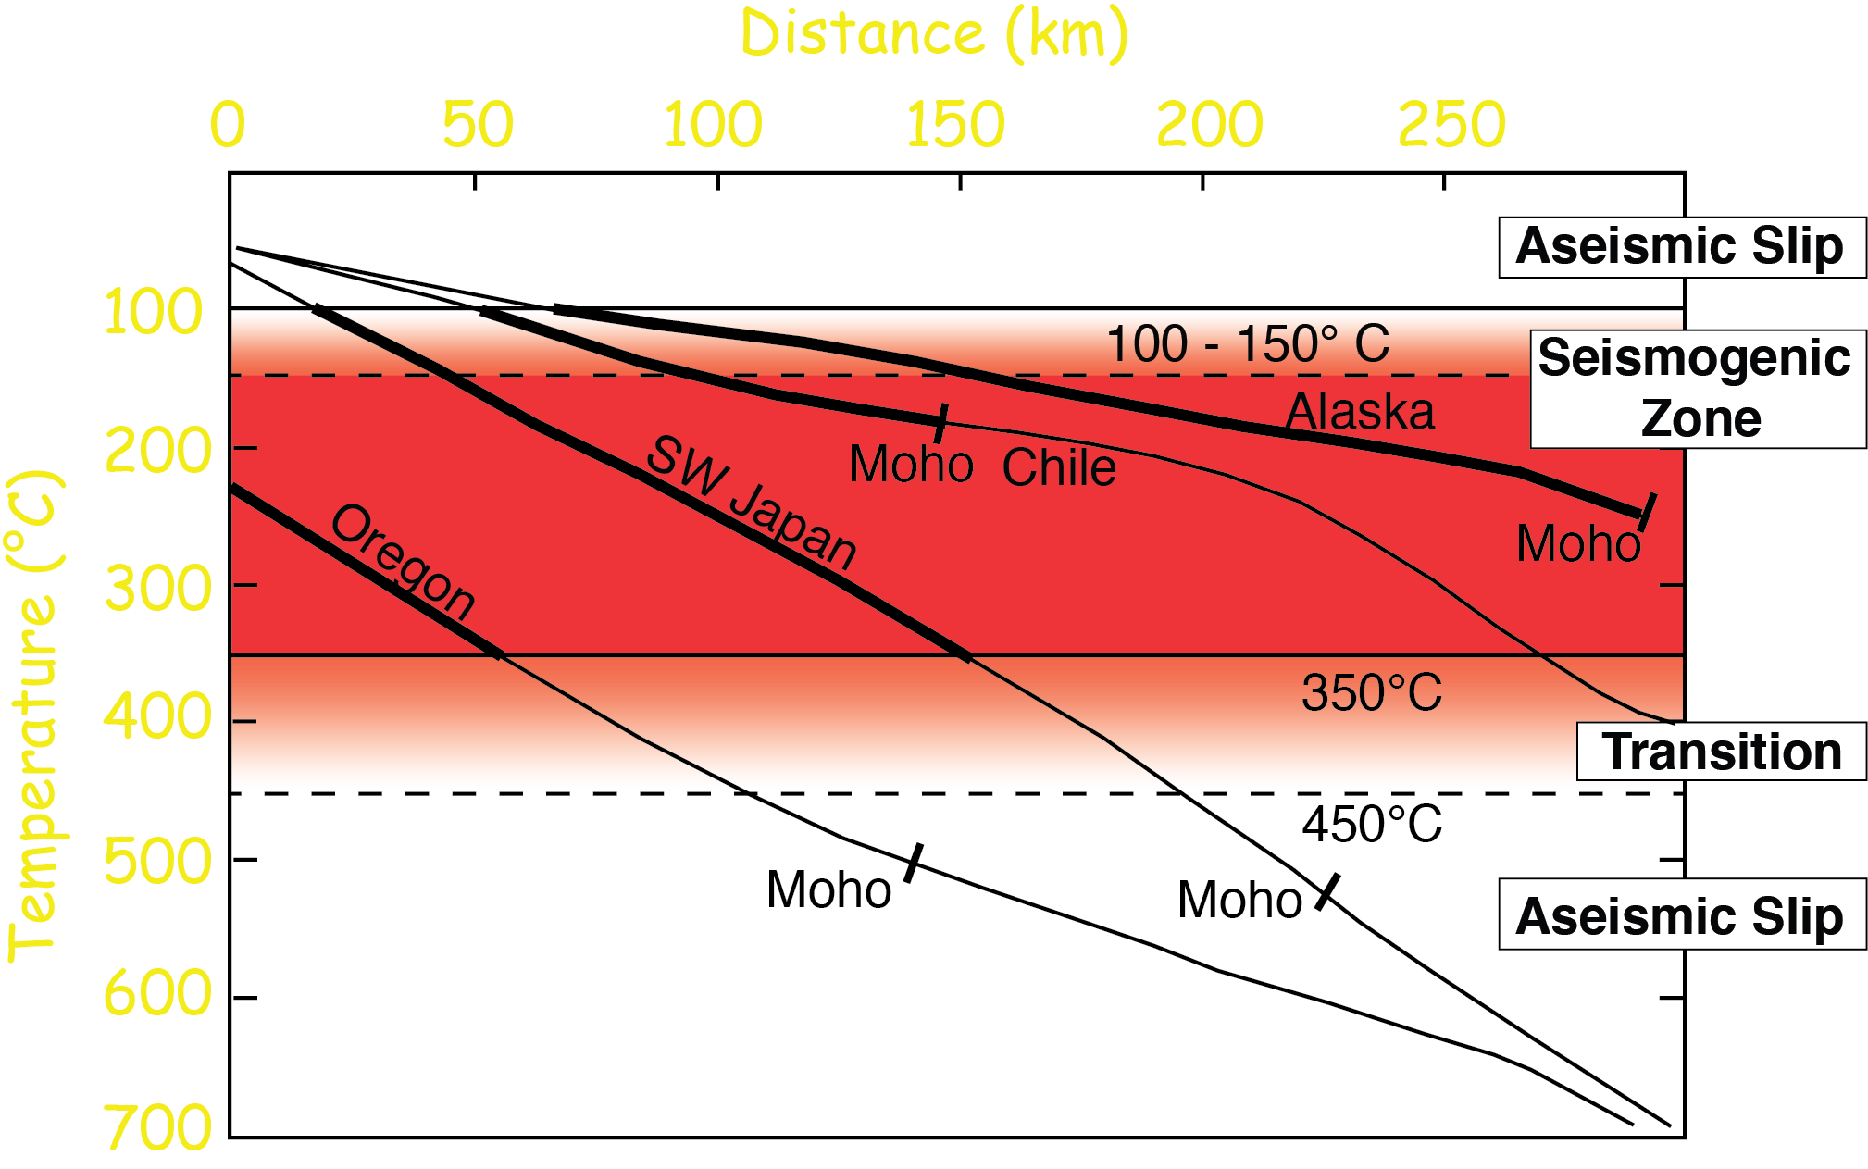
Hypothesis: Temperature along subduction thrust
controls the updip and downdip limits of seismicity
After Hyndman, and Wang, 1993

Slide 6
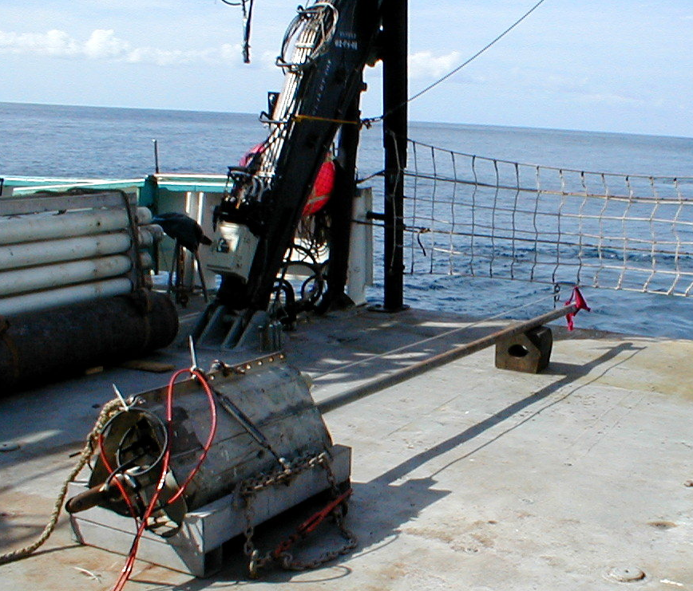
Marine Heat Flow
q = -k dT/dz
dT/dz = thermal gradient
k = thermal conductivity
seafloor
sediments
each thermistor
thermistors
Temperature
Time
See: http://marine_heatflow.oregonstate.edu

Slide 7
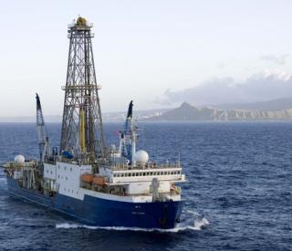
IODP Downhole Temperature Measurements

Slide 8
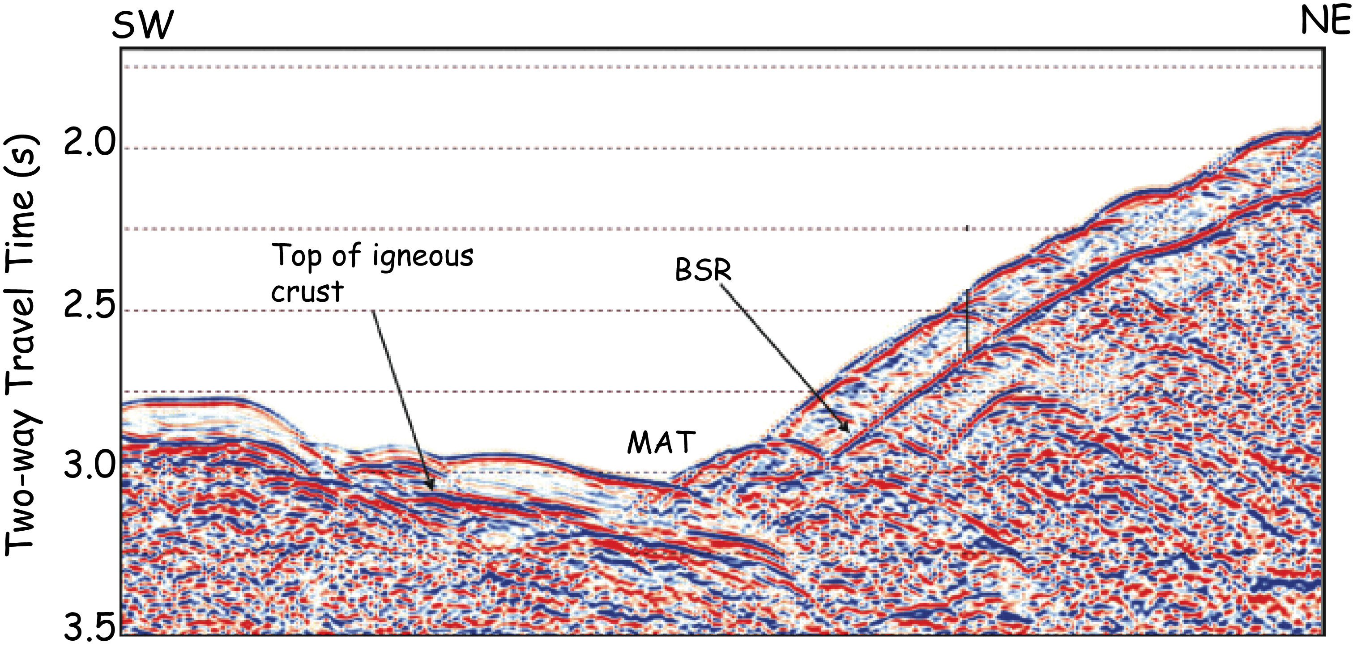
Heat Flow from BSRs
1. k, estimates from ODP Holes and shallow thermal marine probes, 0.9 W/m/K
2. Z_{bsr} from linear velocity function, v = 1550 + 0.65 z;
3. T_{seafloor} from CTD casts and NOAA World Ocean Data Atlas;
4. T_{bsr}, assuming hydrostatic pore pressure and biogenic source [Dickens and
Quinby-Hunt, 1994].

Slide 9
Advantages and Disadvantages
Seafloor Probe
Advantages: direct measure temperature in upper few meters; economical
Disadvantages: susceptible to near surface processes
Note – need to collocate with seismic reflection data
Drilling and Downhole Measurements
Advantages: direct measure of temperature at depth; other supplementary measurements
Disadvantages: expensive
BSR estimates
Advantages: estimate of thermal conditions in upper few hundred meters.
Disadvantage: Proxy, need to demonstrate methane is biogenic

Slide 10
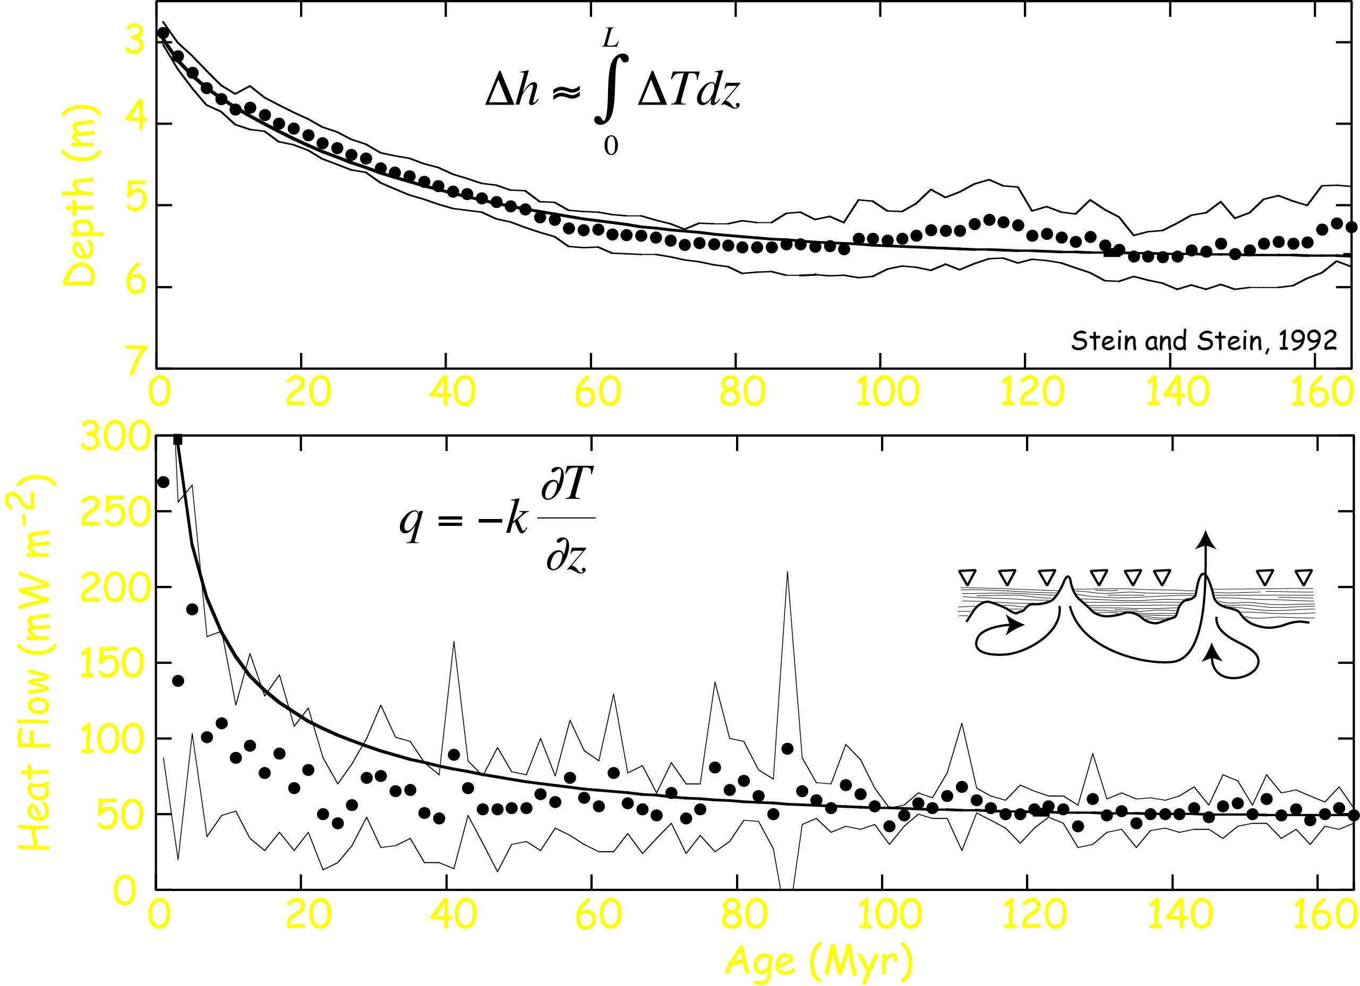
Global Marine Depth and Heat Flow
Stein and Stein, 1992

Slide 11
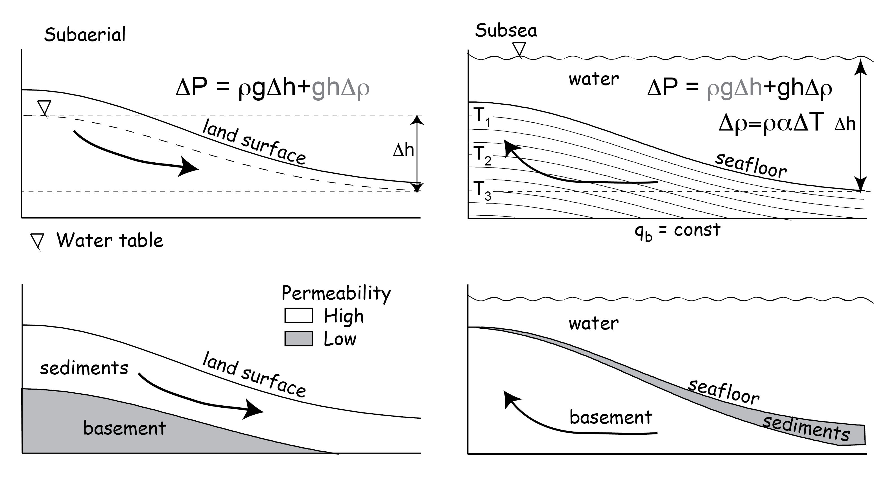
Subaerial versus Subsea Fluid Flow

Slide 12
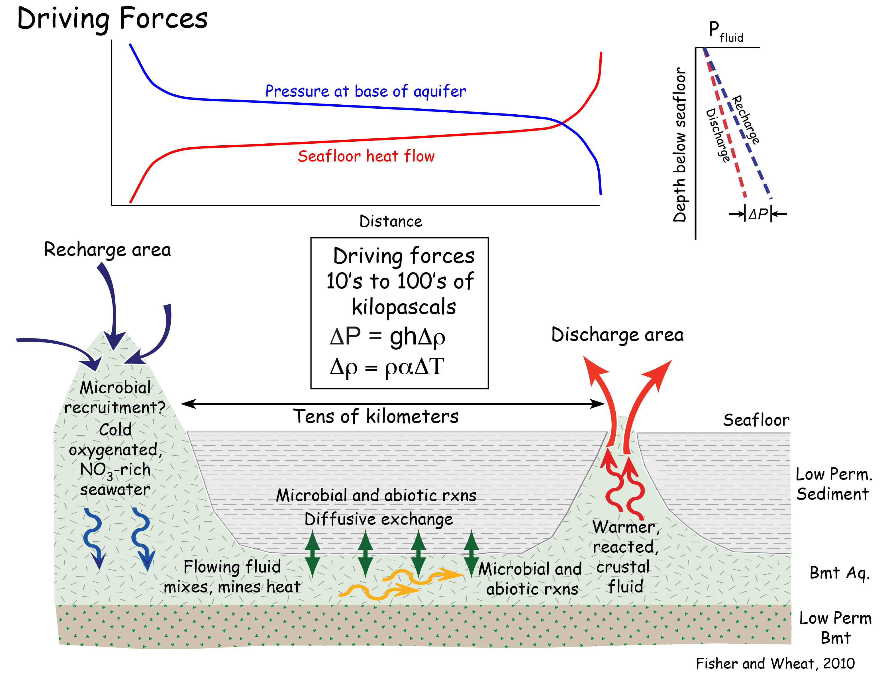

Slide 14
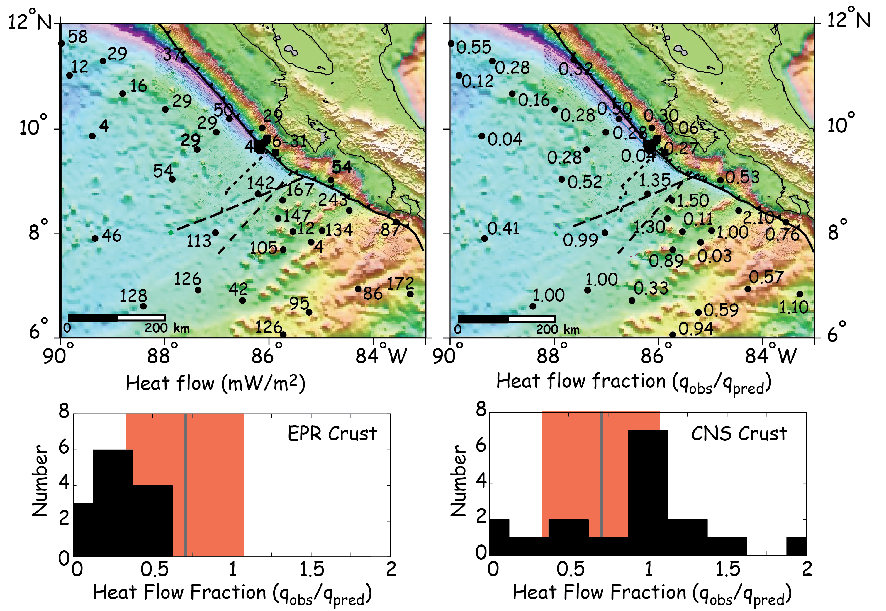
Regional Heat Flow on the Incoming Cocos Plate

Slide 15
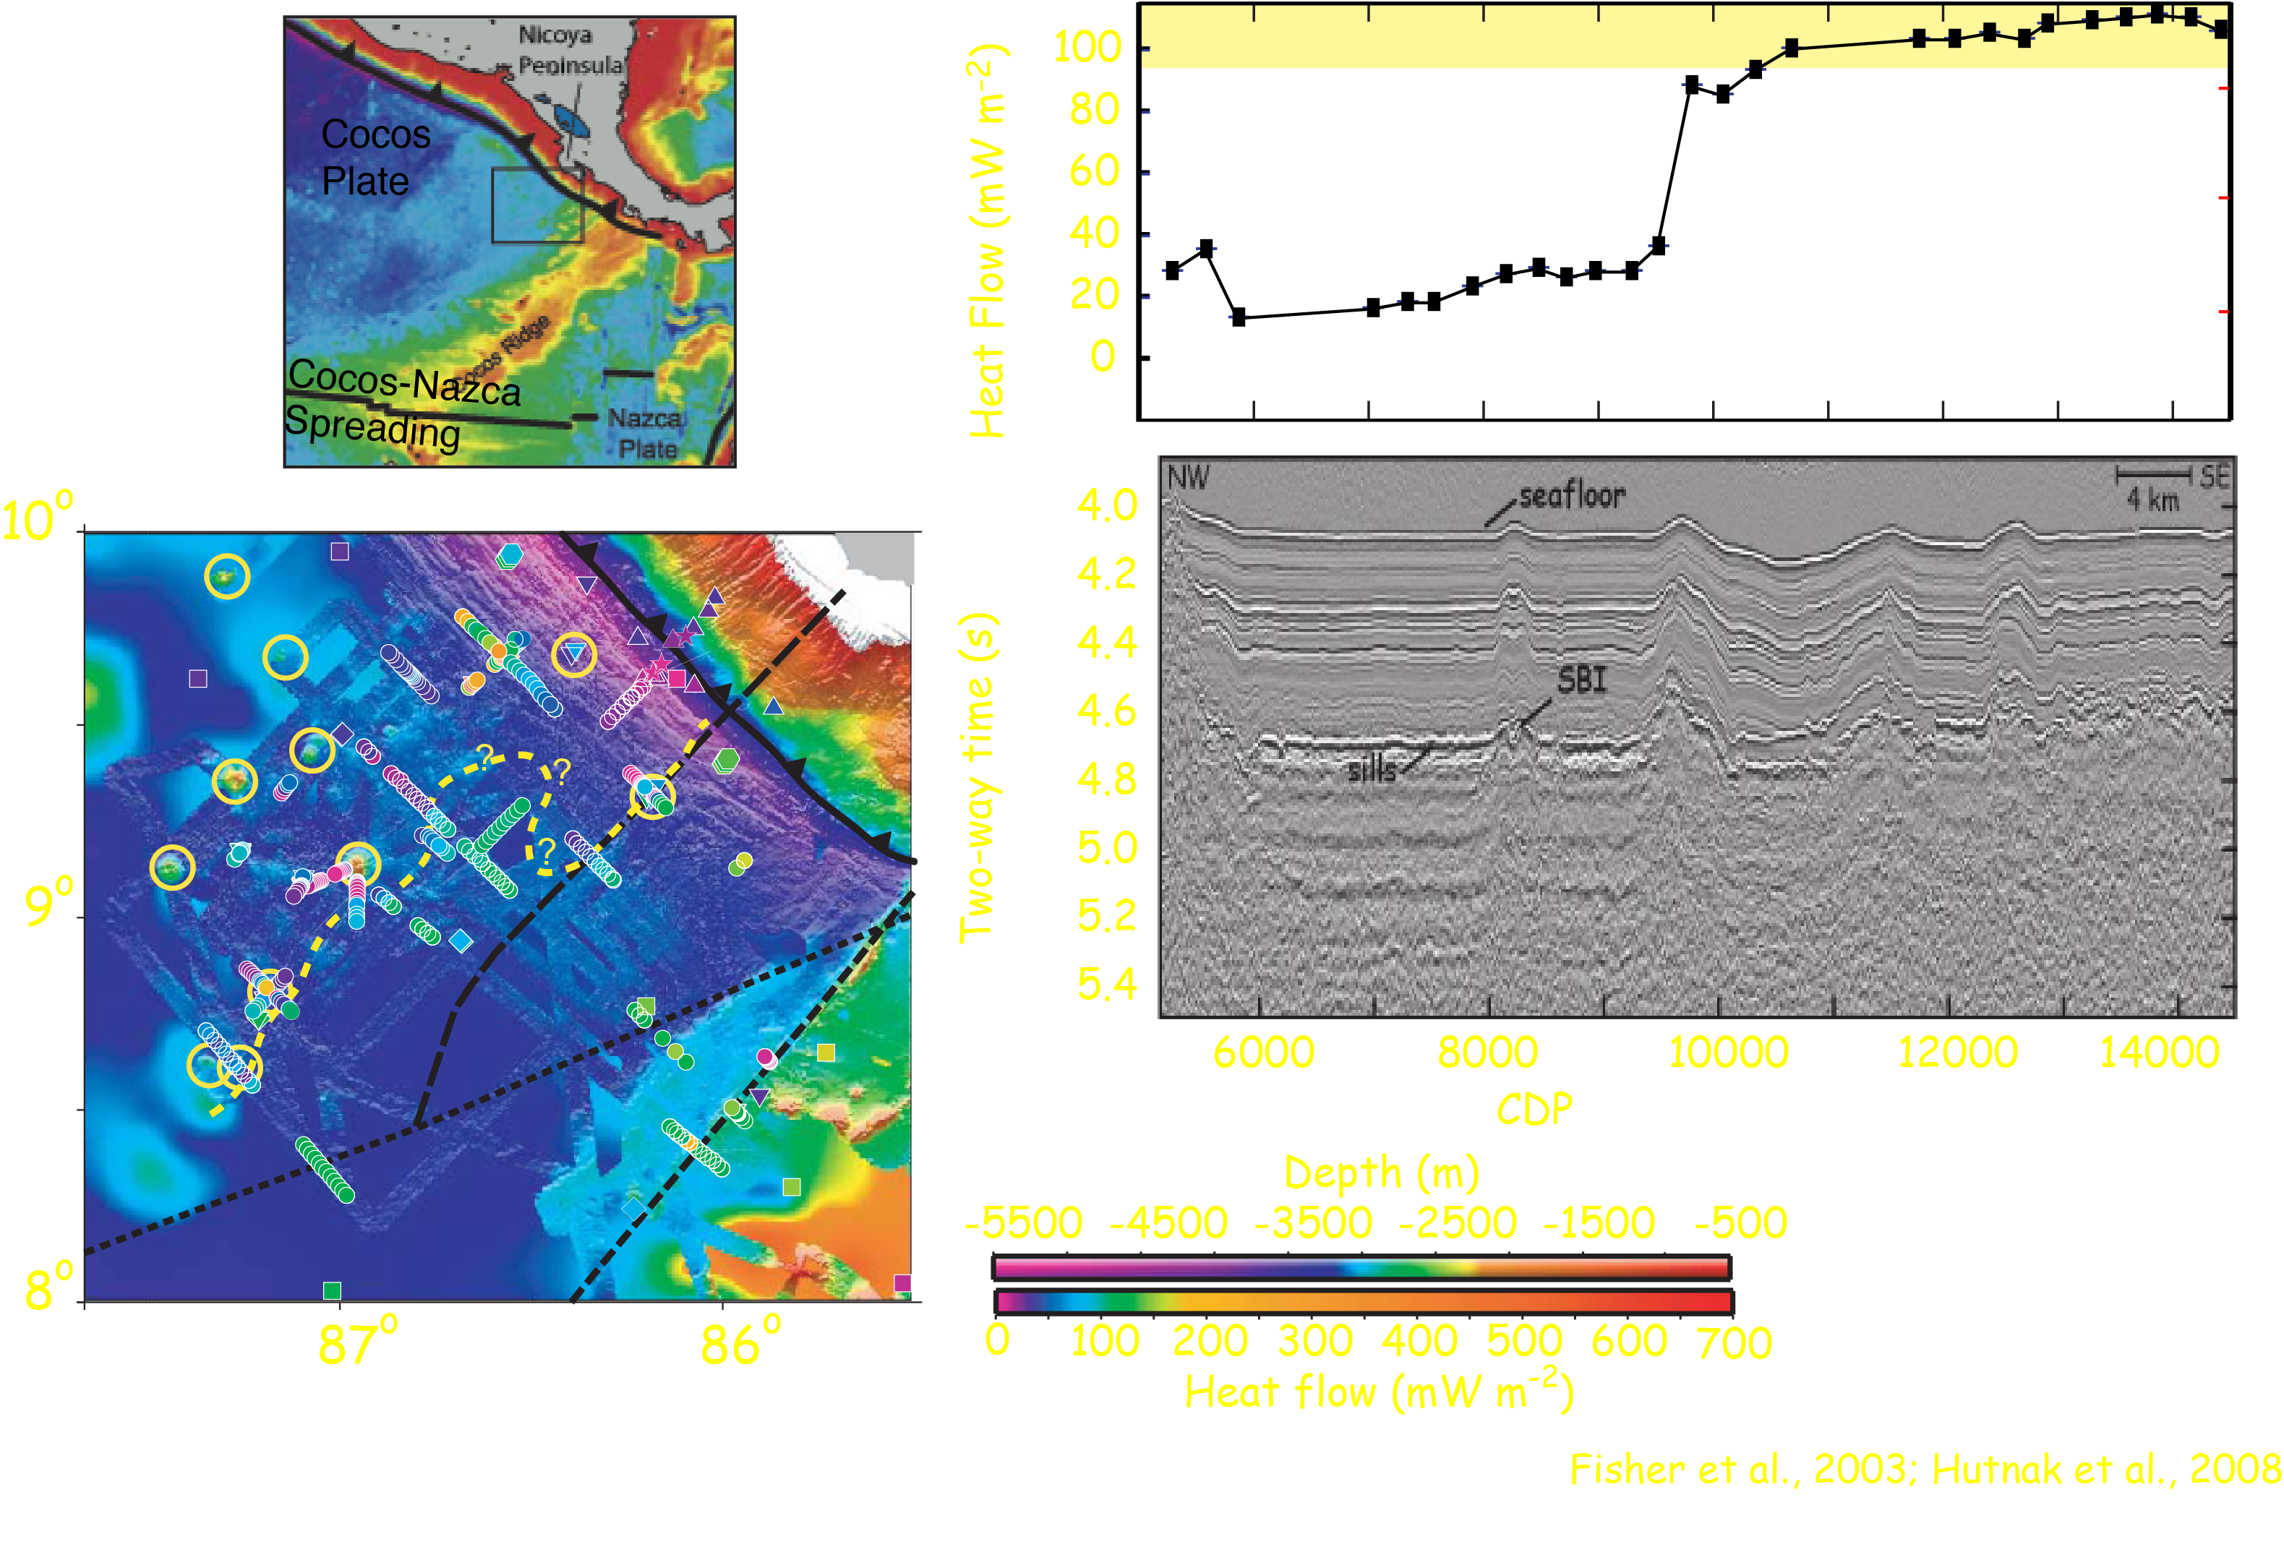
TicoFlux Heat Flow Surveys

Slide 16
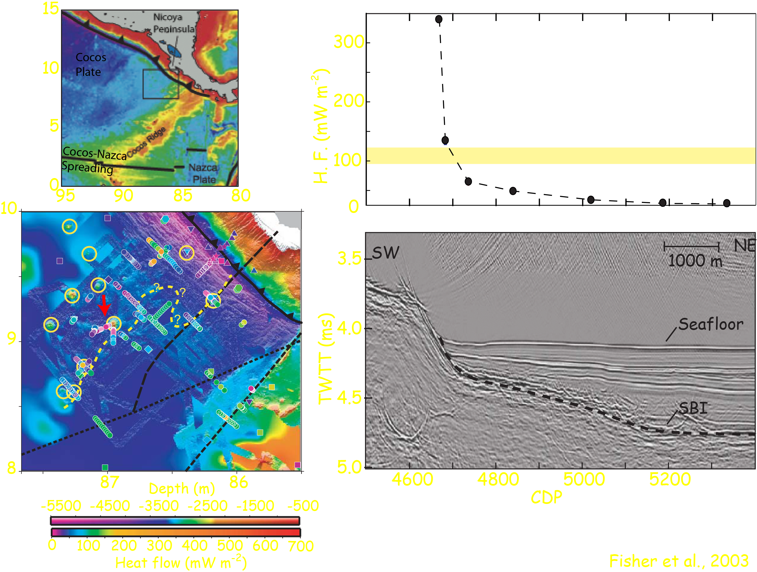
TicoFlux Surveys

Slide 17
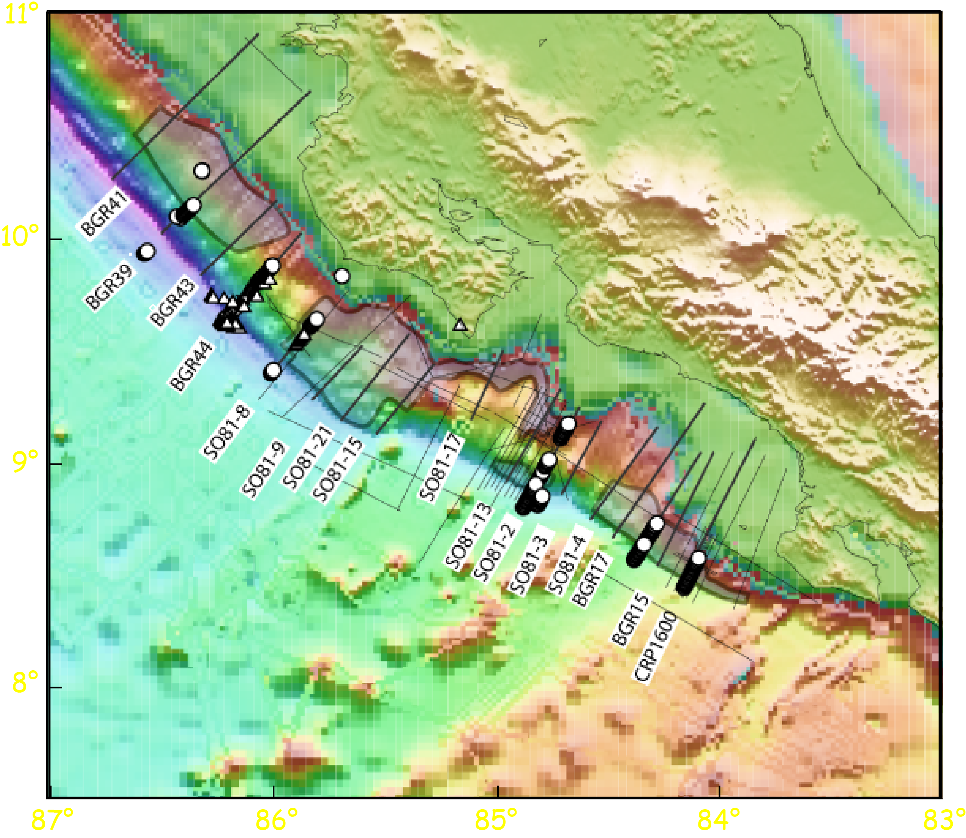
Margin Wedge - Seismic Lines, Heat Flow Data, and
Hydrate Distribution

Slide 18
Heat Flow Map, Costa Rica Margin

Slide 19
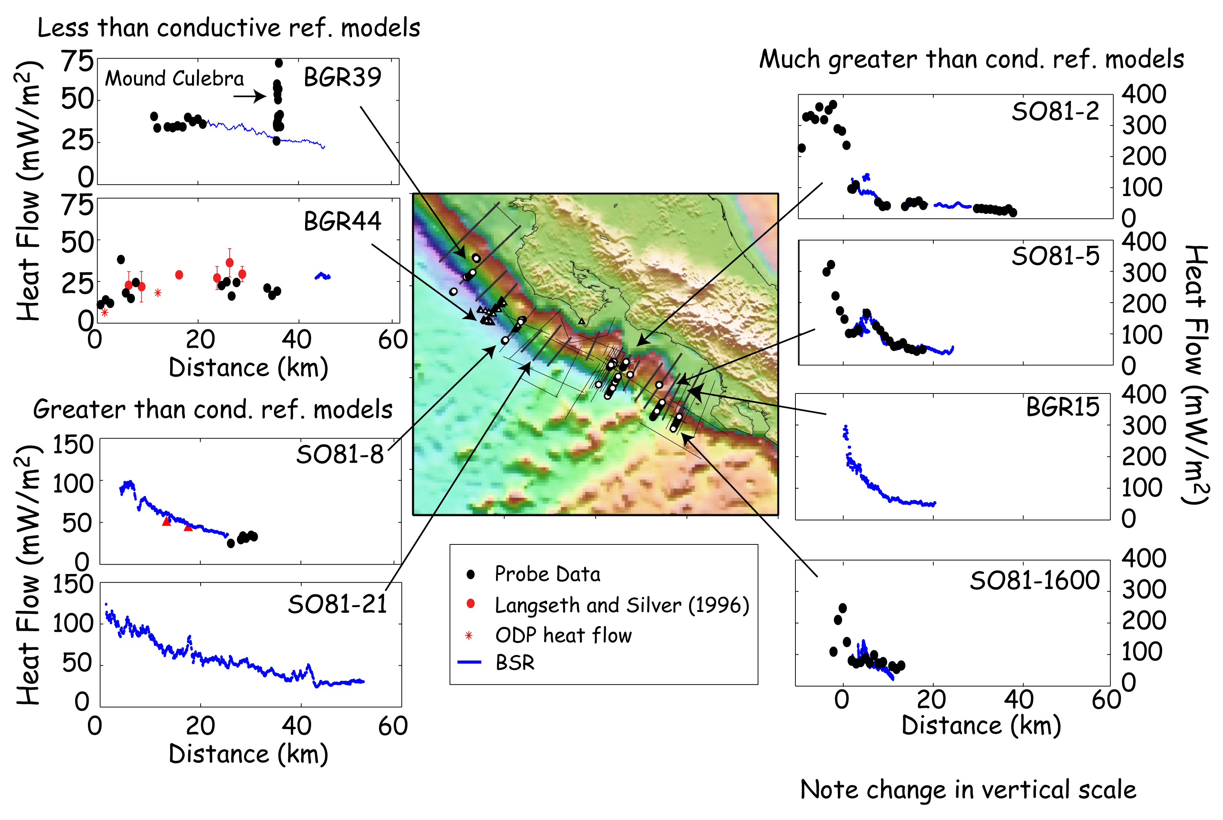
Heat Flow at Selected Areas

Slide 20
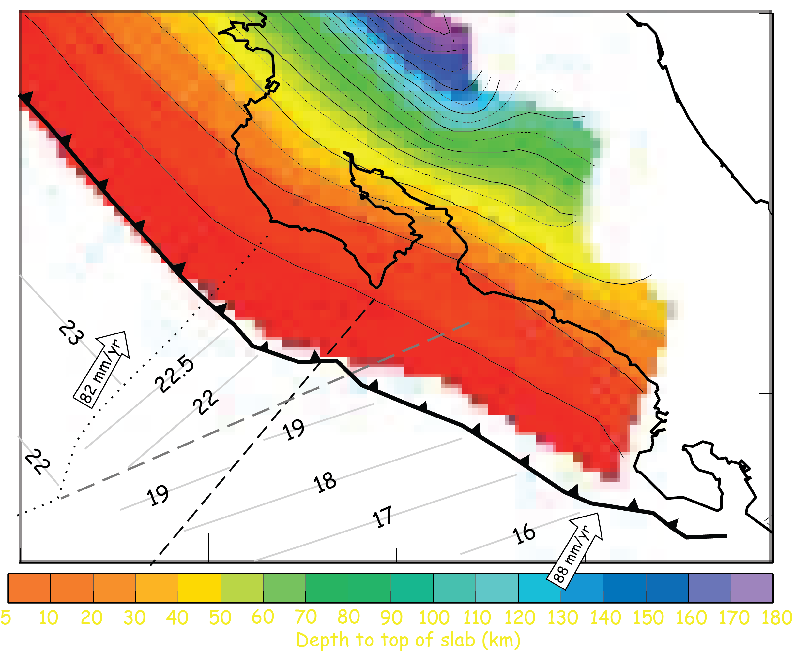
Along Strike Variations in Model Parameters

Slide 25
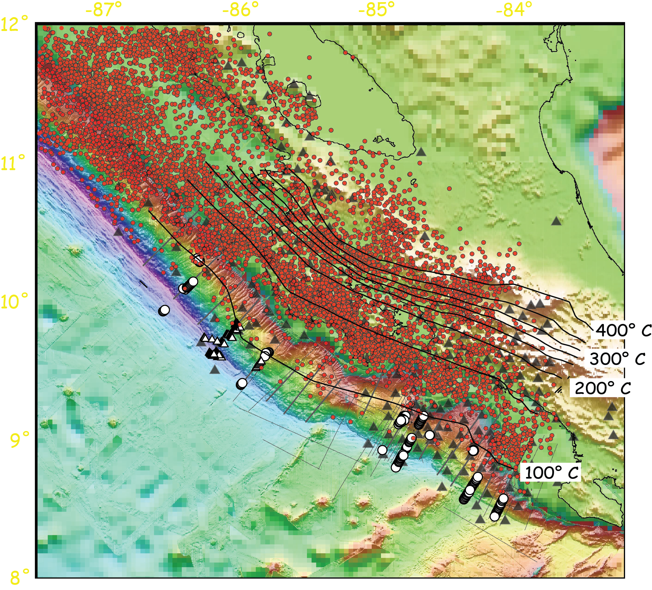
Isotherms and Seismicity on Plate Boundary

Slide 26
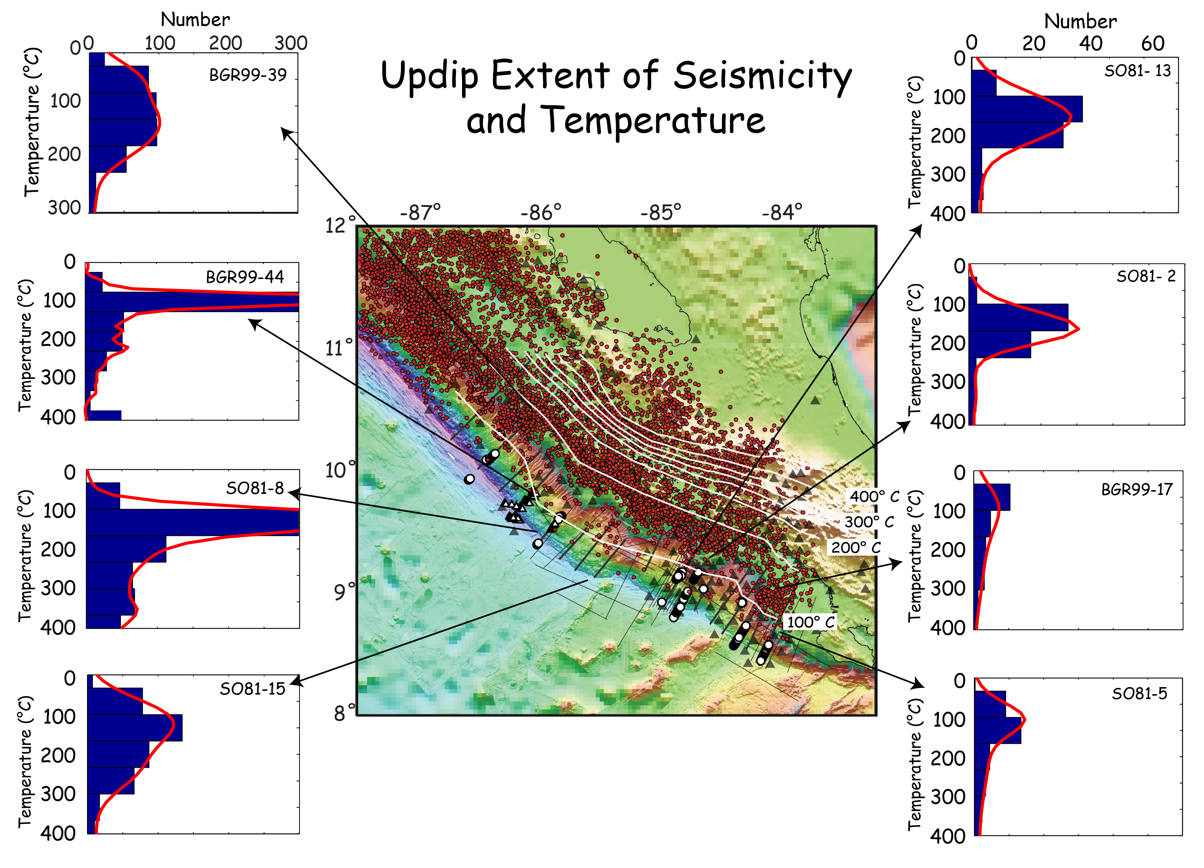

Slide 27
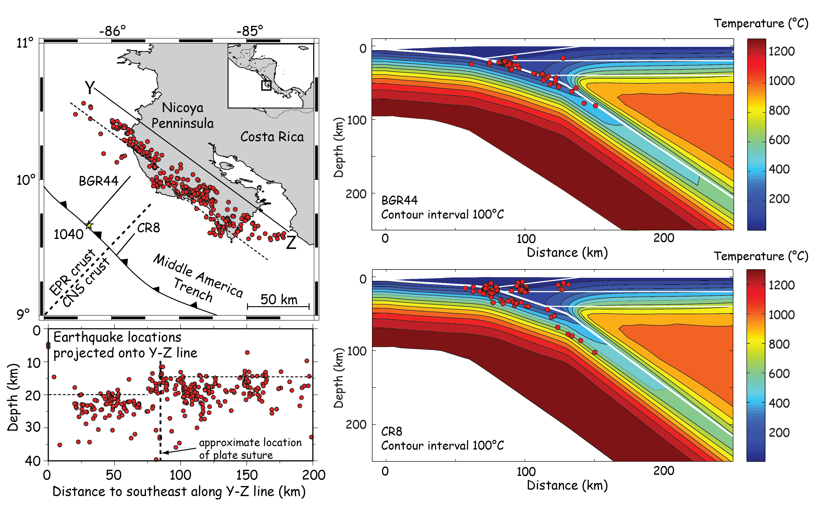
Updip Extent of Seismicity Across Heat Flow Transition

Slide 31
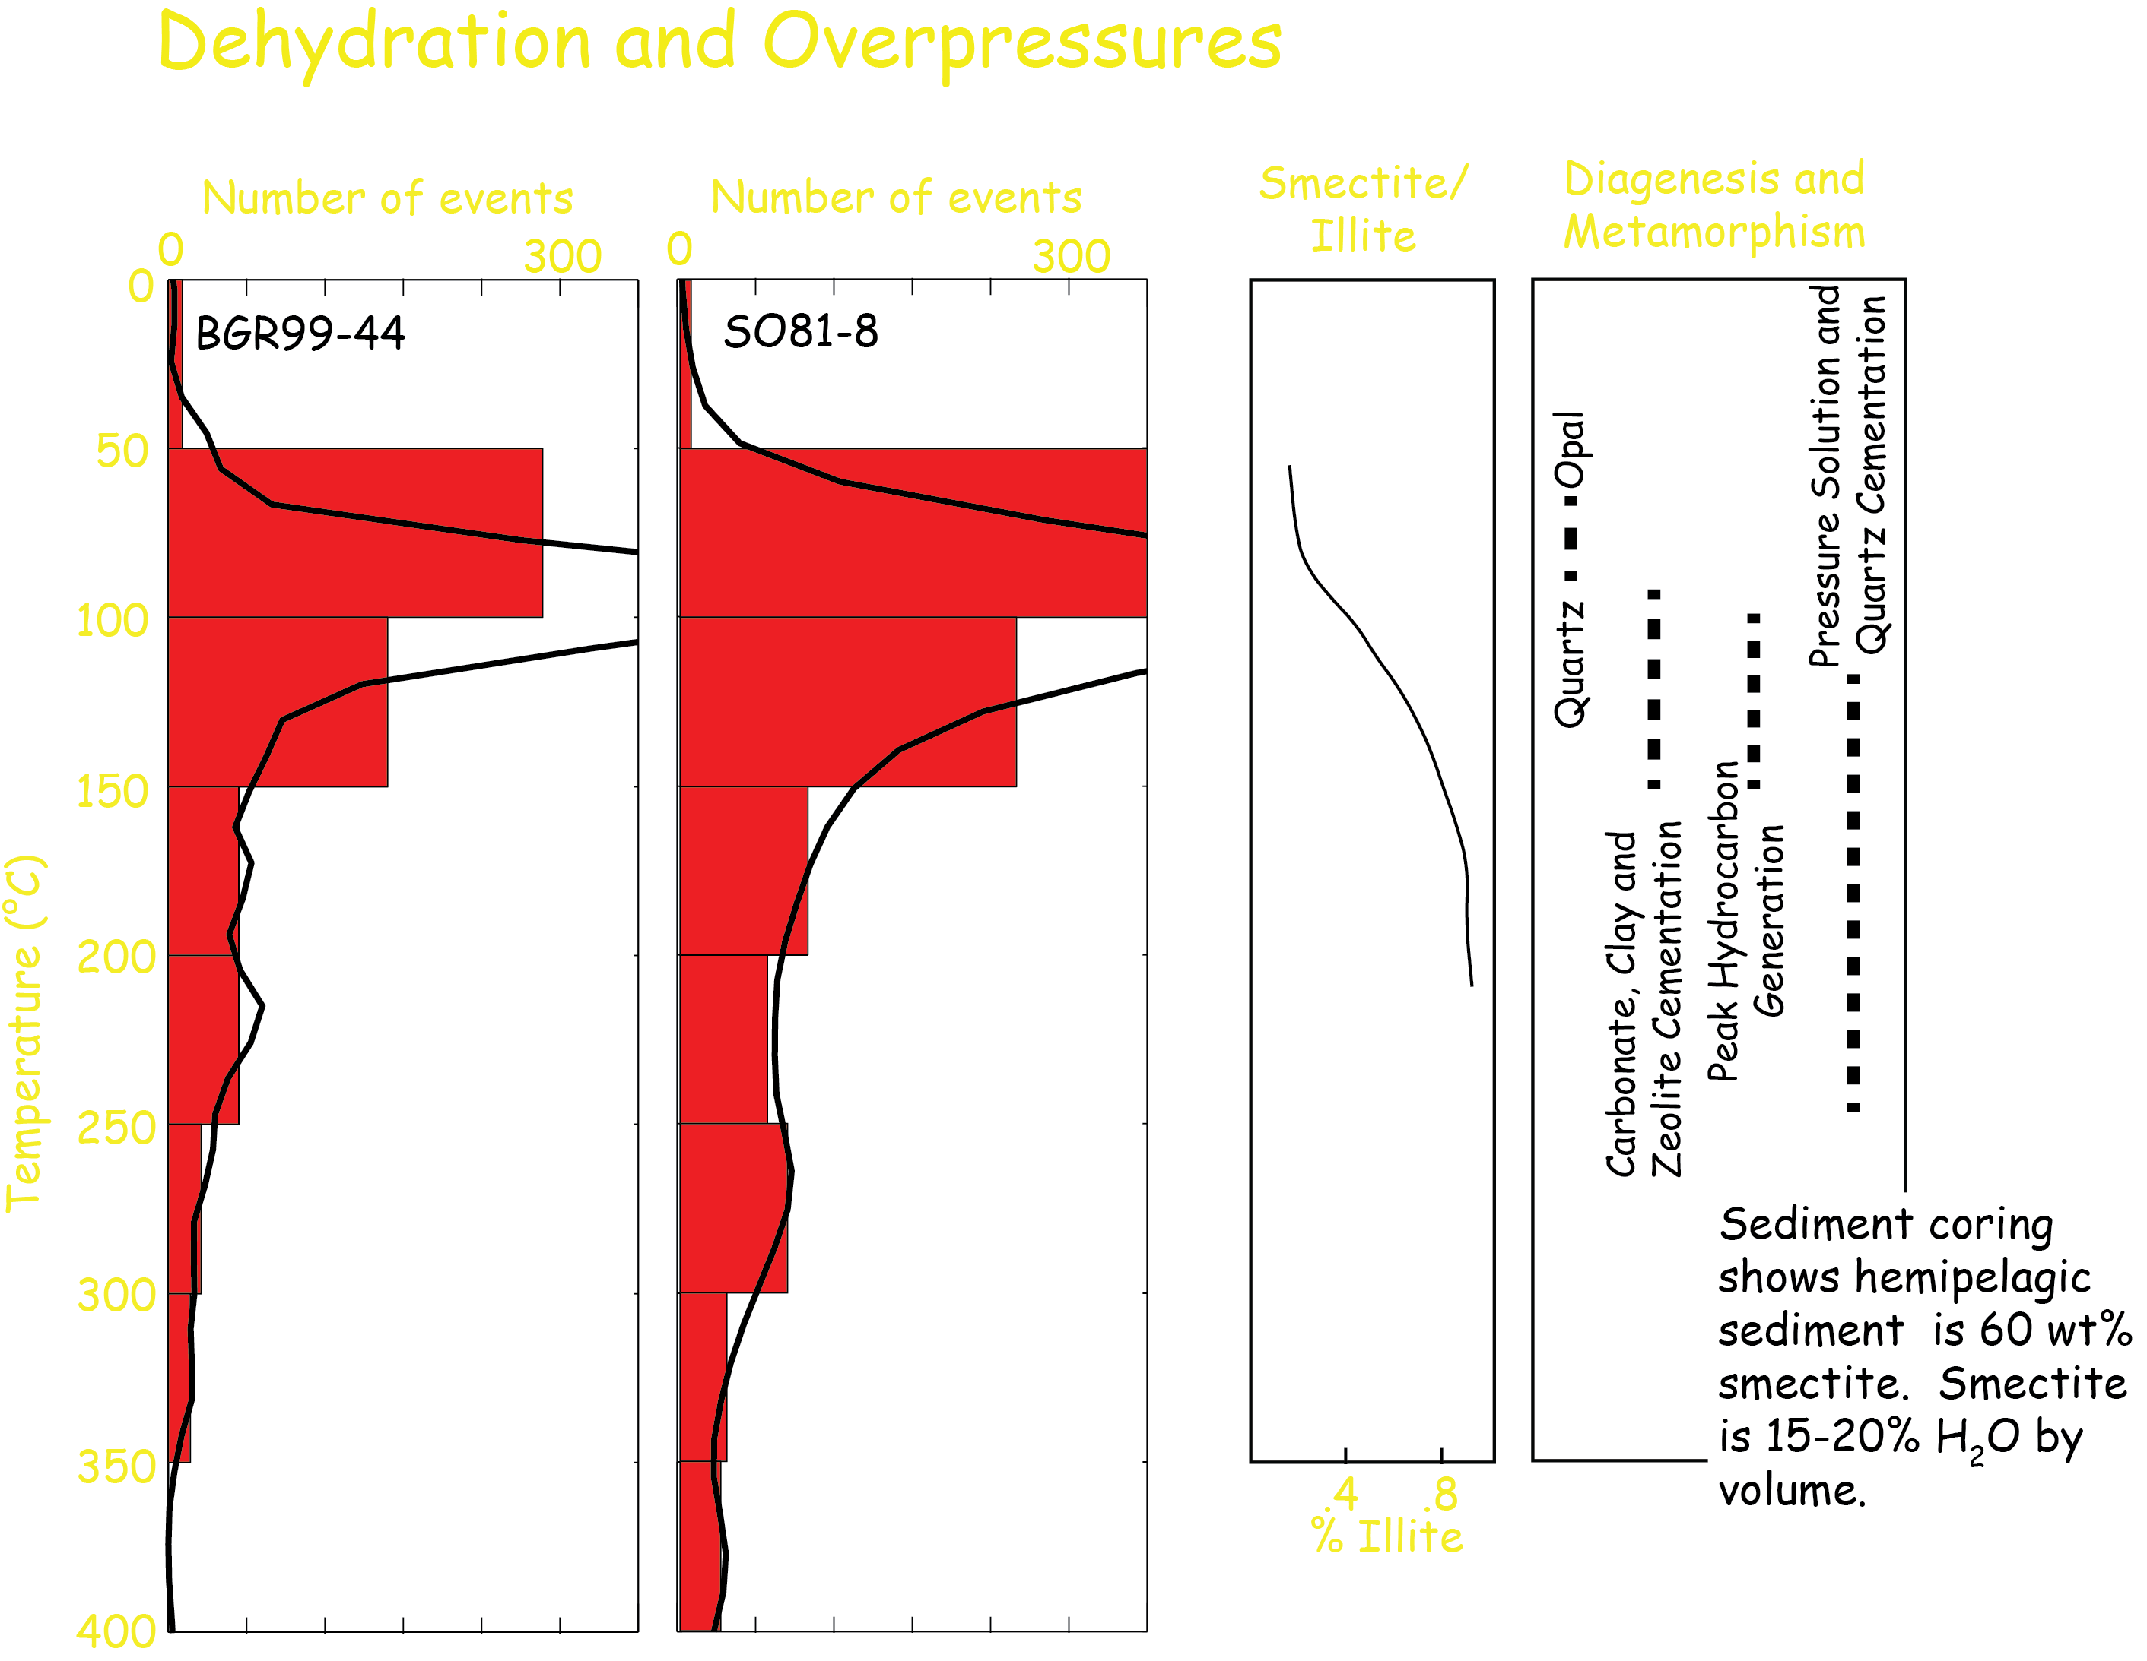
Moore and Saffer, 2001

Slide 33
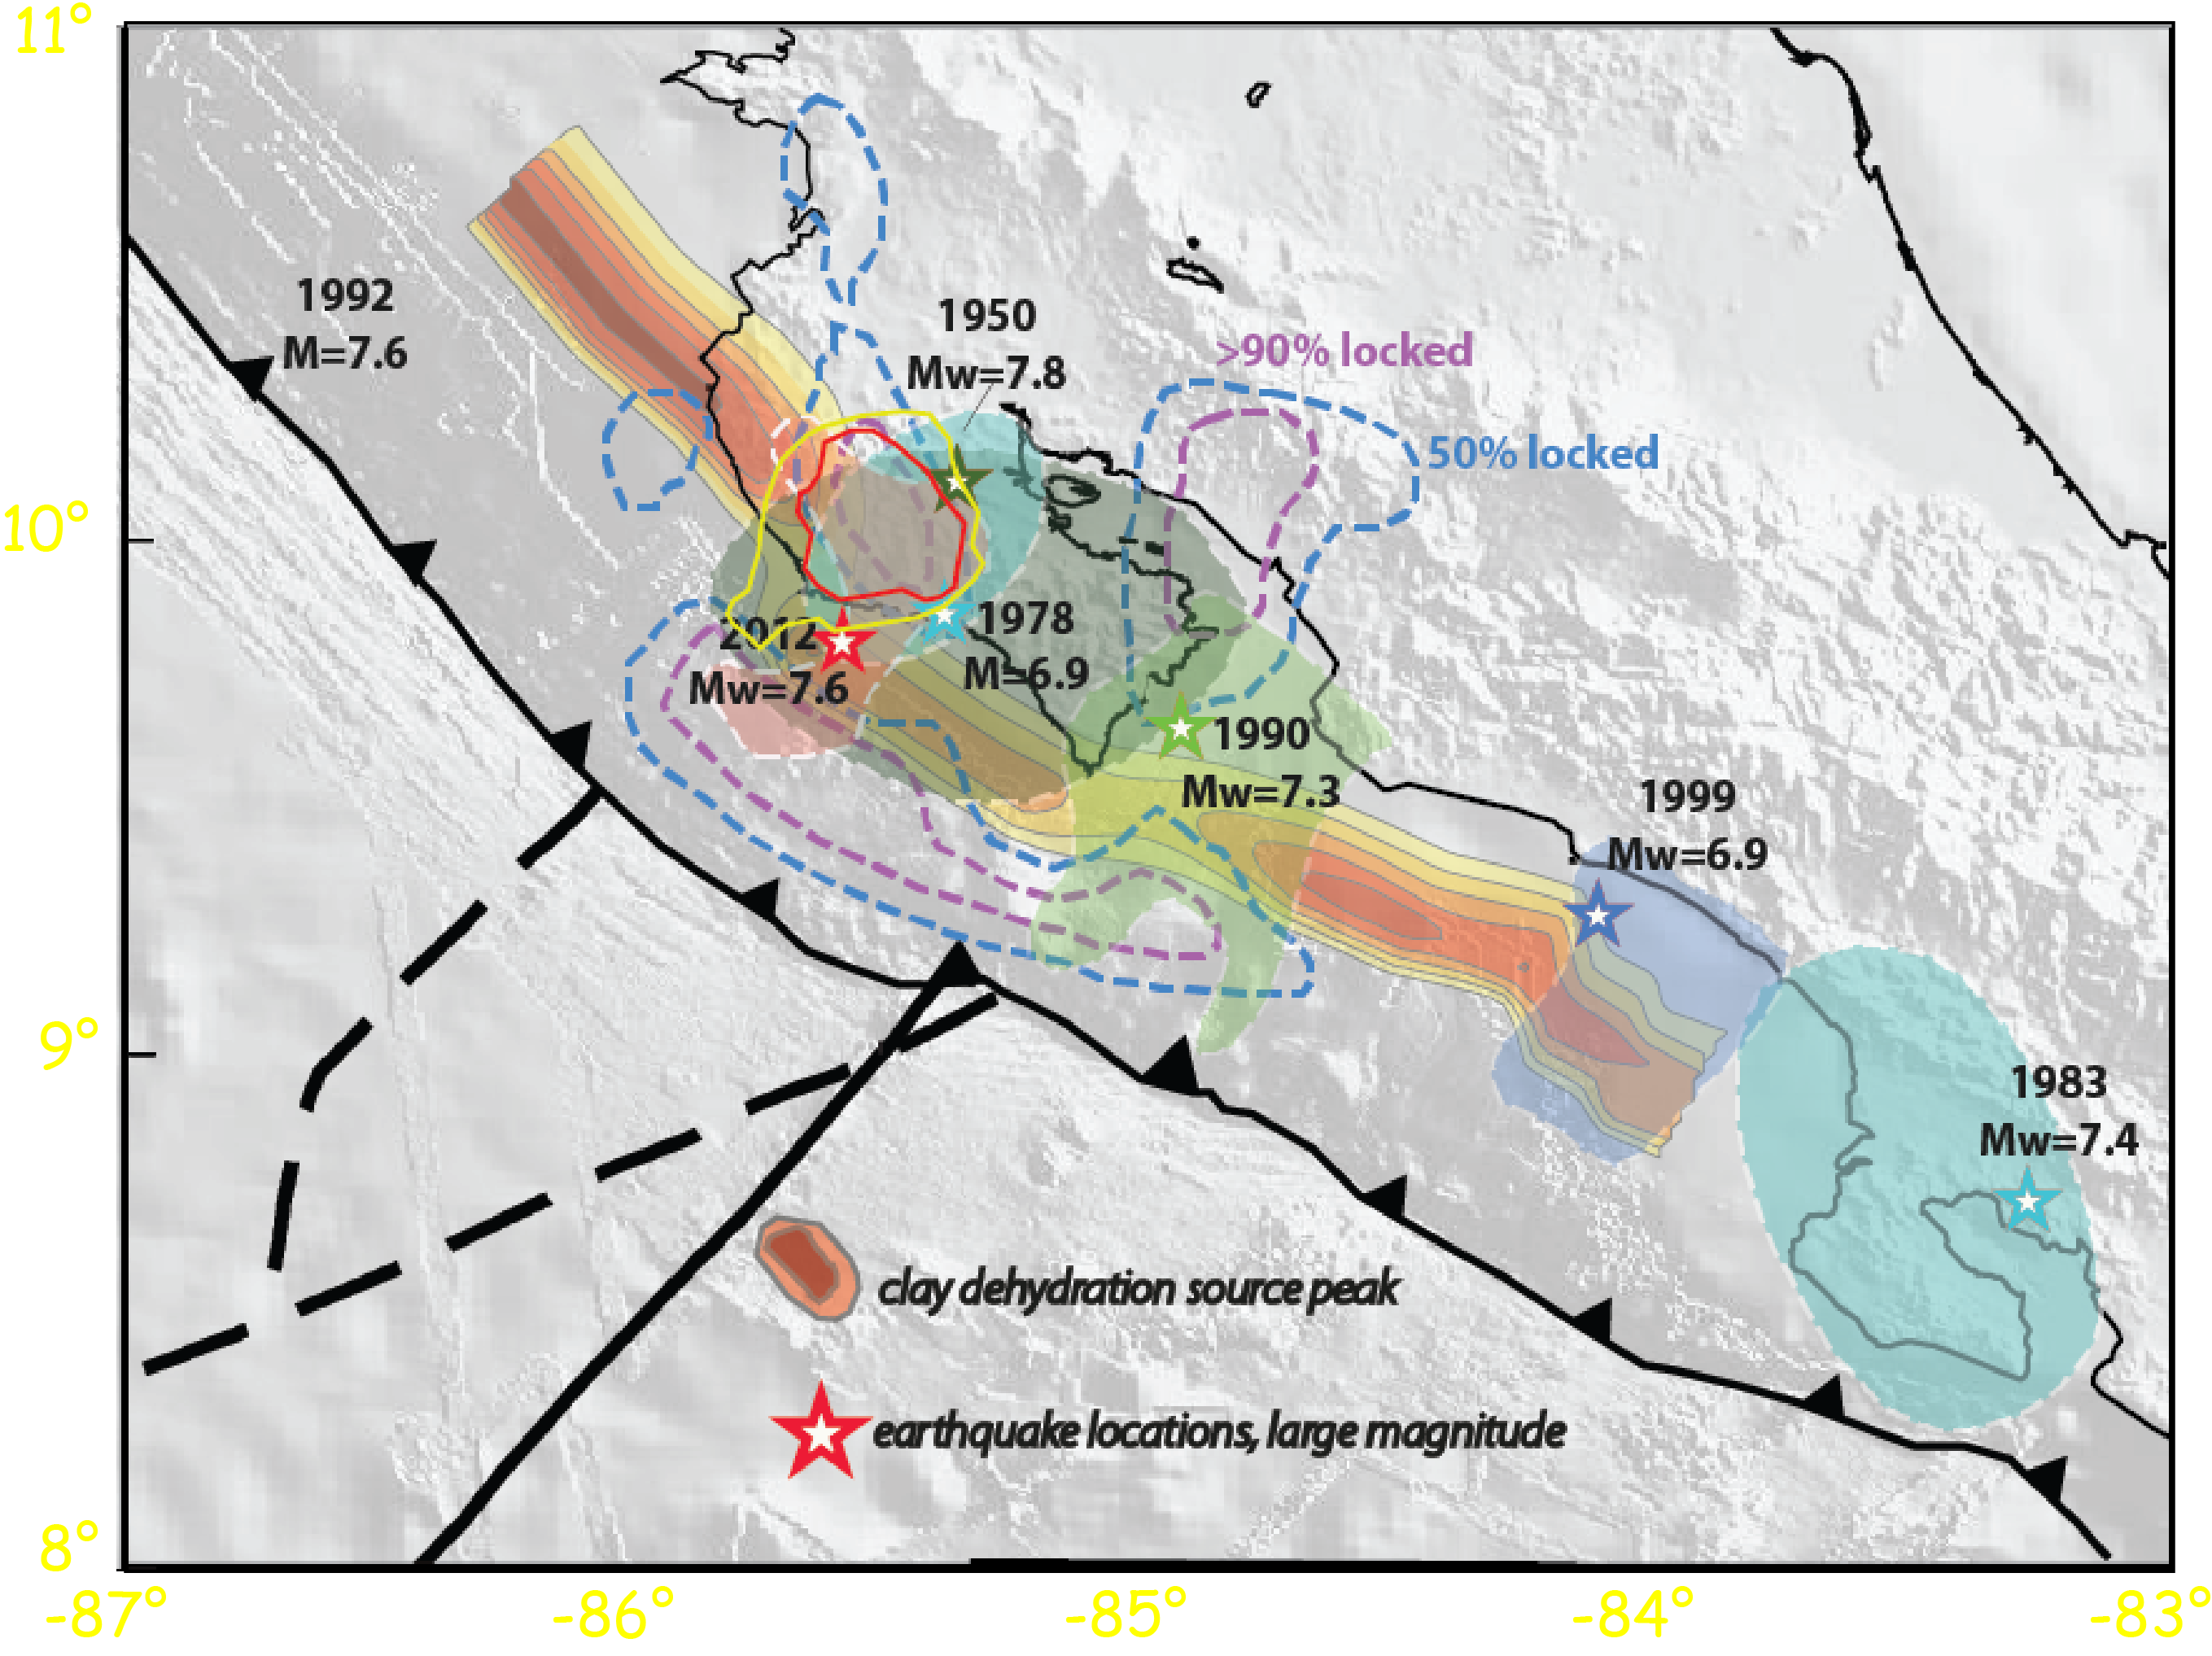
Dehydration and Seismicity

