Slide 1
THE ANTHROPOGENIC GREENHOUSE ERA BEGAN THOUSANDS OF YEARS AGO
William F. Ruddiman
Department of Environmental Sciences
University of Virginia
Abstract The anthropogenic era is generally thought to have begun 150 to 200 years ago, when the industrial revolution began producing CO₂ and CH₄ at rates sufficient to alter their compositions in the atmosphere. A different hypothesis is posed here: anthropogenic emissions of these gases first altered atmospheric concentrations thousands of years ago. This hypothesis is based on three arguments.
(1) Cyclic variations in CO₂ and CH₄ driven by Earth-orbital changes during the last 350,000 years predict decreases throughout the Holocene, but the CO₂ trend began an anomalous increase 8000 years ago, and the CH₄ trend did so 5000 years ago.
(2) Published explanations for these mid- to late-Holocene gas increases based on natural forcing can be rejected based on paleoclimatic evidence.
(3) A wide array of archeological, cultural, historical and geologic evidence points to viable explanations tied to anthropogenic changes resulting from early agriculture in Eurasia, including the start of forest clearance by 8000 years ago and of rice irrigation by 5000 years ago.
In recent millennia, the estimated warming caused by these early gas emissions reached a global-mean value of 0.8ºC and roughly 2ºC at high latitudes, large enough to have stopped a glaciation of northeastern Canada predicted by two kinds of climatic models. CO₂ oscillations of 10 ppm in the last 1000 years are too large to be explained by external (solar-volcanic) forcing, but they can be explained by outbreaks of bubonic plague that caused historically documented farm abandonment in western Eurasia. Forest regrowth on abandoned farms sequestered enough carbon to account for the observed CO₂ decreases. Plague-driven CO₂ changes were also a significant causal factor in temperature changes during the Little Ice Age (1300-1900 AD).

Slide 2
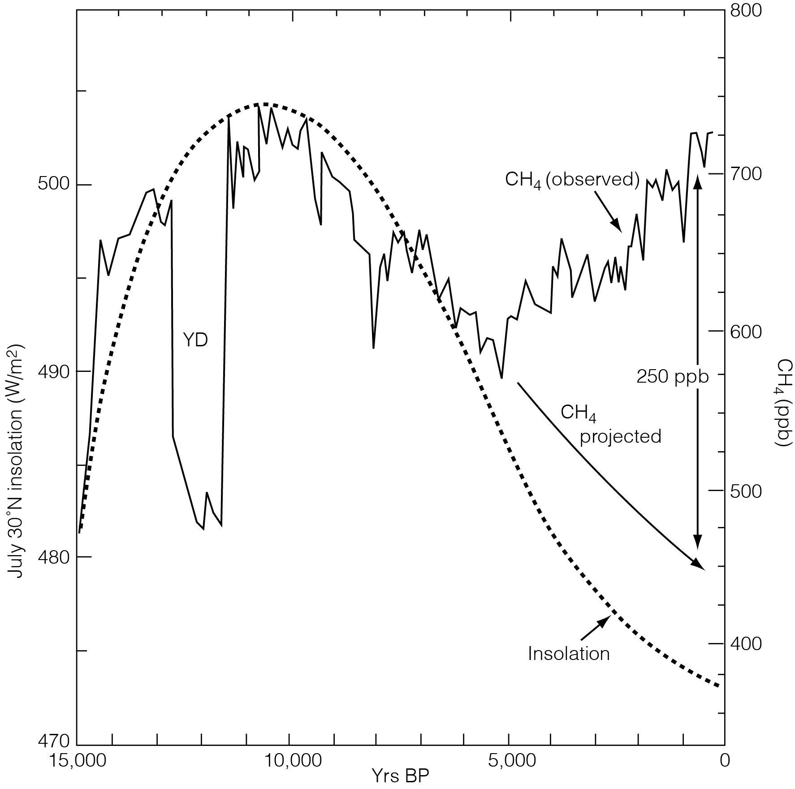
Notes:
But in this case one spanning only 10 years: What did I say in 2003?
What does the new science show? Ice-core, archeological, and historical data
Blunier et al published the first detailed Holocene CH4 time series
I predicted CH4 should have dropped because of decreasing summer insolation (monsoons)

Slide 3
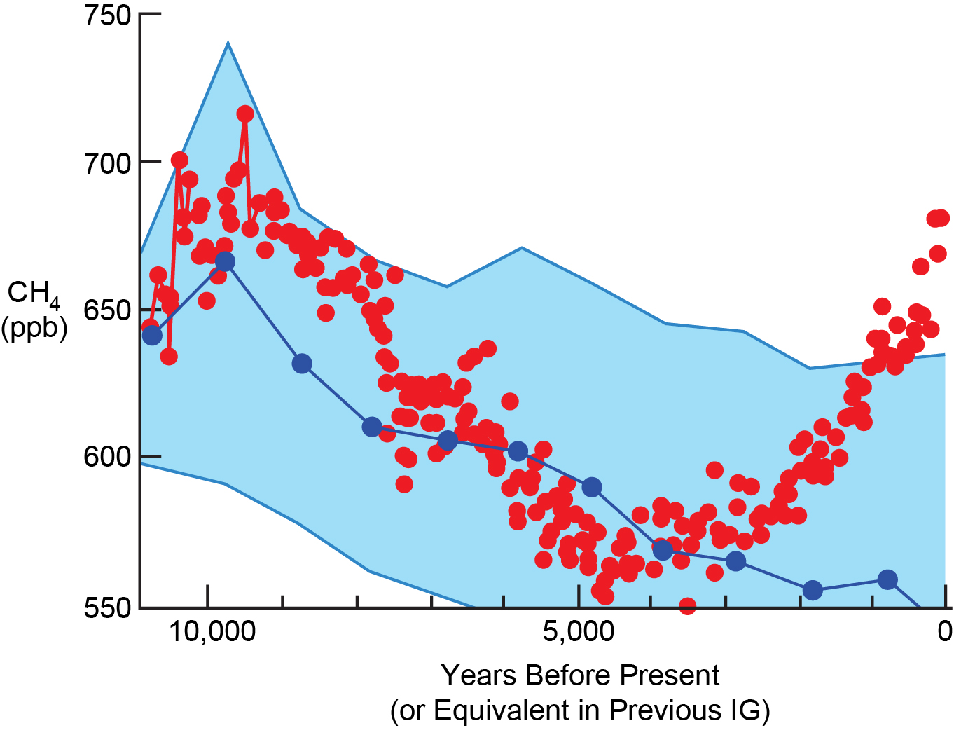
Notes:
Newer data: Dome C CH4 data from many EPICA Community authors
Using Parrenin’s EDC3 time scale, I aligned the records on P insolation (1st min in IG’s)
Previous IG stack: 1K bins of EDC3 data: average & standard deviation
Stack spans analogous ‘100K” IG’s back to > Stage 19 (785K), but not Stage 21
The upward Holocene trend indicates that the late Holocene is anomalous
EPICA DOME C: EDC2 TIME SCALE, ALIGNED ON P INSOLATION EXPLAIN PREVIOUS IG STACK . IK BINS: AVERAGE AND STD DEVIATION
ALL ANALOGOUS IG’S > STAGE 19 (780K); ALL 100K IG’S EXCEPT STAGE 21 CALL THIS THE “TOP-DOWN” APPROACH

Slide 4
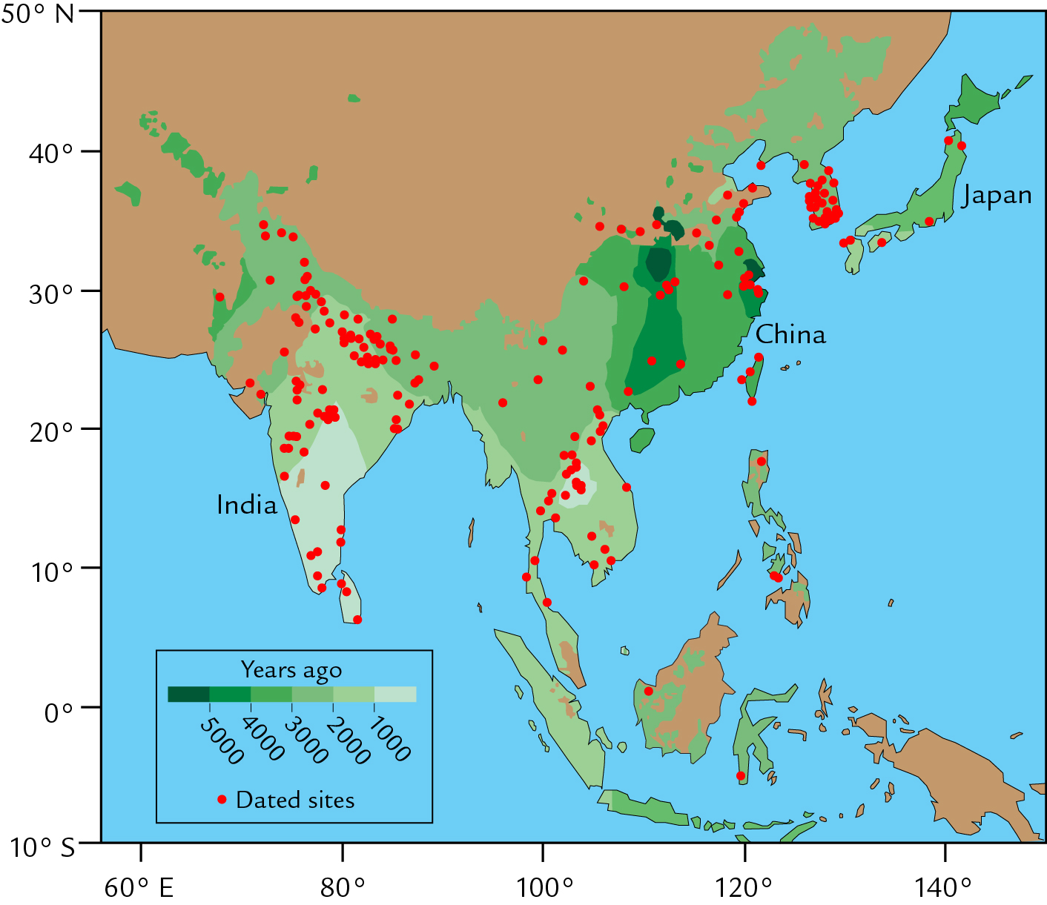
Notes:
Also: new “bottom-up” evidence is emerging from archeological syntheses
Rice irrigation is a major source of early anthropogenic CH4 emissions
Dorian Fuller et al: Map of first arrival of rice irrigation in S and SE Asia

Slide 5
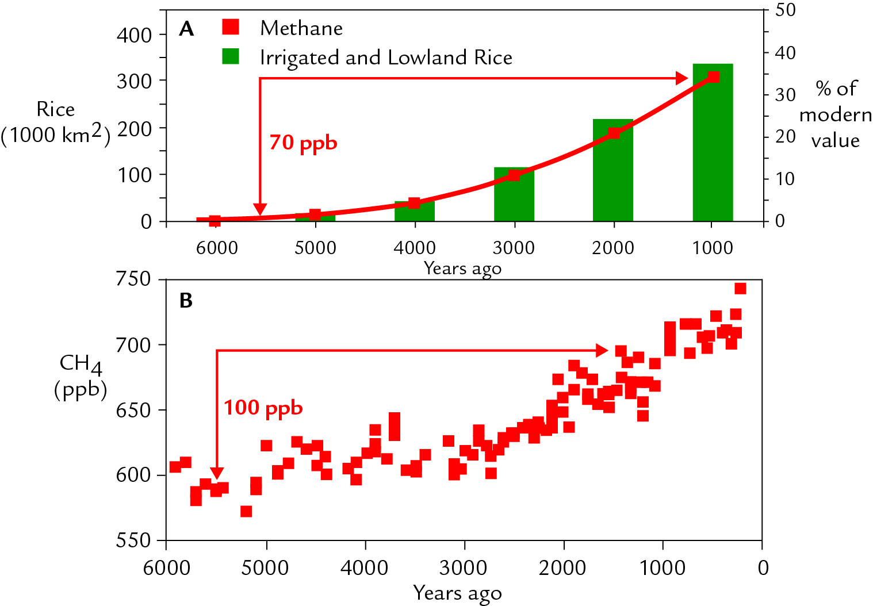
Notes:
Fuller assumed infilling after rice arrival follows modern spatial pattern:
Irrigated area increases with square root of growing pop density
Estimated: Total irrigated area > total CH4 emissions > atm CH4 concentration
Emissions and atm CH4 conc were scaled from modern relationships
Rice irrigation accounted for 70 ppb of observed 100 ppb rise 5-1K

Slide 6
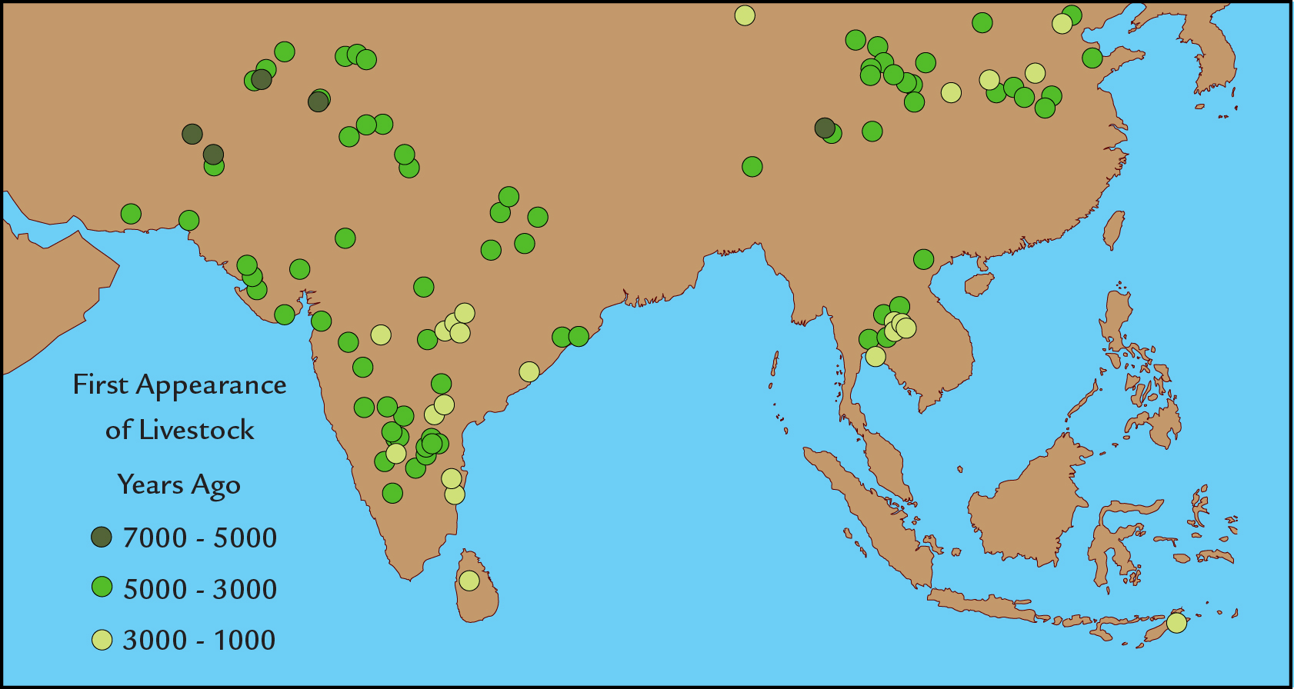
Notes:
But: the full CH4 anomaly has two parts: one “up”, one “down”
Up: observed CH4 rise; down: previous IG decreases not seen in Holocene
Livestock is another CH4 source: a larger CH4 emitter today than rice paddies
Fuller: livestock limited to arid regions until 5K; then spread > moister regions
So: agricultural emissions are a promising explanation for the anomalous CH4 trend

Slide 7
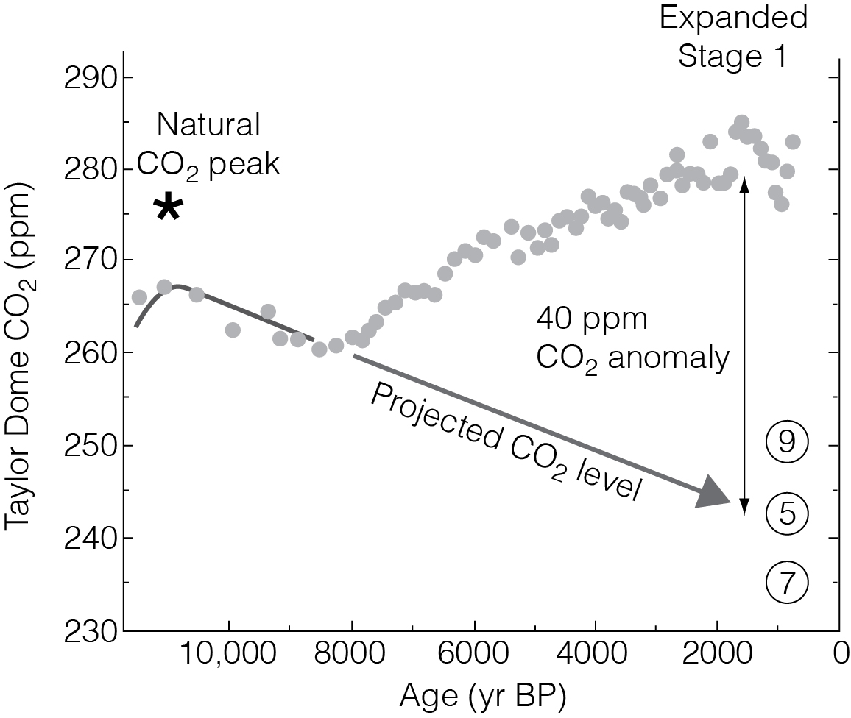
Notes:
2003: Vostok CO2 from Petit et al 1999
CO2 dropped from 11/10K-8K (few data points), then rose after 8/7K
I predicted that the CO2 drop should have continued after 8/7K > St 5, 7, 9 levels
But it didn’t; instead we find another ‘wrong-way’ (rising) trend
Looks like another possible anthropogenic overprint

Slide 8
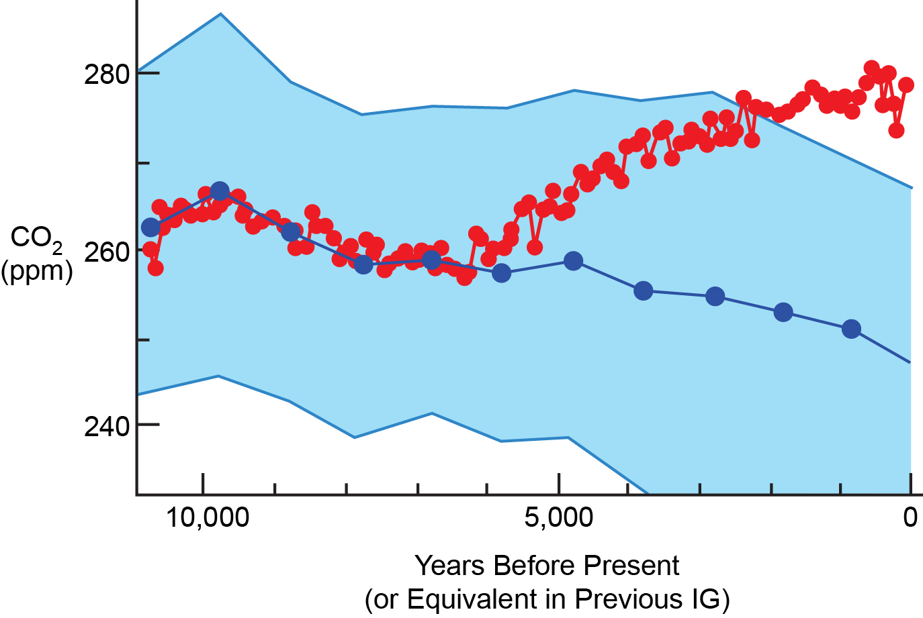
Notes:
Dome C CO2: again, data from EPICA Project authors using EDC3 time scale
Much more Holocene data, downward 10-7K trend now well defined
Compare Holocene to previous IG stack: same method as for CH4
Late Holocene CO2 rise confirmed as anomalous

Slide 9
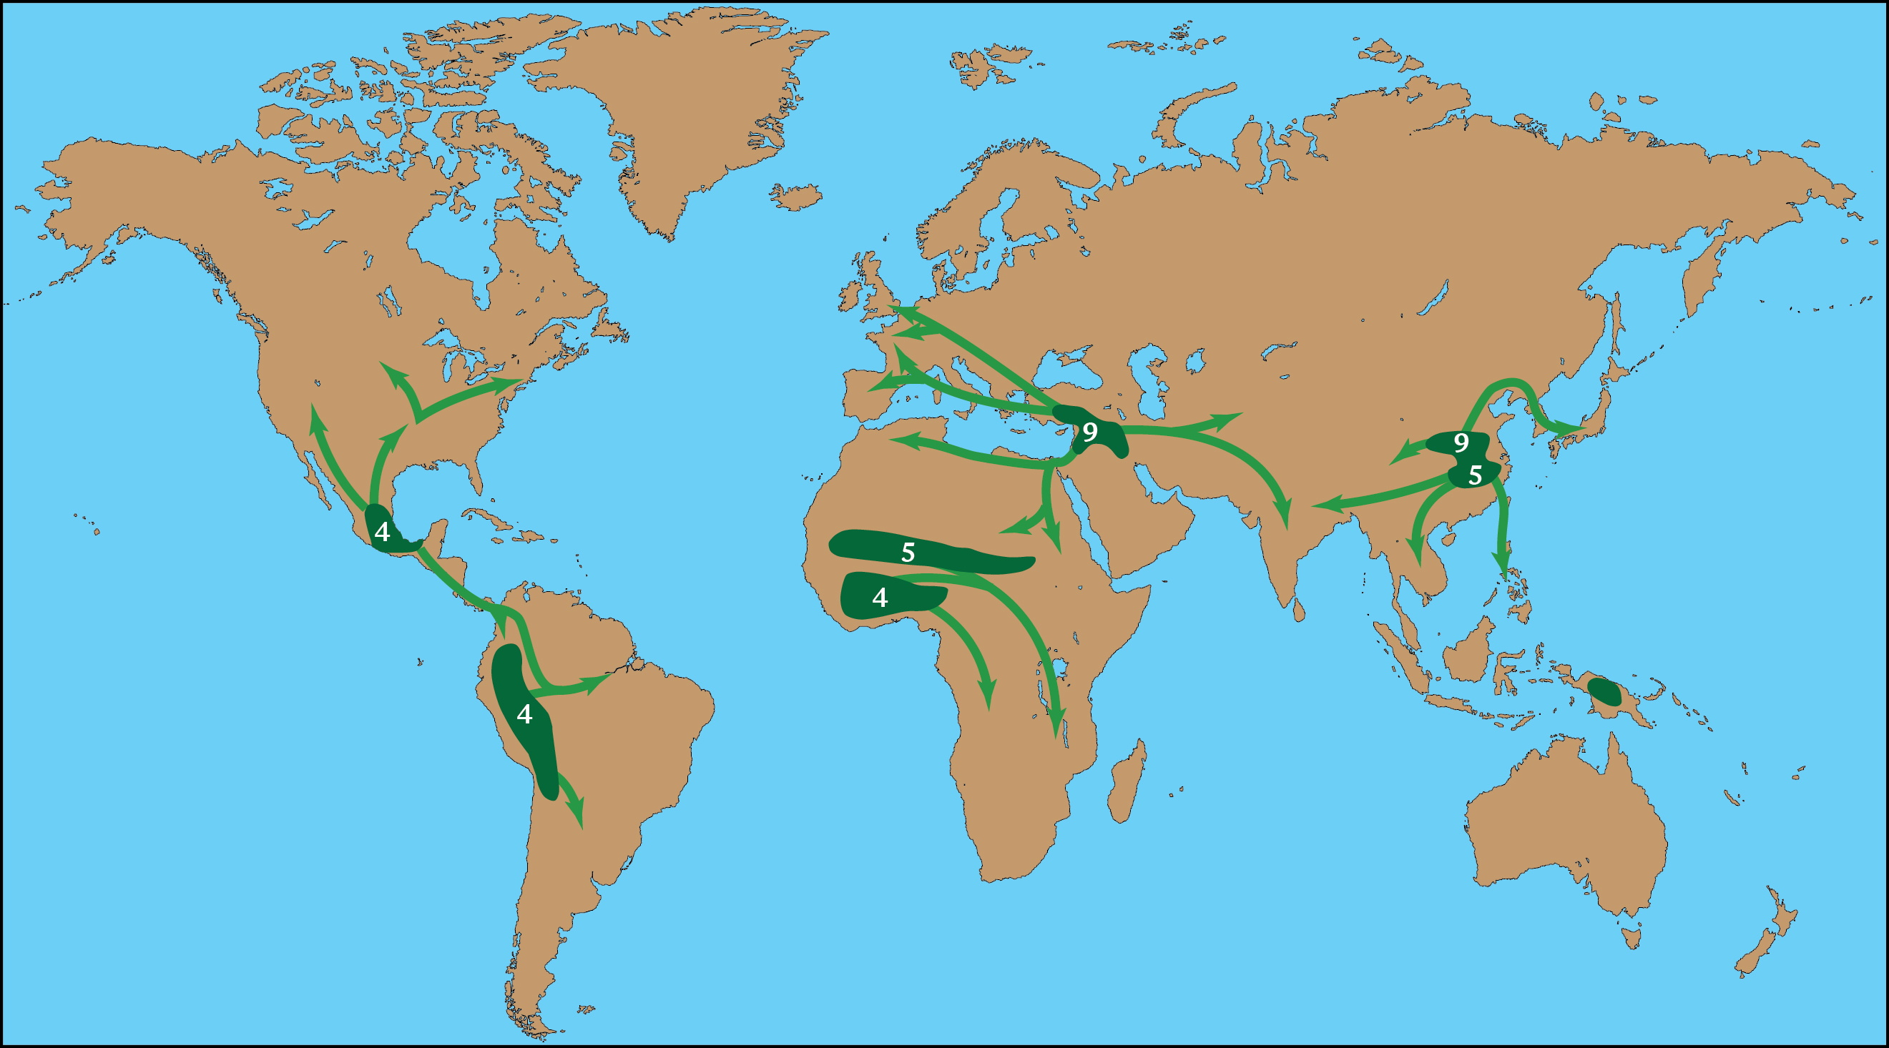
Notes:
As with CH4, archeology has begun playing a big role in the CO2 story
Along with data from land-use histories
CO2 rise matches spread of agriculture after 9K
Most farming was in naturally forested areas (rainfall or irrigated)
Cutting trees for farming caused CO2 emissions

Slide 10
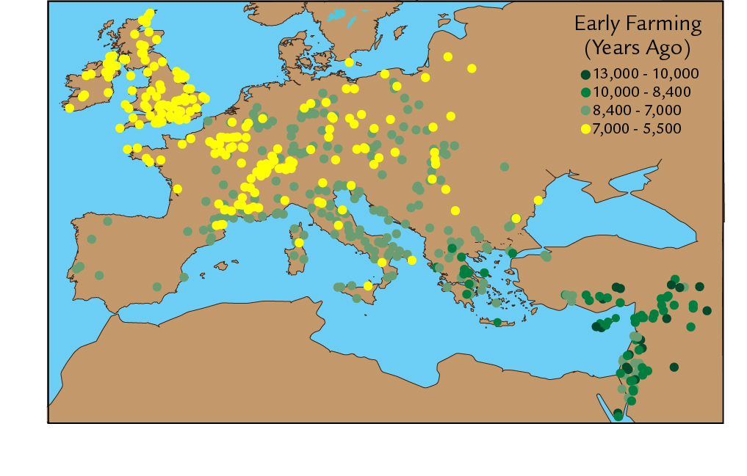
Notes:
Zohary-Hopf compiled ¹⁴C-dated archeological sites in Europe
Major spread of agriculture (7.7-5.5K) brackets 7K CO2 reversal
Note: 5.5K is still late Stone Age (Neolithic)
Not yet in the age of metals (bronze, iron, steel)!

Slide 11
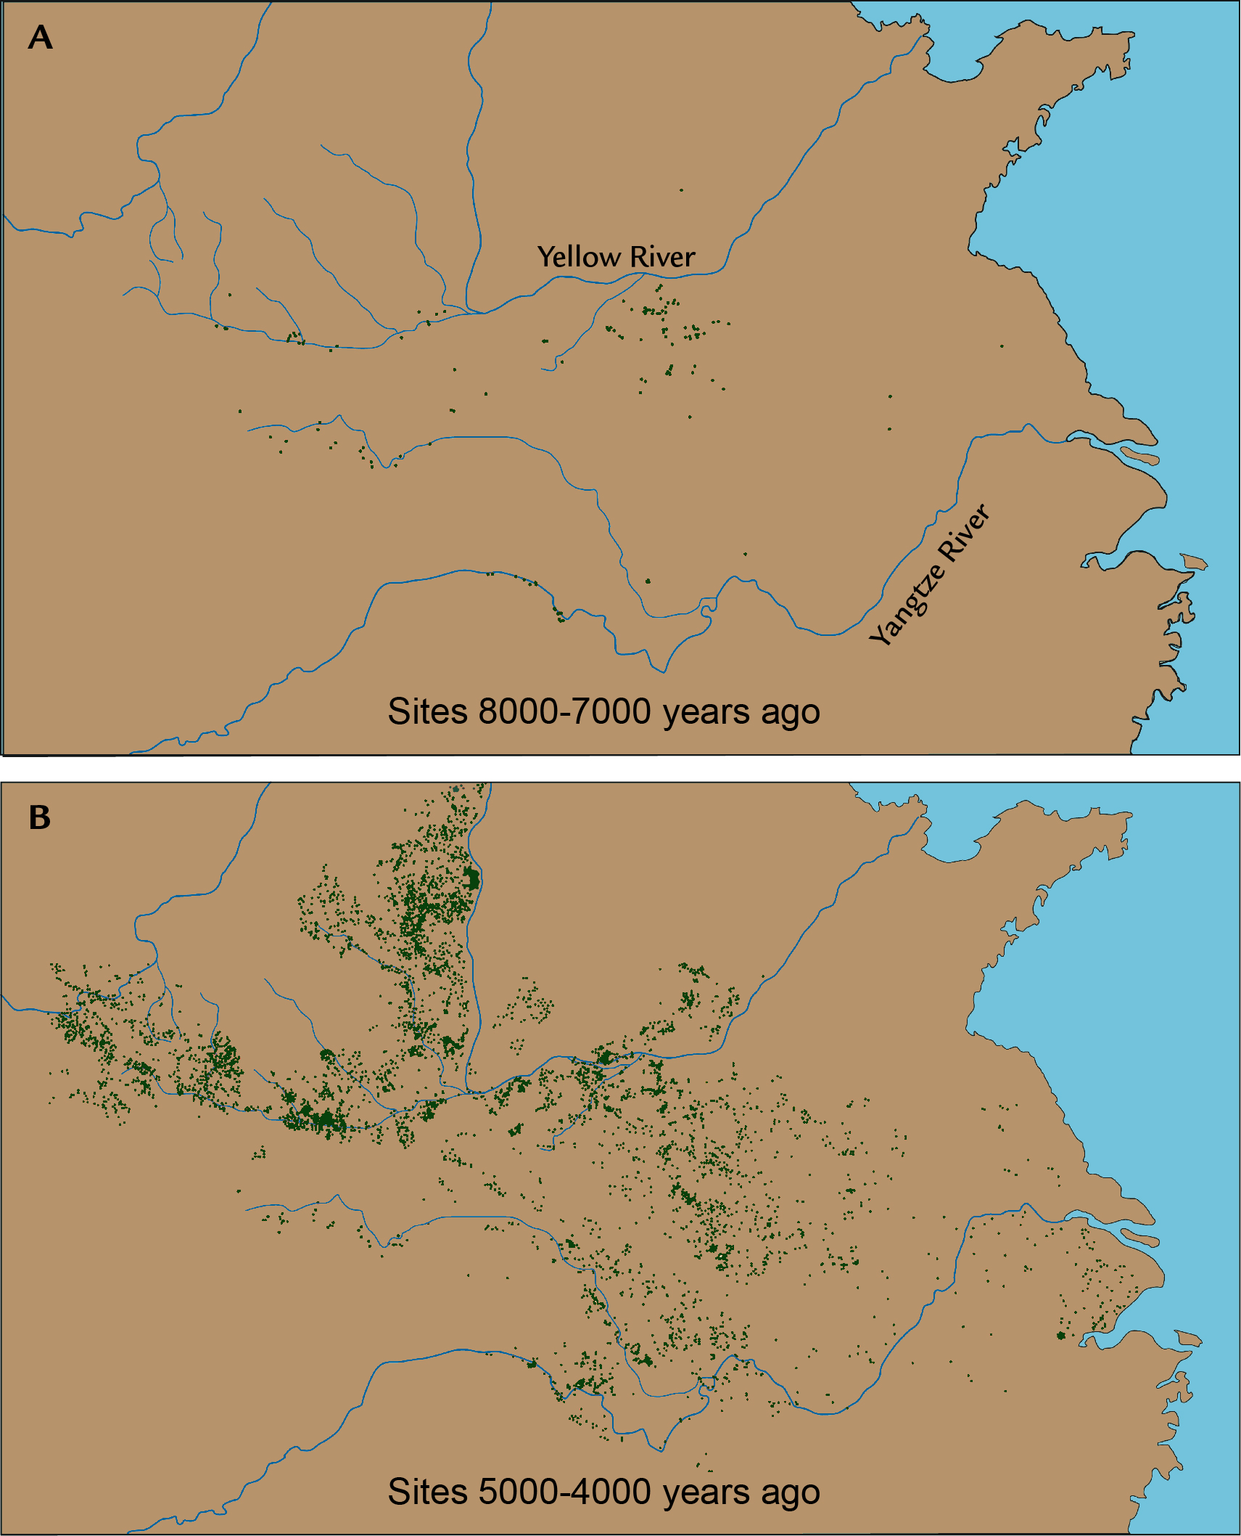
Notes:
Li et al: archeological sites in China
30-fold increase in # of sites from 8-7K interval to 5-4K
Implies major farming population increase & forest clearance
Major spread of sites again brackets the 7K CO2 reversal
More evidence favorable to the EAH CO2 hypothesis, but not definitive

Slide 12
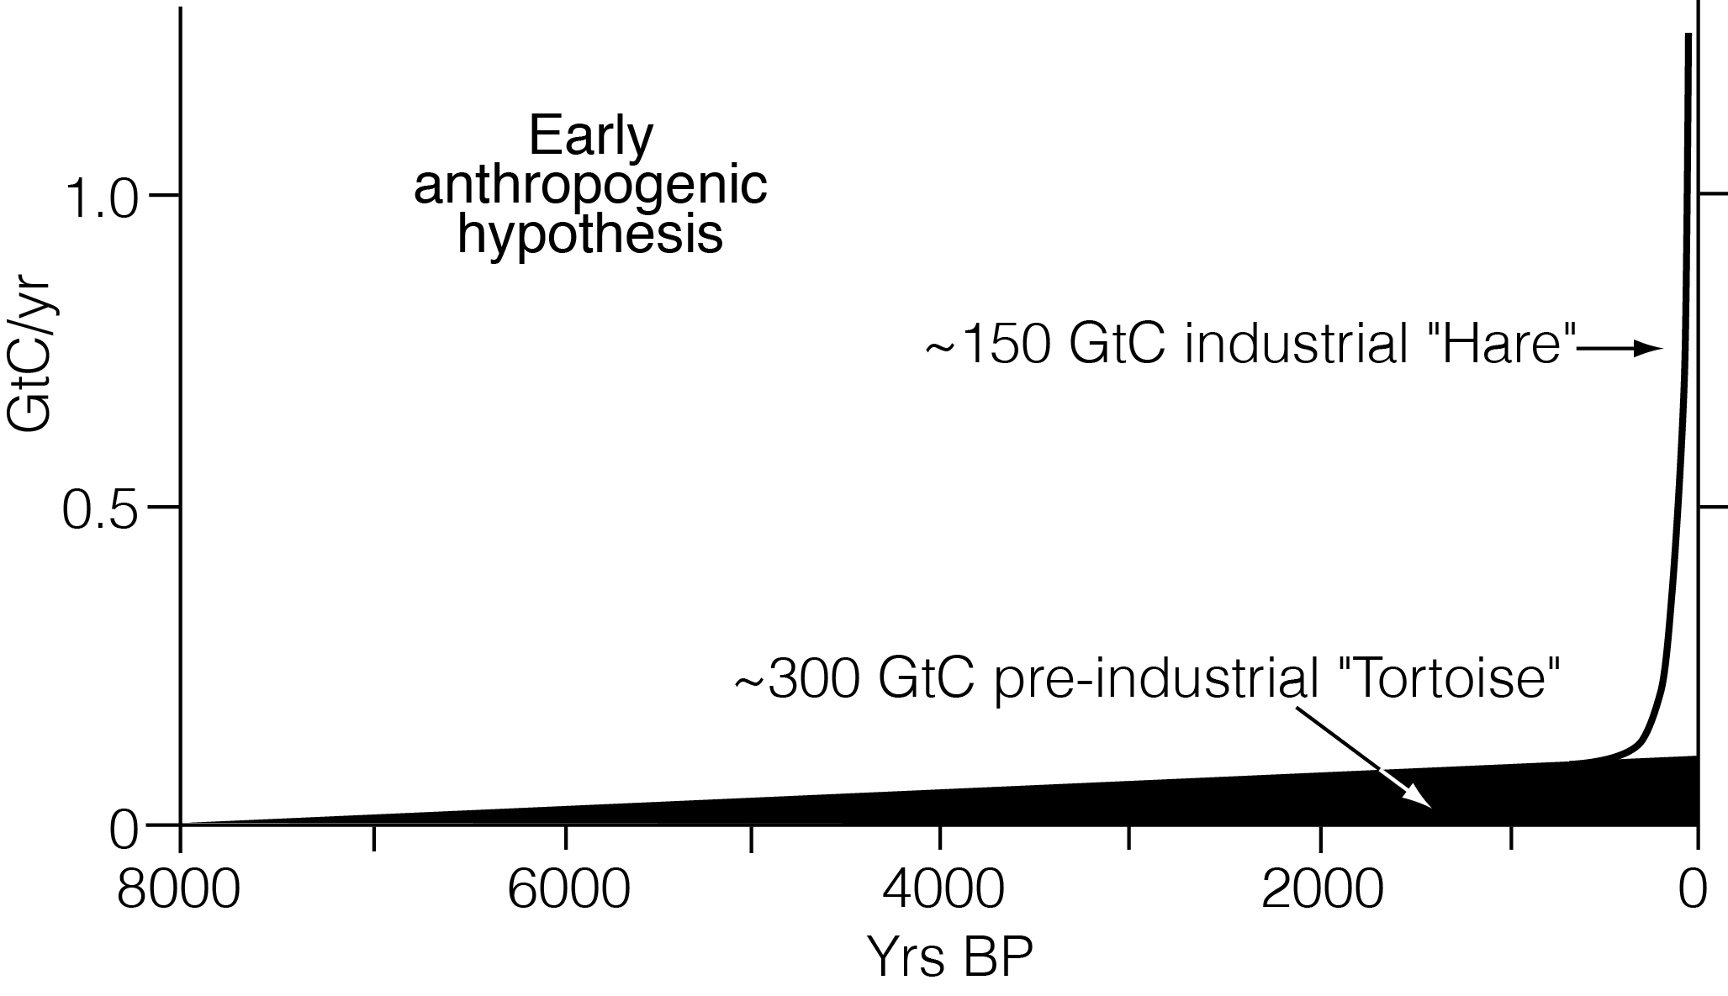
Notes:
My crude 2003 estimate: 300 GtC pre-ind emissions vs 150 GtC industrial
I assumed near-complete deforestation of Europe, China, and India
And substantial but lesser deforestation elsewhere (SE Asia, Mexico, Peru)
I proposed that the slow agricultural ‘turtle’ outdid the fast industrial ‘hare’ by 2x
The turtle had thousands of years, the hare has had only ~200

Slide 13
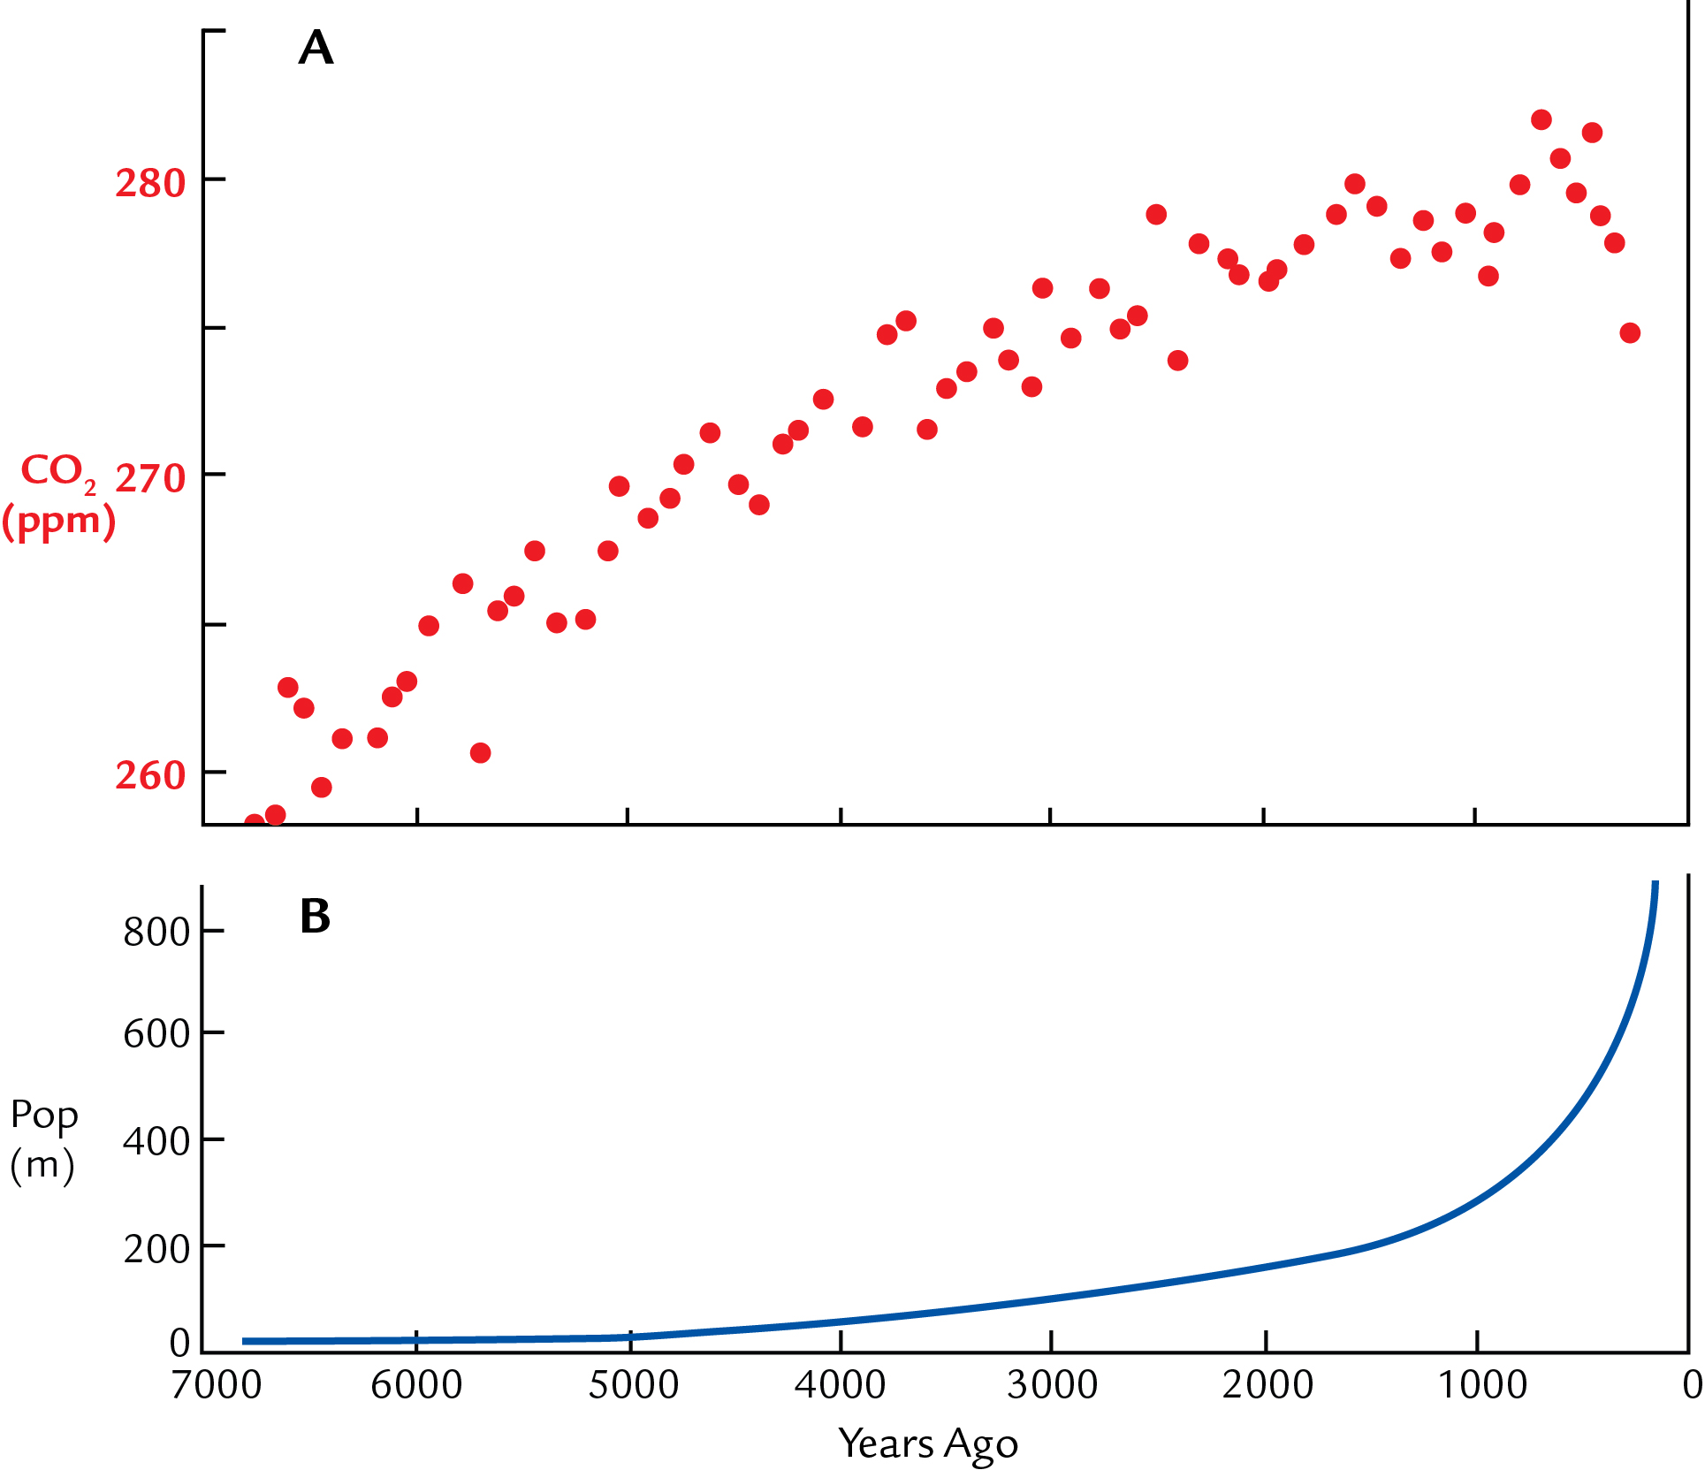
Notes:
Most common criticism of EAH: too few people on Earth in pre-industrial time
<1B at 1800, 7B by 2000: so 85% of population growth is post-1800
Some land-use simulations assumed constant per-cap clearance for last 7K
This places most forest clearance during the post-1800 populaion increase
And leaves very little clearance and CO2 emitted prior to 1800

Slide 14
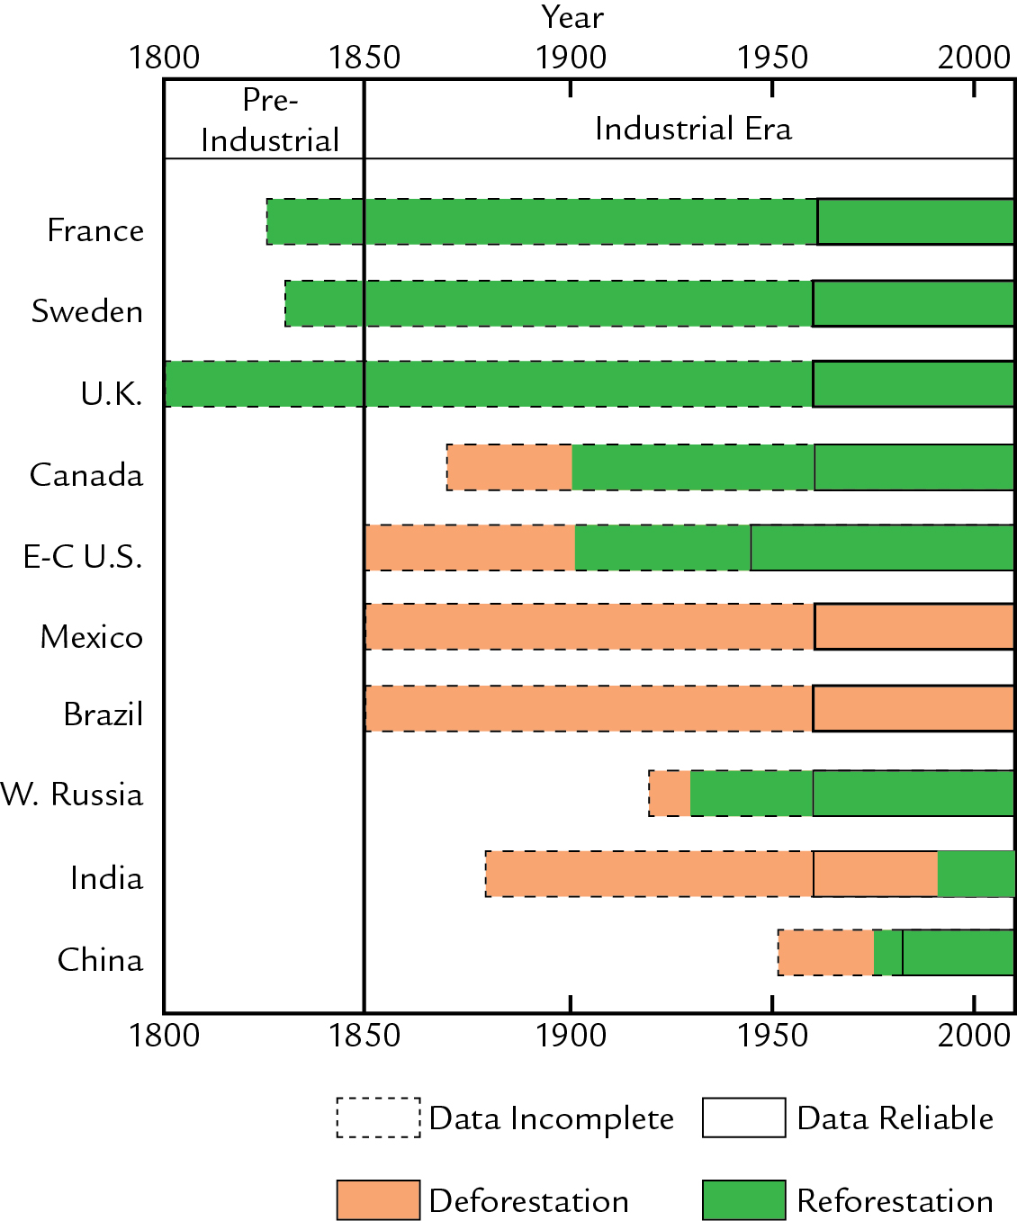
Notes:
But fully reliable records meeting modern standards are very short (post-1960)
And many areas have been REforesting during much or all of the industrial era
Particularly Europe: well-defined trends compiled by Alexander Mather
This presents a daunting problem for land-use studies:
How to estimate pre-industrial DEforestation from industrial-era REforestation?

Slide 15
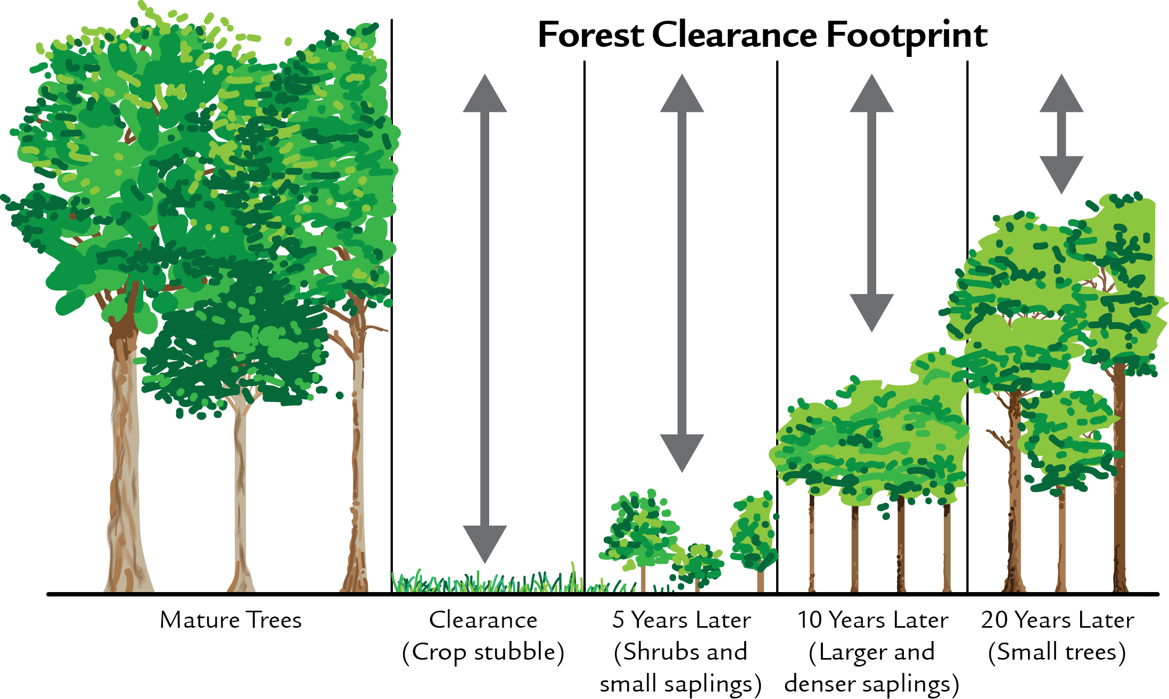
Notes:
A very different view has long prevailed among those doing field-based studies:
Originated with economist Ester Boserup in 1960’s-1980’s
Rotating early land use was very inefficient/wasteful, left a trailing C footprint
Much larger per-capita clearance and C emissions in earlier millennia
But land-use modelers in the 1990’s and early 2000’s ignored her work

Slide 16
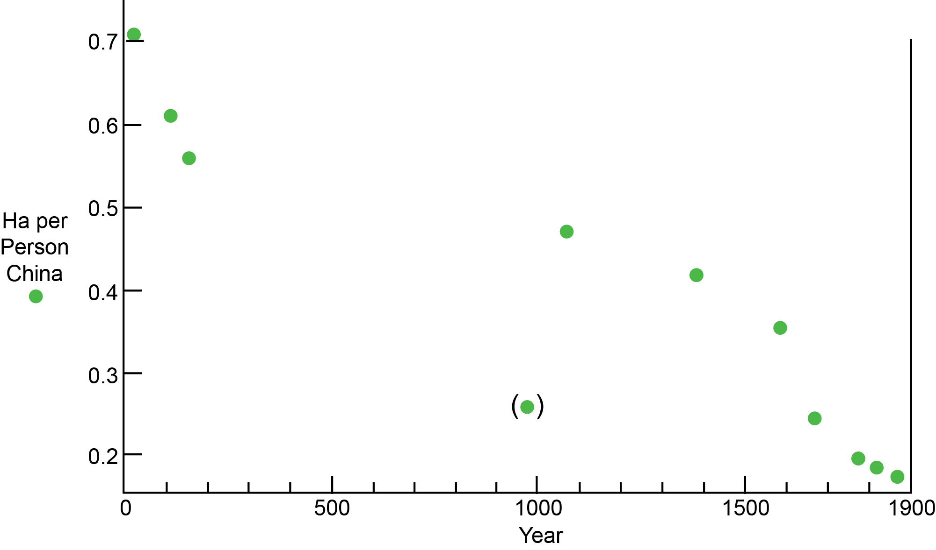
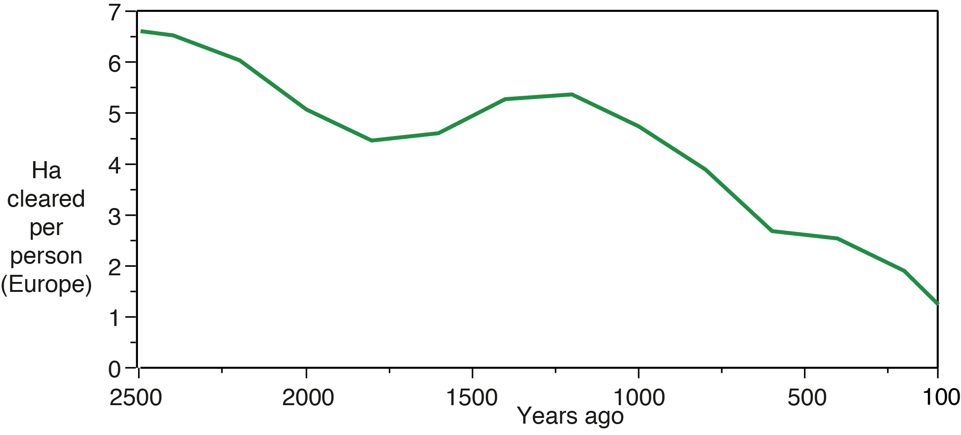
Notes:
Historical data from China support Boserup: Buck (1937), Chao (1986), Ellis & Wang (1997)
Also results in Europe from Mather (1990’s-2000’s), recompiled by Kaplan (2009/10)
Per-capita land use (cultivation, forest clearance) was ~4x larger 2000 years ago
And likely to have been higher still before 2000 years ago
Famers NOT dull-witted slugs; they learned to produce more food per ha over 7000 years!

Slide 17
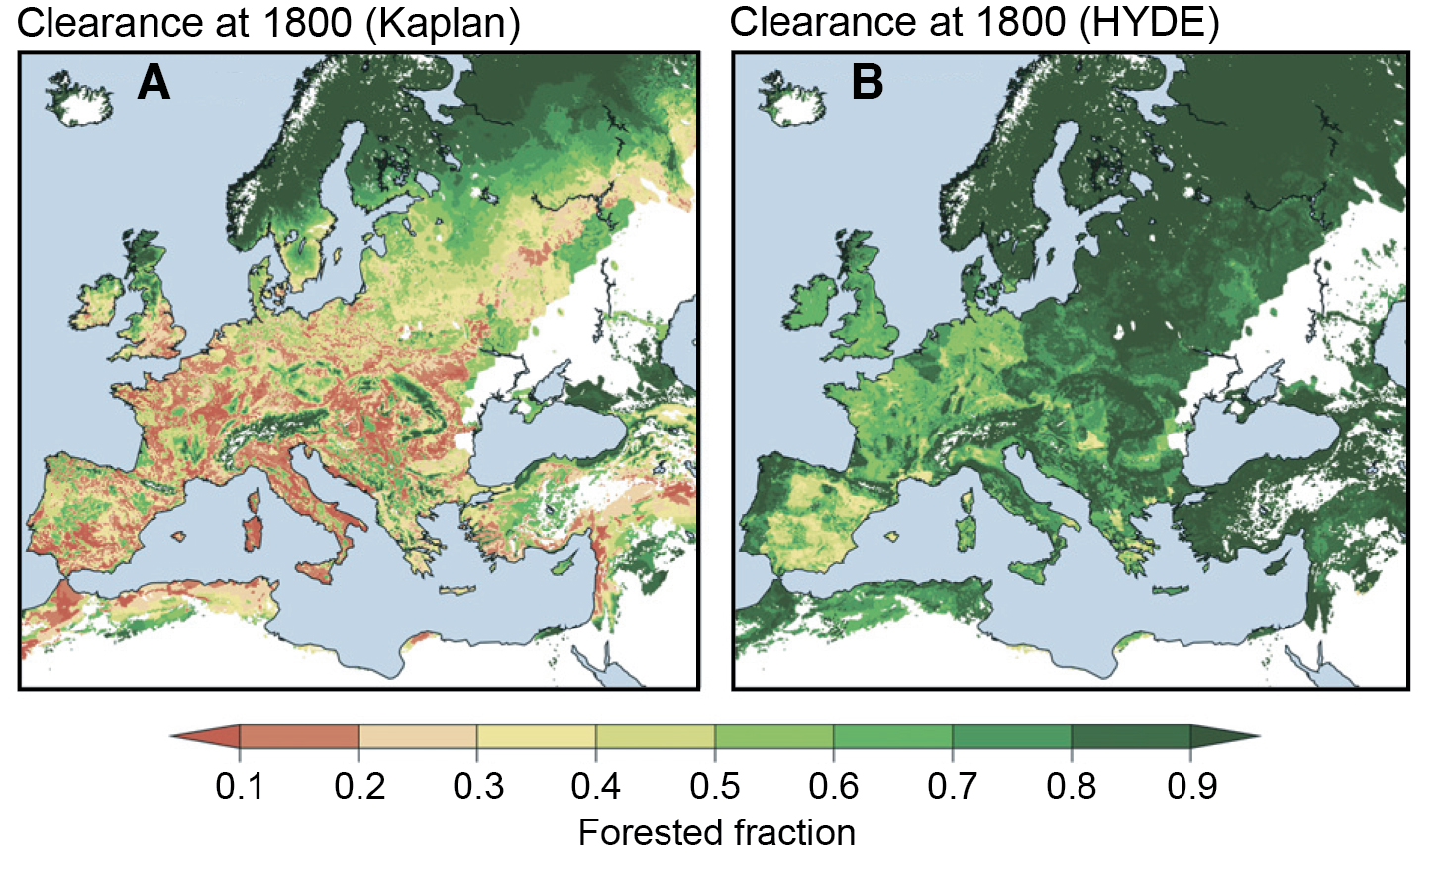
Notes:
Assumptions about per-capita clearance history have major consequences
HYDE-based simulation (~constant per-cap): Europe still 60-70% forested in 1800
But then REforested after 1800? So Europe was never deforested? Logical bind!
Compare to Kaplan 2010: greater earlier per-cap land use based on historical evidence:
Europe was mostly deforested before 1800, then partilly reforested (makes sense)

Slide 18
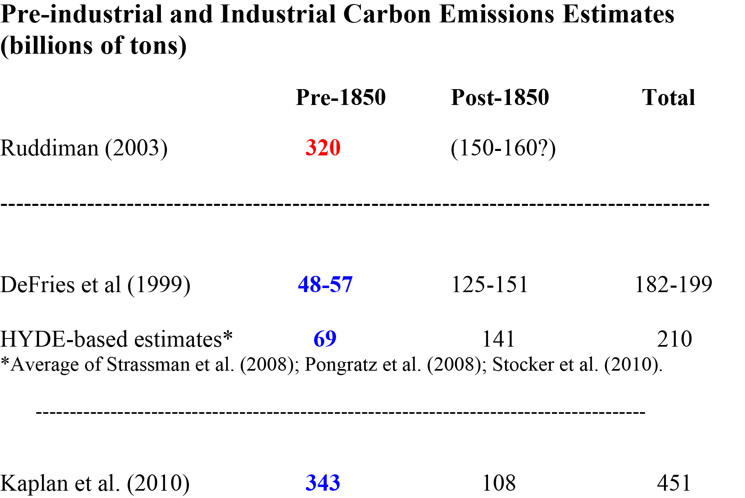
Notes:
Quick summary: Carbon emissions from clearance: pre-industrial versus industrial
300-320 GtC estimate from Ruddiman 2003 cited earlier
Hyde-based estimates (assuming constant per-cap): 60-80 GtC: 4-5 ppm CO2
Kaplan (2010; available historical data): 340 GtC = 24 ppm CO2 (at equilibrium)

Slide 19
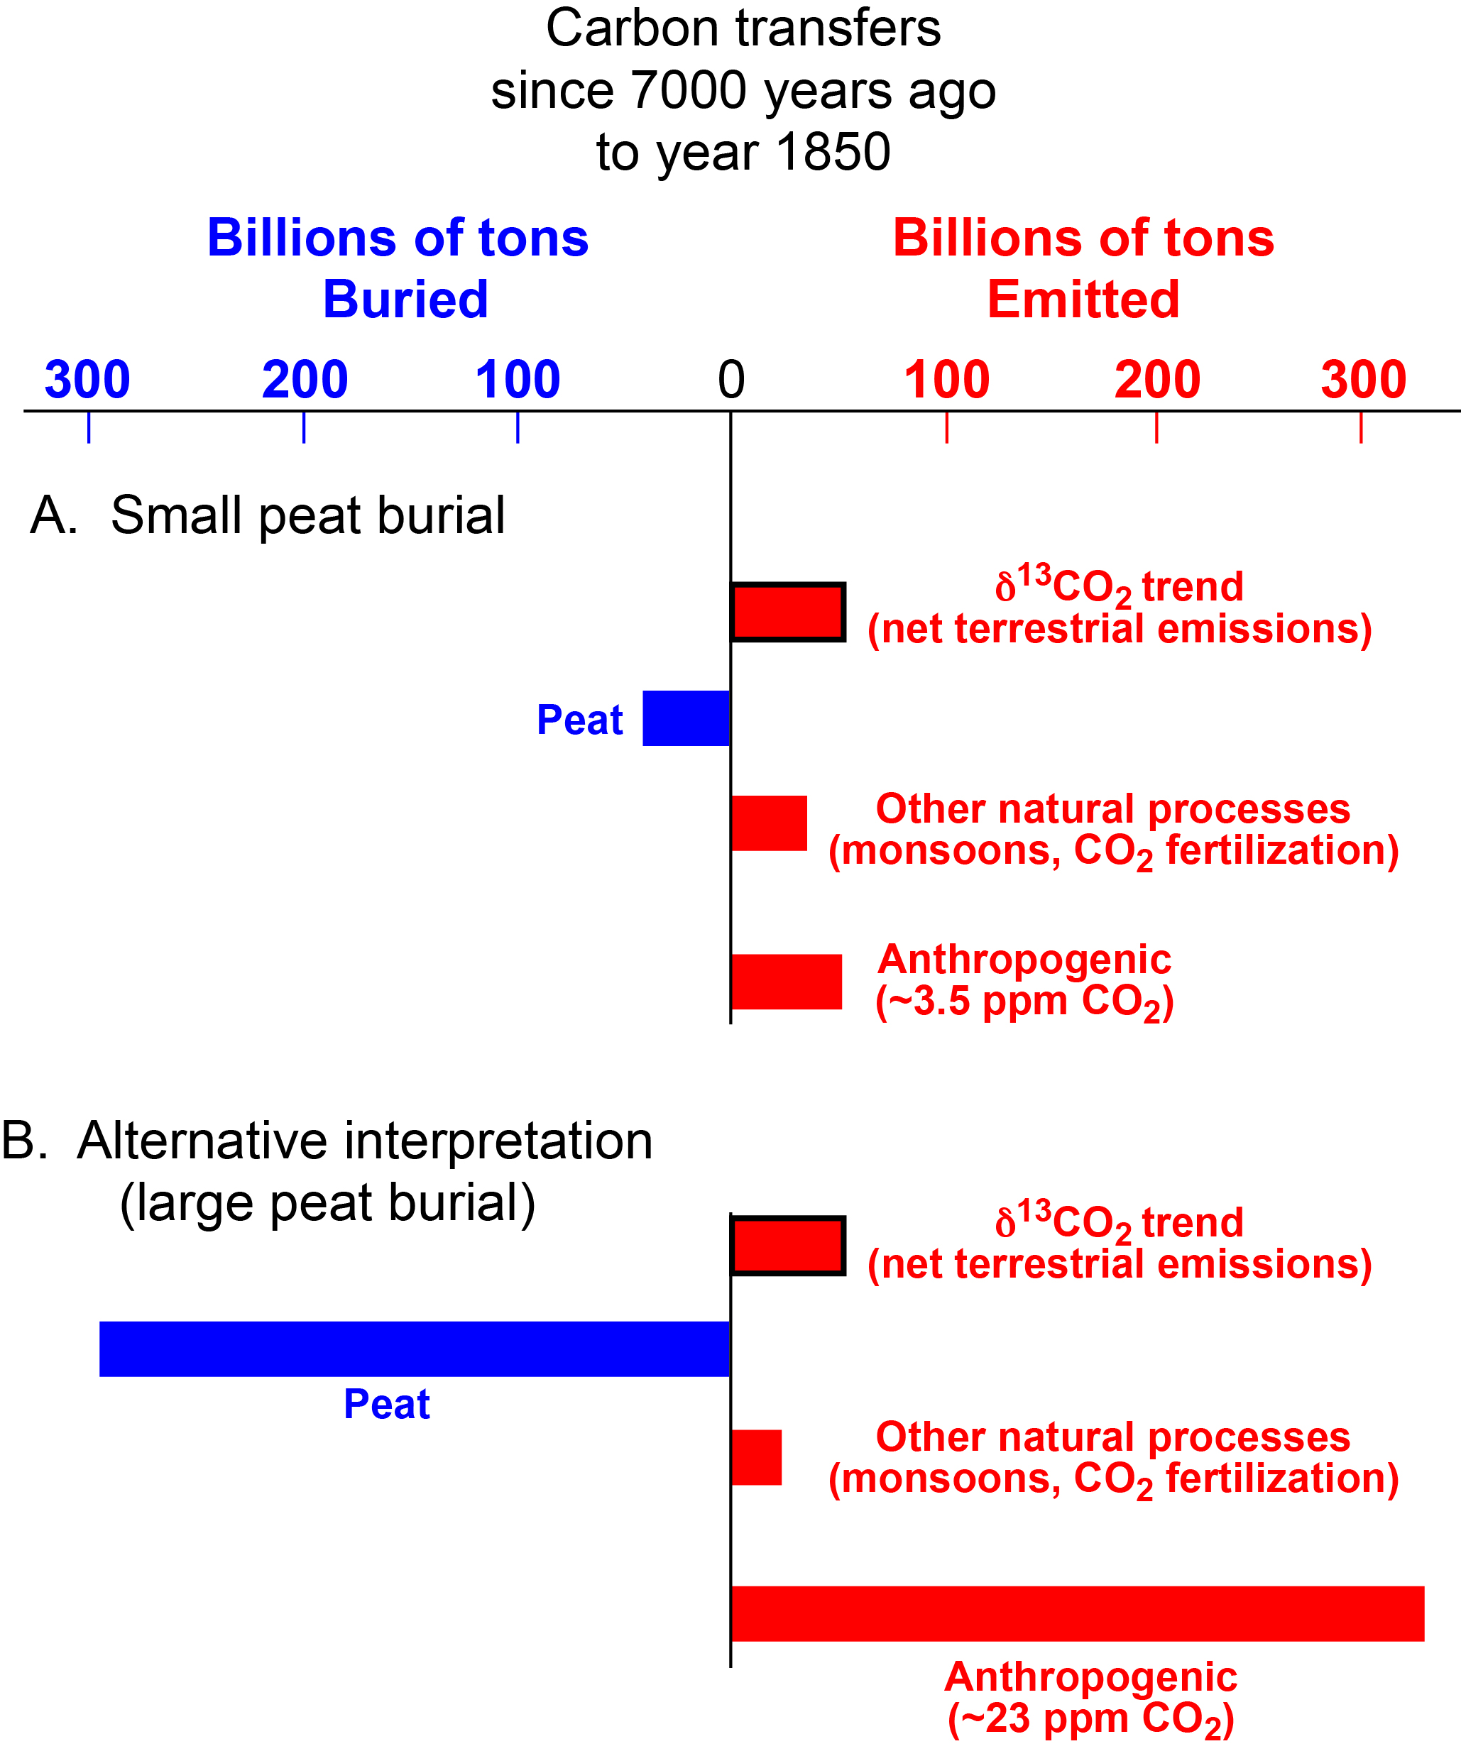
Notes:
Influential challenge from Bern group (Elsig & colleagues, 2009) based on d¹³CO2
Small (50 Gt) net terrestrial C release = 3-4 ppm CO2 (similar to earlier land-use estimates)
But Bern estimated Gt peat C burial as 40 Gt; in my opinion, unjustifiably low
More realistic estimates (Evil Gorham, Zicheng Yu) suggest 300 Gt or more since 7K
Requires offsetting anthro emissions of >300 Gt: close to Kaplans’ 340 GtC

Slide 20
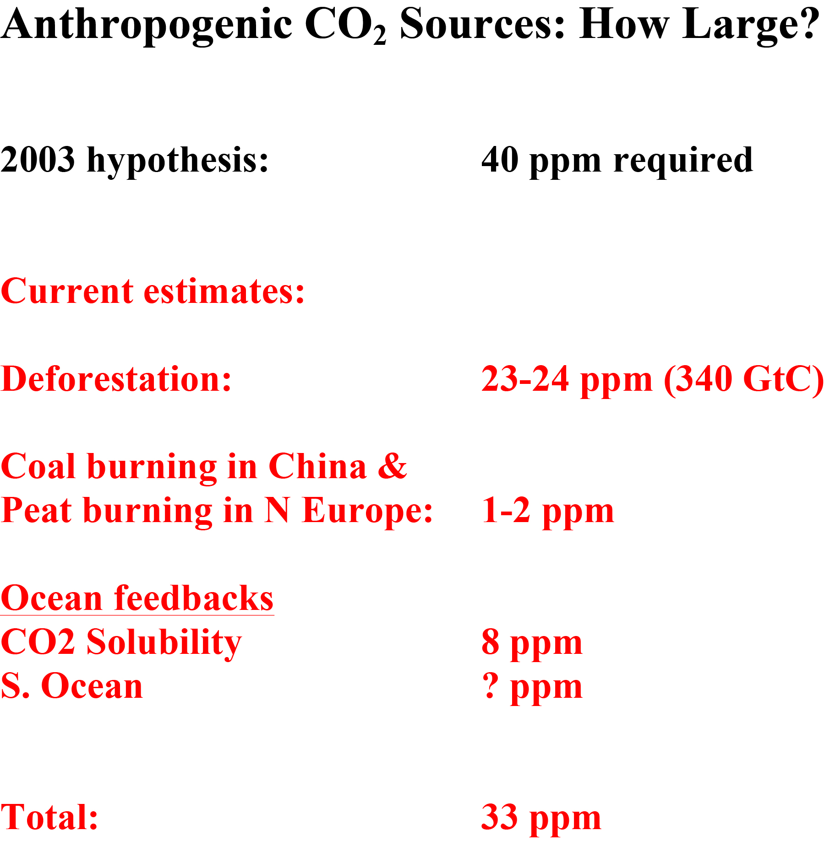
Notes:
Current estimates of pre-industrial CO2 budget: 24-25 ppm direct emissions (vs 40)
Solubility feedback from warmer ocean (Kutzbach et al) adds 8-9 ppm >> 33 ppm total
Feedbacks from S. Ocean another possibility; will be tested when models are ready
So: EAH meeting challenges well, but much work on sources/sinks remains (soil C)

Slide 21
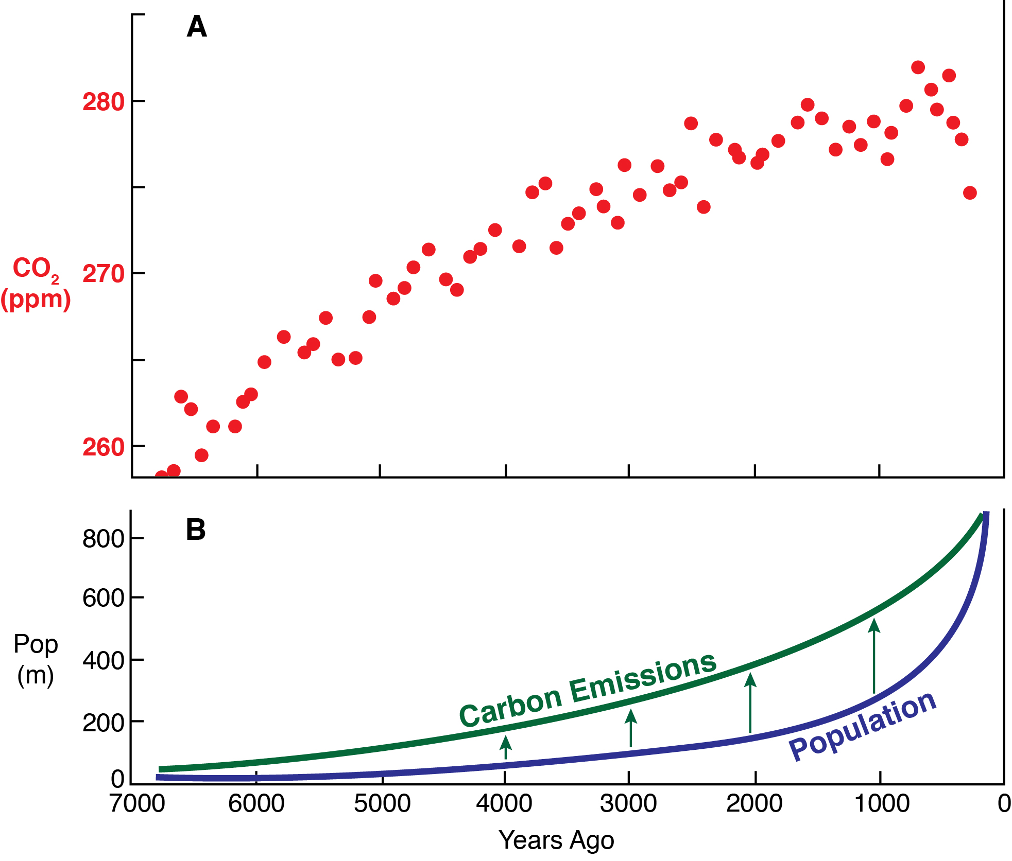
Notes:
Major remaining issues with the Early Anthropogenic Hypothesis
CO2 rise occurs much earlier than the geometric population model
Higher early per-capita land use boosts C emissions above population curve
& toward the CO2 trend
But the CO2 rise is still too early. Why the mismatch?

Slide 22
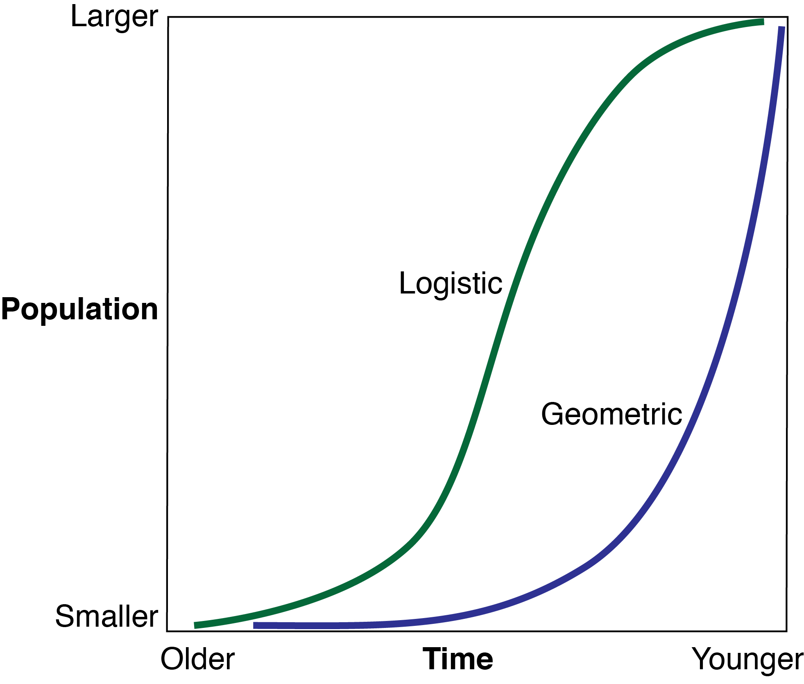
Notes:
Geometric pop curves assume constant fractional pop growth 7-2K (then historical data)
Implicitly requires constant global environmental favorability for all that time
But: logistic (sigmoidal) curves (often used by ecologists) assume faster early growth:
Early resources are unlimited (e.g. richest soils), but then become limited
Pandemics also come into play as population checks (more on that shortly)

Slide 23
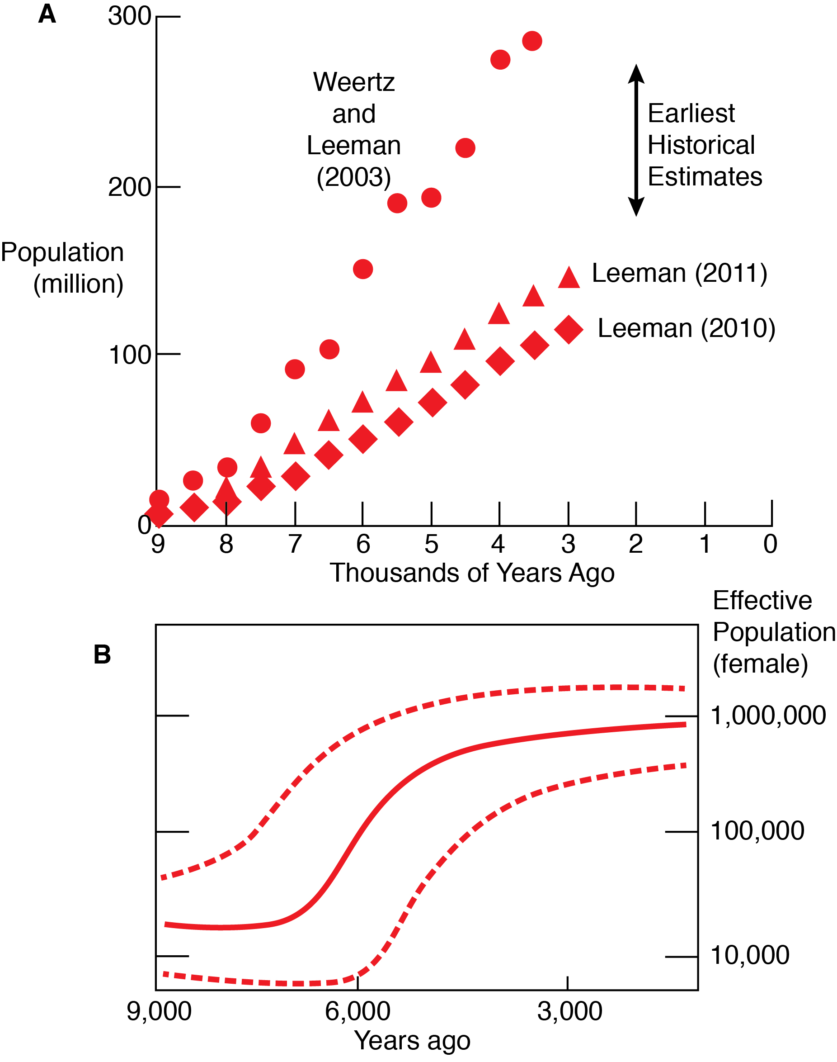
Notes:
Several population reconstructions suggest faster early growth (Carsten Leeman)
Also DNA methods are now being applied to the problem (note log scale)
DNA mutation rates in female population are proportional to rate of pop increase
Fastest growth rates among earliest farming populations: Europe (also Asia, Africa)
True pop trend still uncertain, but faster earlier growth could explain early CO2 rise

Slide 24
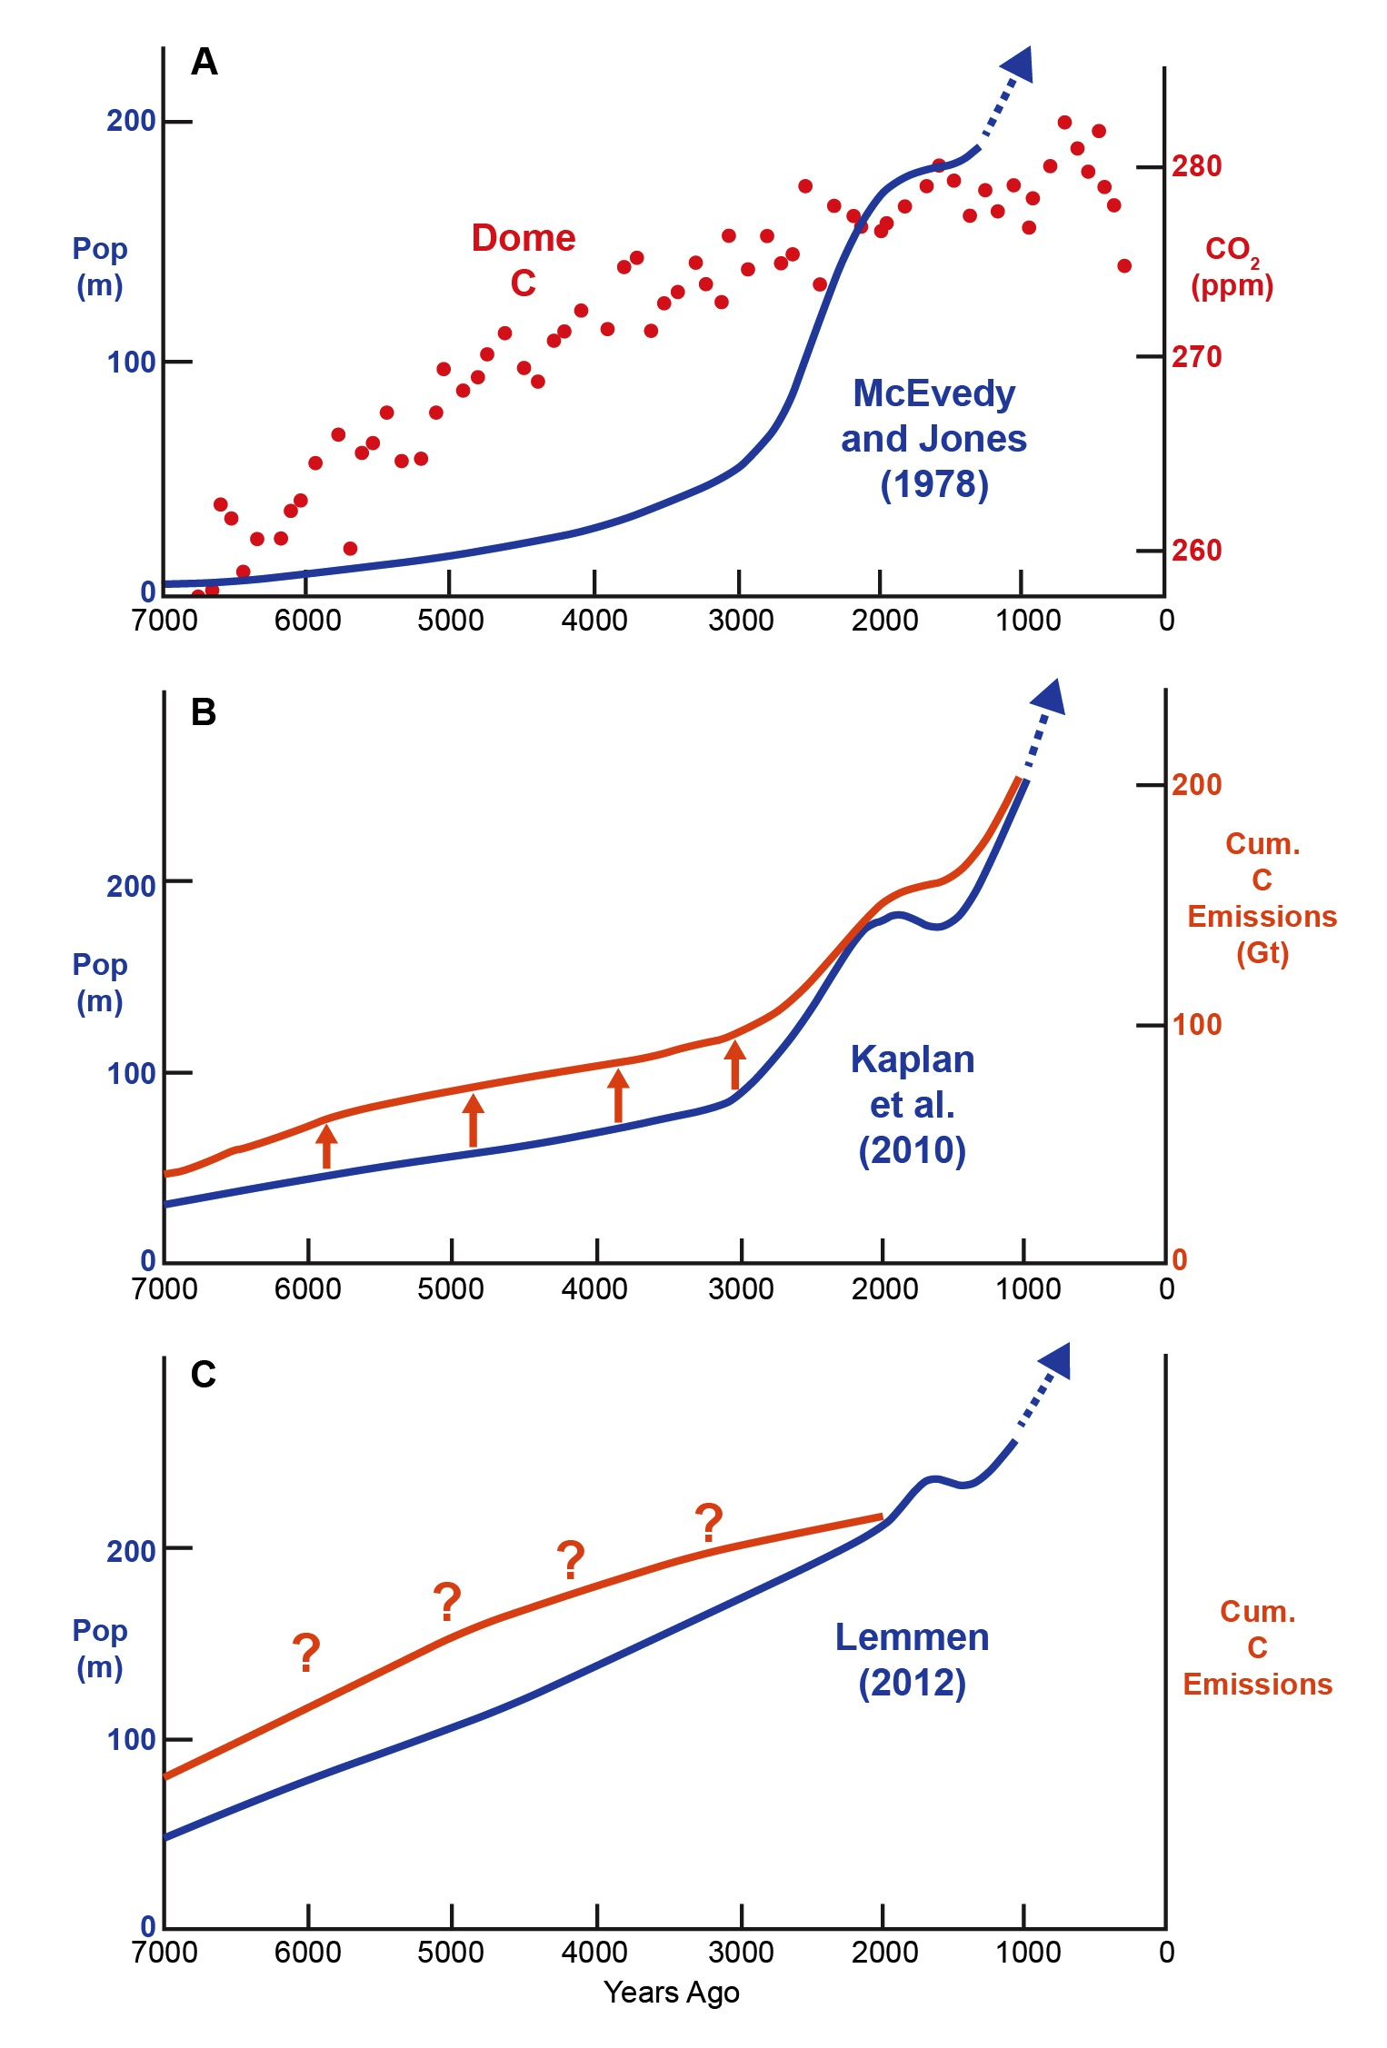
Notes:
Evolving answer to the apparent mismatch
Note: Cum C emissions need to be converted to CO2 trend

Slide 25
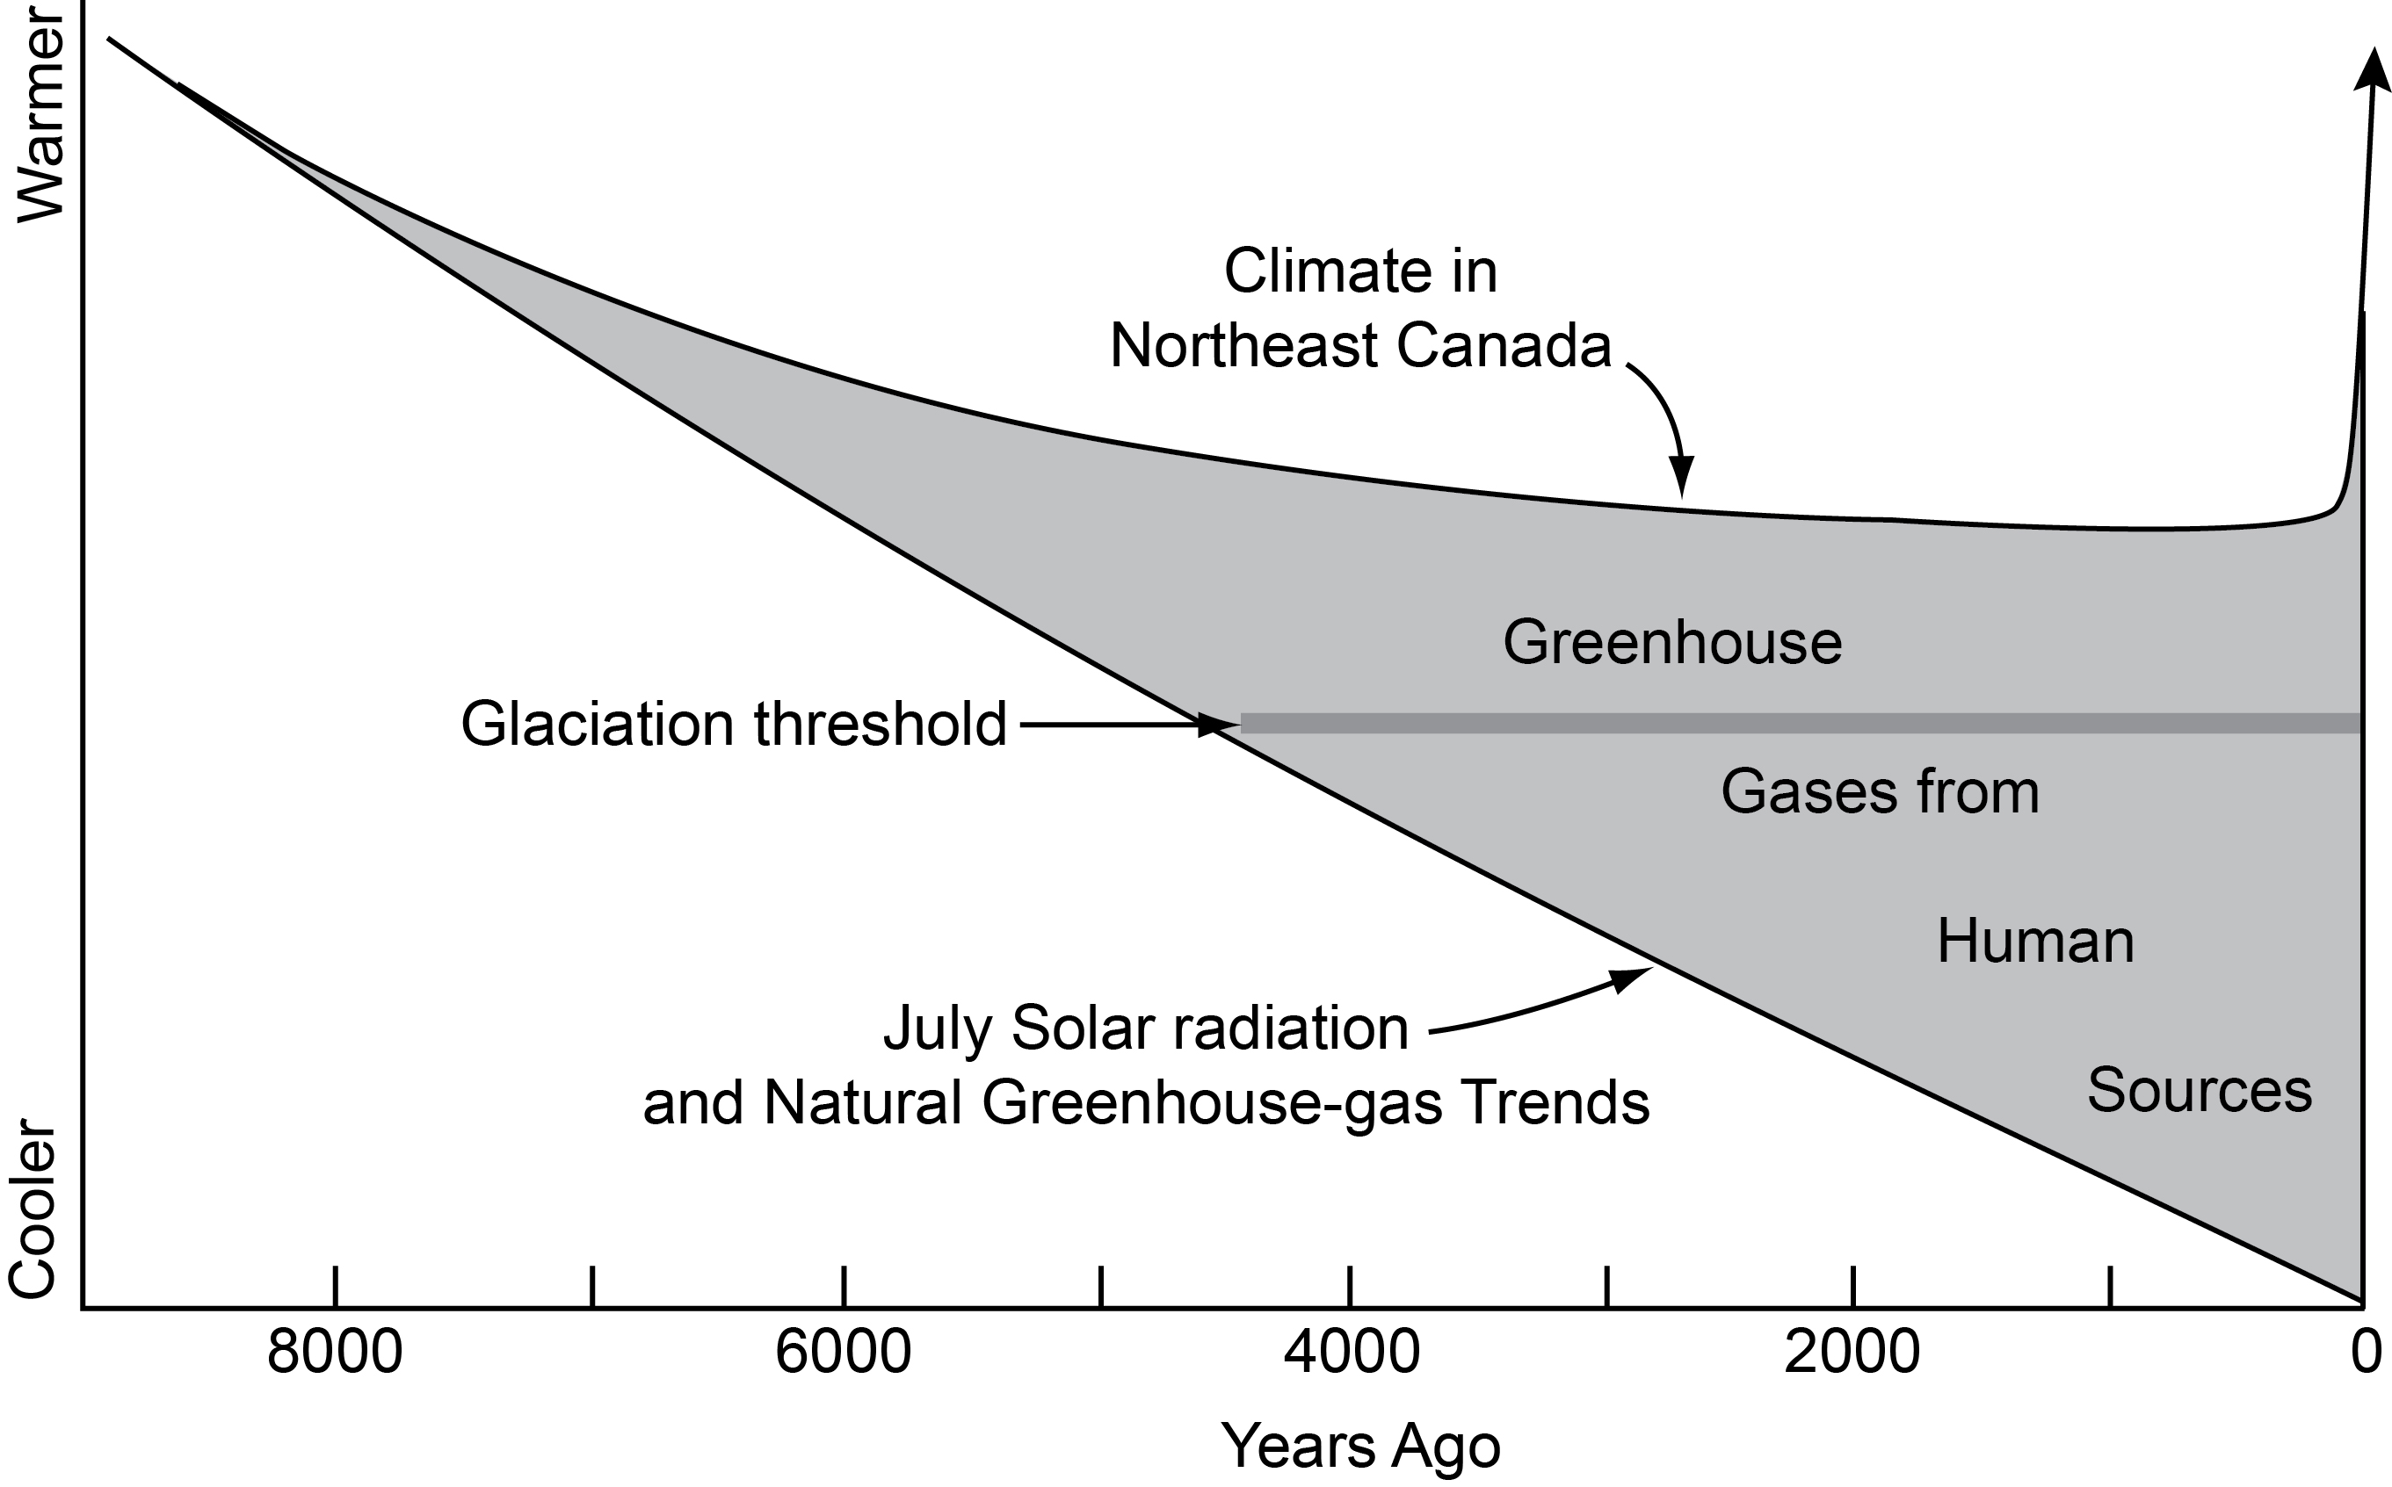
Notes:
Cartoon: ‘observed’ Holocene Northern Hem temp vs proposed no-anthro trend
In 2003 I proposed that a new glaciation would have begun in the late Holocene
But GHG emissions kept temperature from falling below the glaciation threshold
Without those emissions, small glaciations would be underway now
This was a crude first attempt; my 5K glacial inception guess was too early

Slide 26
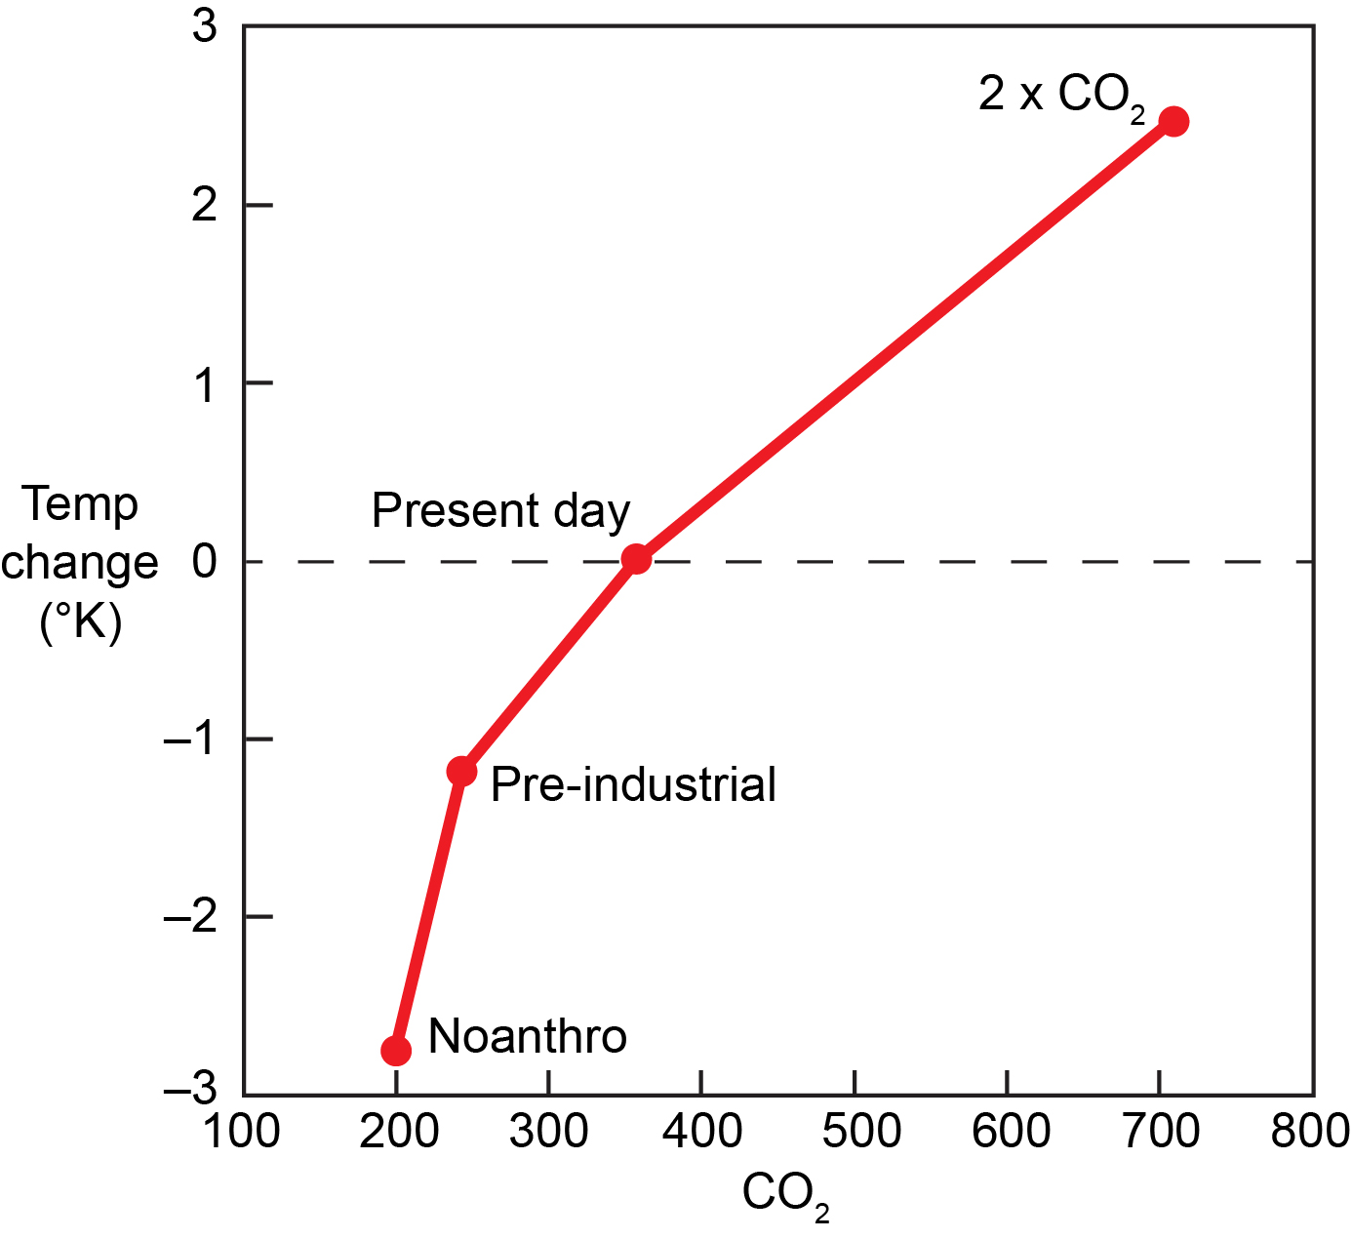
Notes:
Kutzbach et al (2013): well-known (Manabe) non-linear temp trend vs CO2
Larger cooling per ppm CO2 drop for CO2 concentrations below 300 ppm
Proposed pre-industrial GHG changes were smaller than industrial-era
But the pre-industrial warming effect was larger: at least 1.0ºC vs 0.85ºC
Industrial aerosols cancel some recent warming; slow ocean response delays it

Slide 27
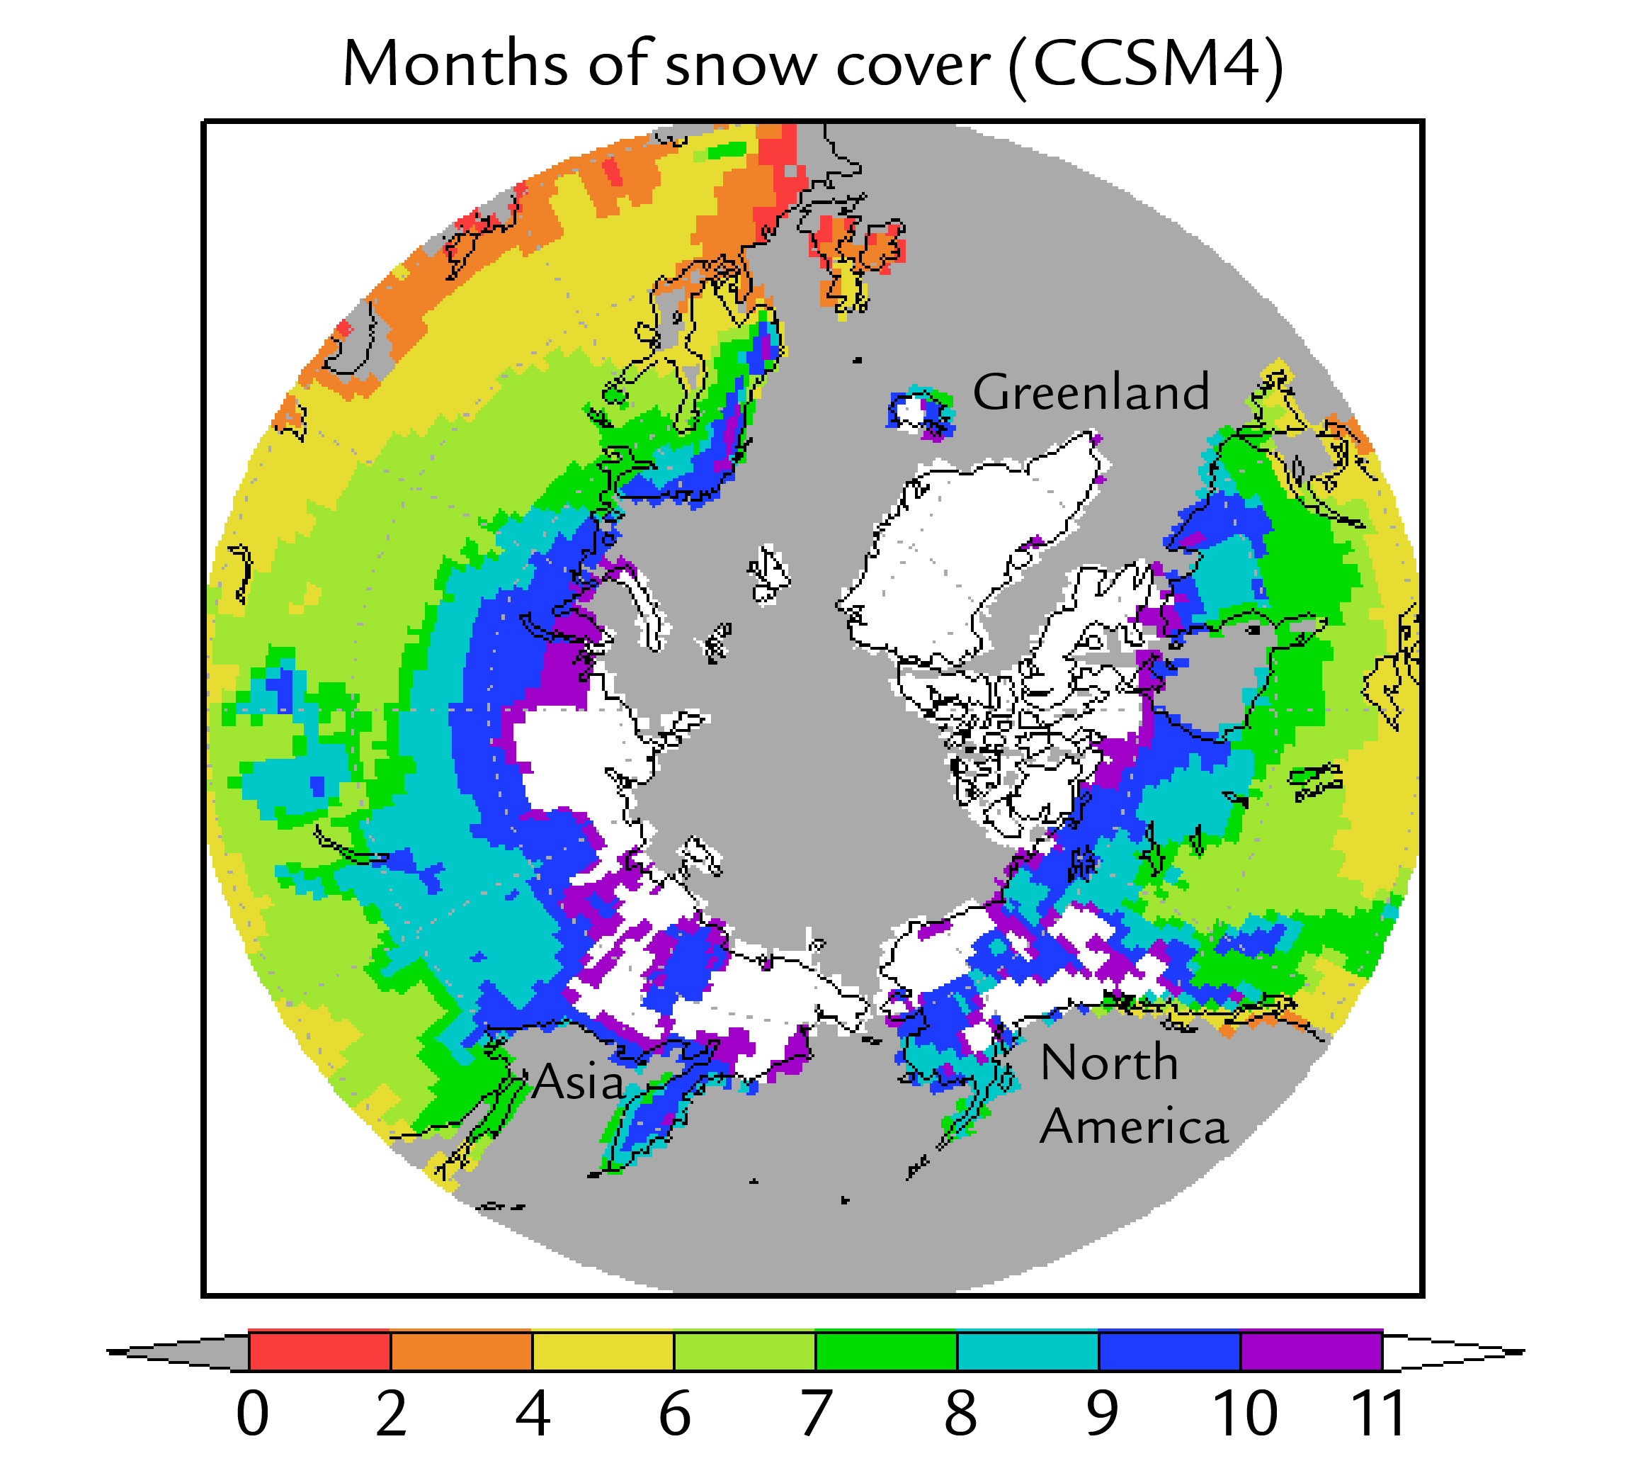
Notes:
Without (measured) industrial GHG’s or (proposed) pre-industrial GHG’s,
CCSM4 simulation of 12-month snow cover; equivalent to glacial inception
Incipient glaciation in Northern Rockies, Canadian Arctic, Eastern Siberia, etc
Conclusion: If GHG levels had dropped as proposed in the original EAH
Small glaciations would be underway today
(some thought I meant major glaciation, but I did not say that)

Slide 28
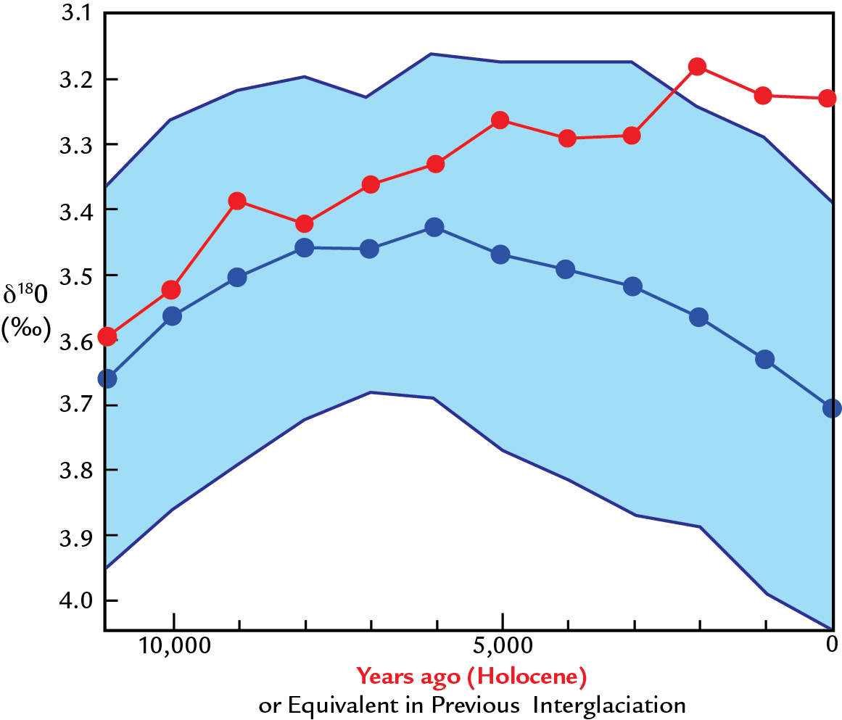
Notes:
Another way to come at this overdue glaciation issue:
Lisiecki-Raymo: Holocene O18 versus previous IG
Same wrong-way trend (after 6K) and escape from envelope as GHG's

Slide 29
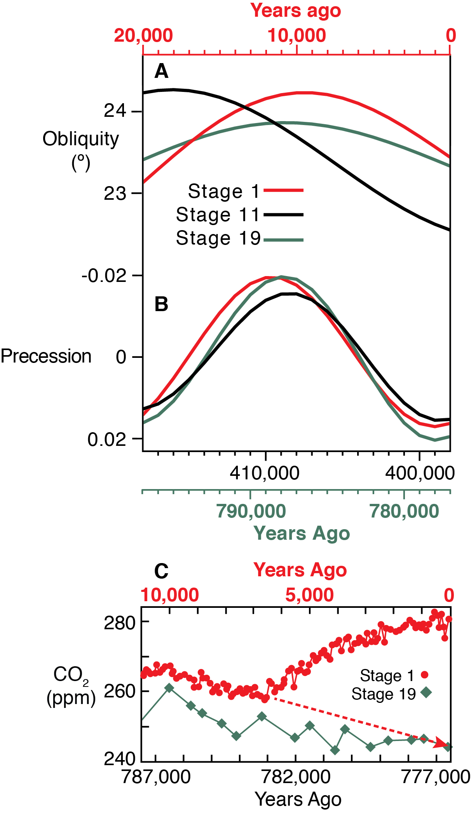
Notes:
Stage 19 is the best analog to Stage 1
Note relative position of P, T disqualifies Stage 11 as analog
Also note very close analog of P, T, 'no-anthro CO2 at 0K (777K)

Slide 30
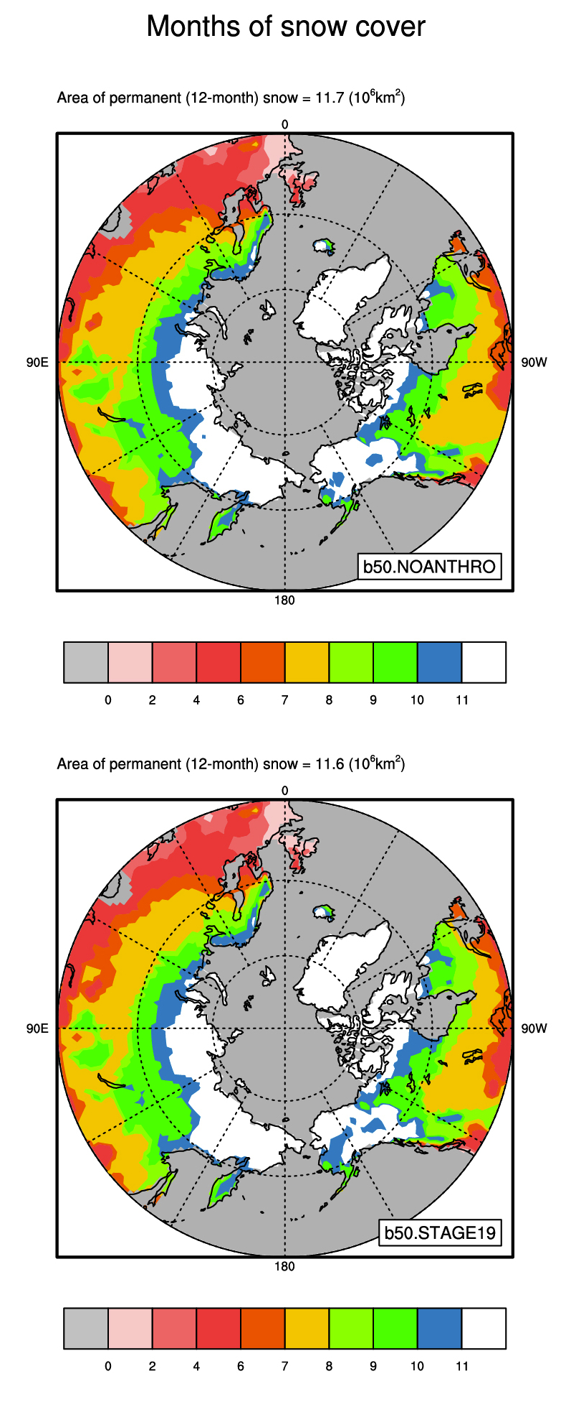
Notes:
Stage 19 simulated snowcover nearly identical to no-anthro case
Real-world support for hypothesized overdue glaciation

Slide 31
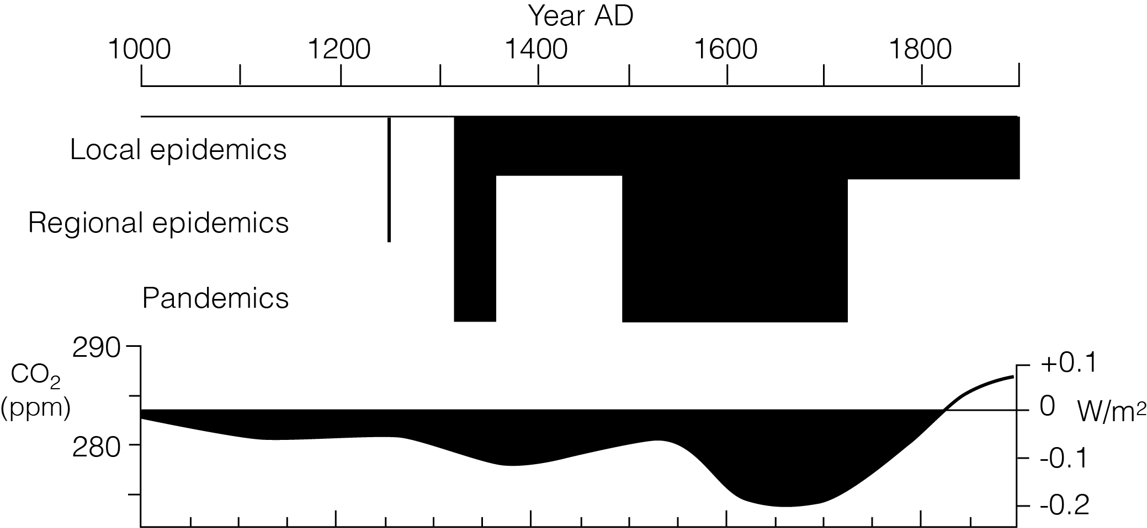
Notes:
Is there a link between CO2 drops and population catastrophes (pandemics, strife)?
In 2003: I suggested a link: caused by C sequestration in regrowing forests
But ice-core records were poorly dated (the Taylor Dome time scale was wrong)
And my understanding of pandemics and warfare history was incomplete
***

Slide 32
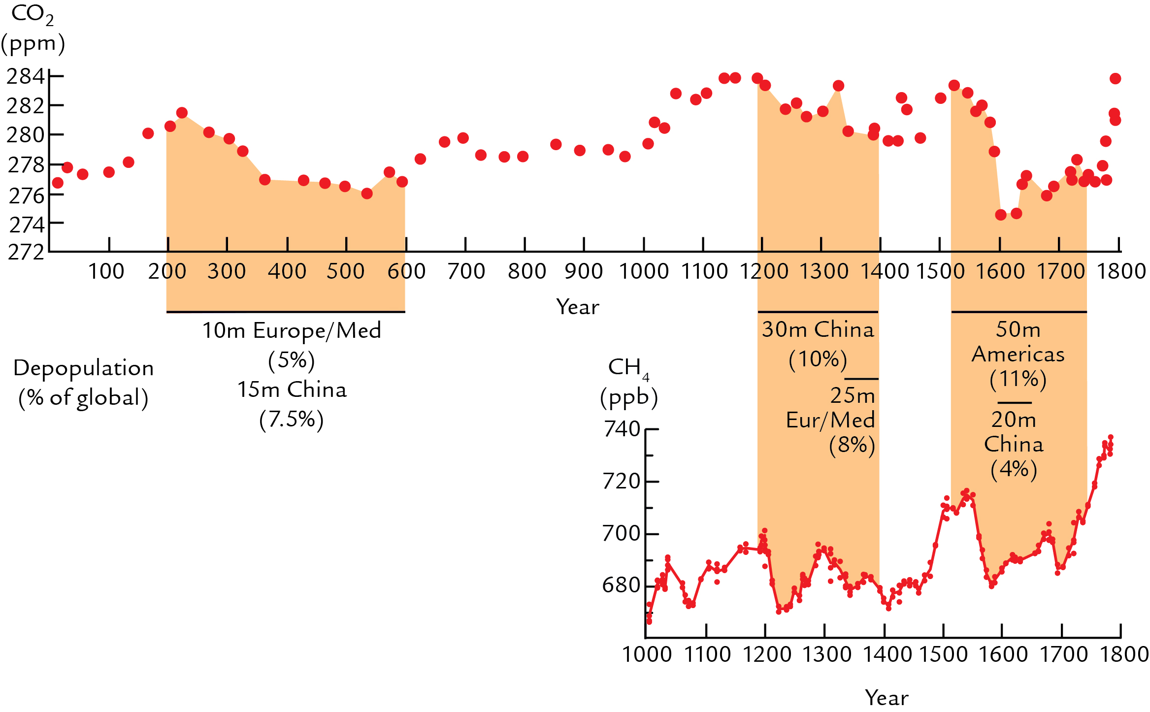
Notes:
Now: high-resolution CO2 & CH4 from Law Dome: Etheridge, McFarling-Meure
Also: a full history of ‘depopulation episodes’: match is pretty good
CO2 drops could have been caused by C sequestration due to forest regrowth
CH4 drops caused by destruction of irrigation infrastructure; starvation of livestock
American pandemic (1525 to early 1600’s) was the worst: 50 million net deaths

Slide 33
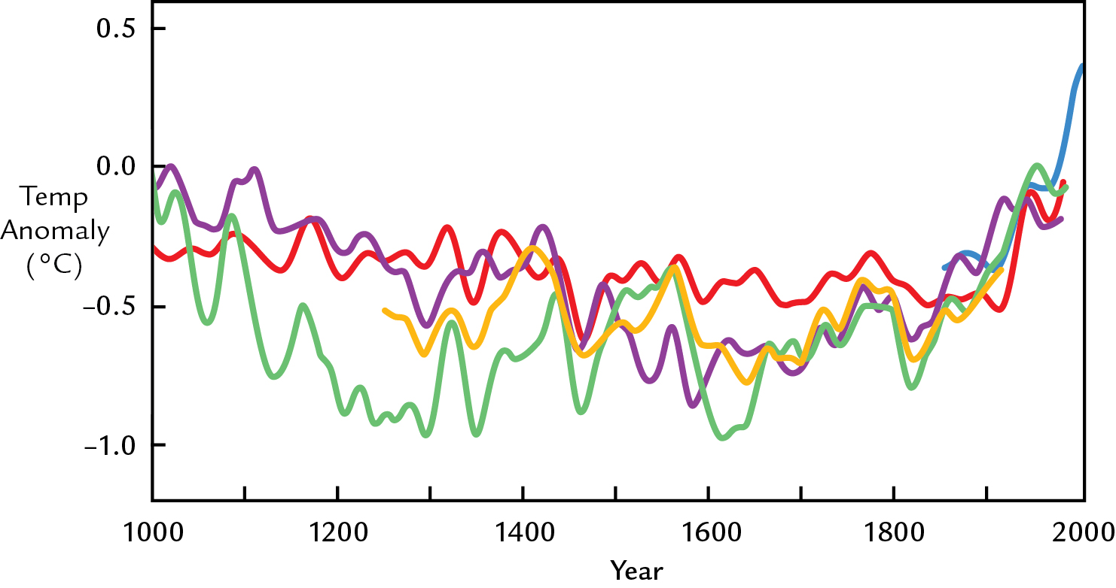
Notes:
Most recent papers on CH4 drops have favored anthro over climatic explanations
But most papers on the CO2 drops have invoked natural cause: cooling
Here are several reconstructions of temperature in recent centuries
Look at 1525 to the early-middle 1600’s: the worst phase of the American pandemic
Trends vary but on average indicate a small cooling (~0.17ºC)

Slide 34
Notes:
Ten coupled carbon/climate models estimate CO2 change per ºC temp change
The reconstructed/estimated 0.17ºC cooling can only account for a 1-2 ppm CO2 drop
Only a small part of the 7-10 ppm CO2 drop
This leaves population catastrophes as the primary explanation for this feature

Slide 35
Notes:
So: the EAH has been generally confirmed by 2 major lines of evidence:
(1) ‘Top-down’: Holocene GHG rises anomalous relative to previous IG’s (robust)
(2) ‘Bottom-up’: Archeol/historical evidence supports large early GHG emissions
growth area for more data collection/synthesis and model transformations
To learn more: ‘Earth Transformed’ just published by W.H. Freeman in Oct

Slide 36
Notes:
If EAH-estimated GHG levels are correct, AGW is > twice as large as thought
Not ~0.85C industrial, but more like 1.9C
Overview of mid-late Holocene: Marcott et al 0.7C cooling since 7K
Plus: another 1C cooling prevented by early agricultural GHG emissions
World would now be 1.8C cooler = 40% of full G/IG diff of 4-5C

Slide 38
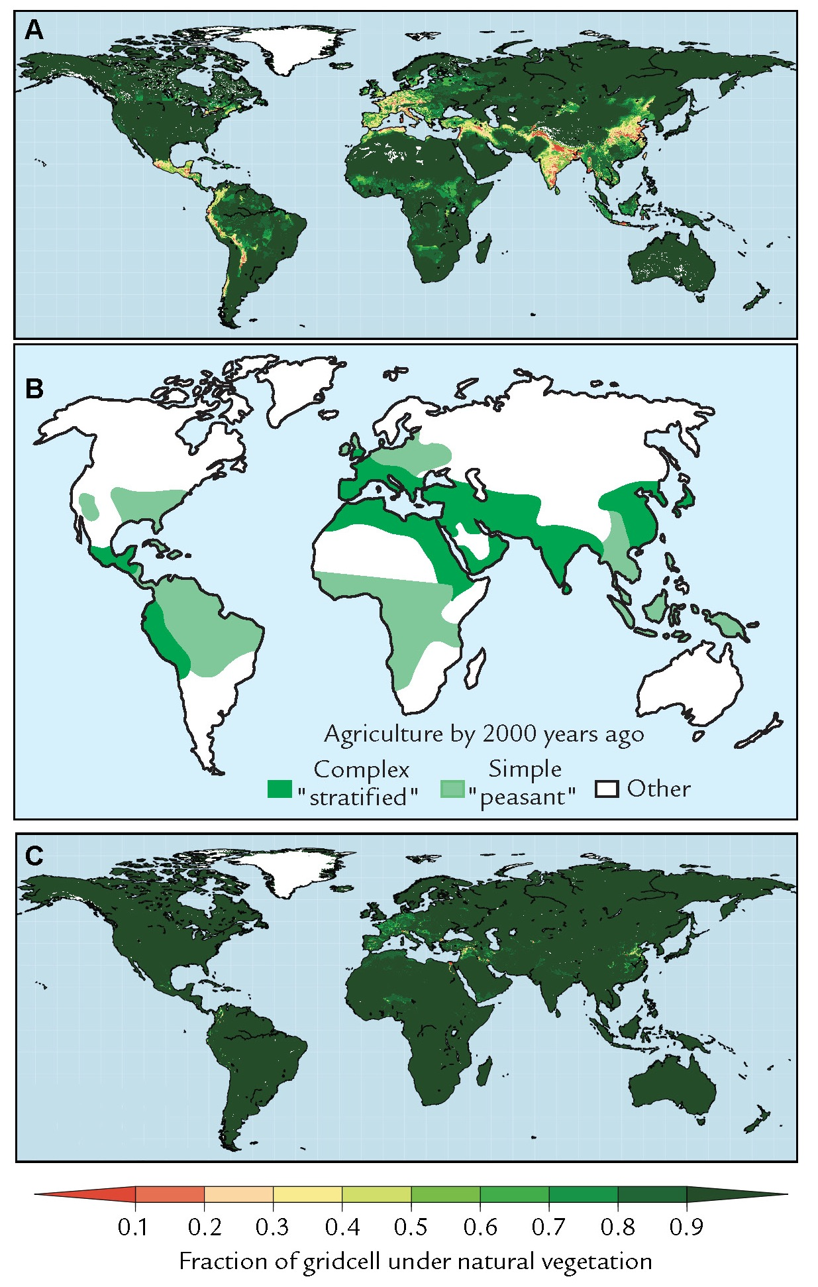

Slide 39
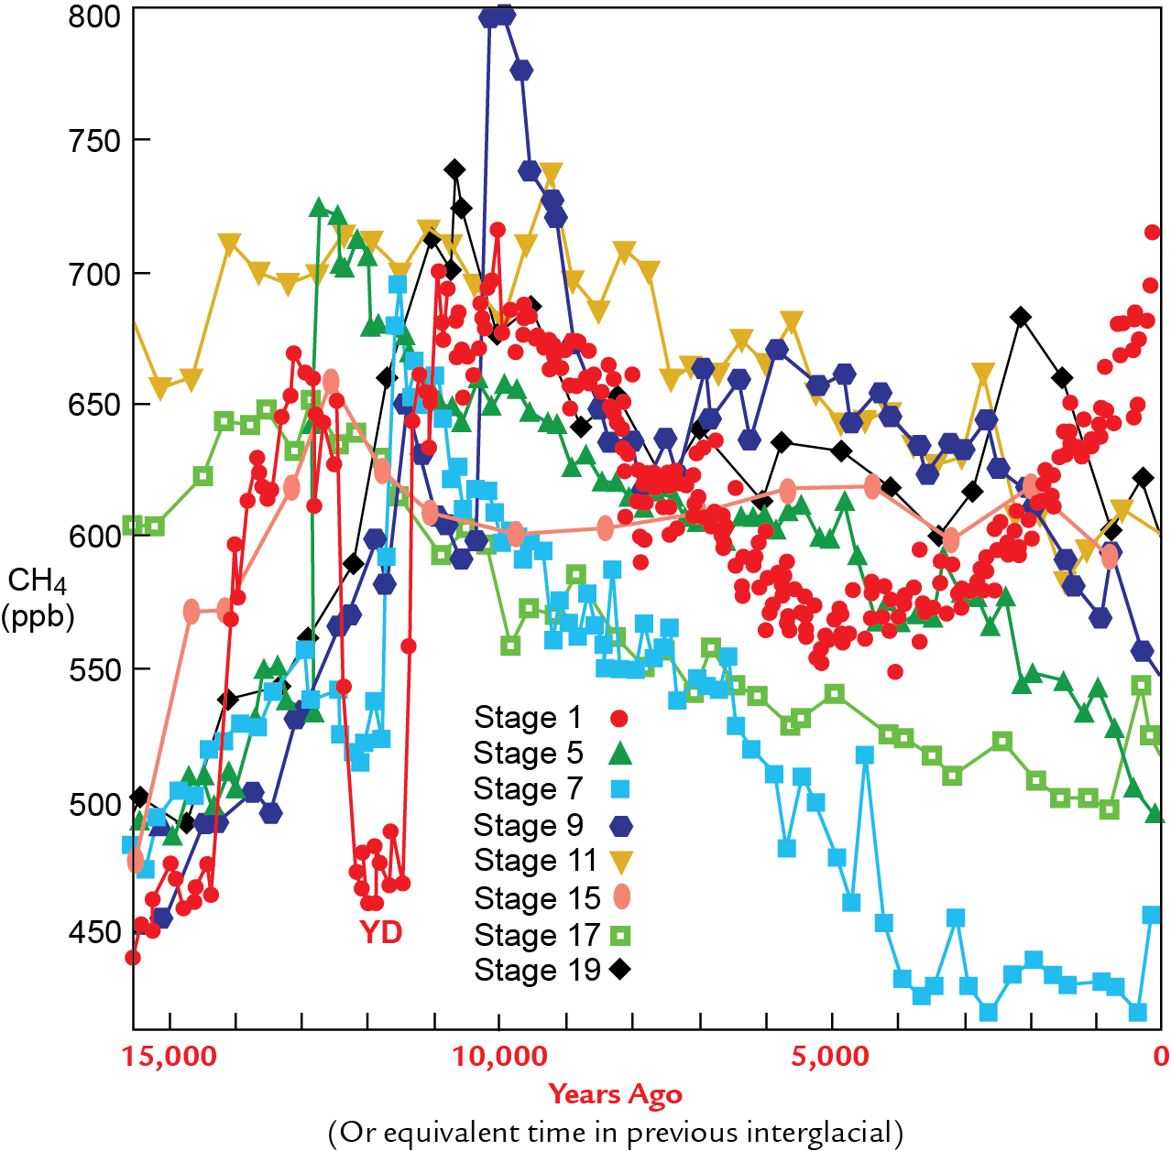

Slide 40
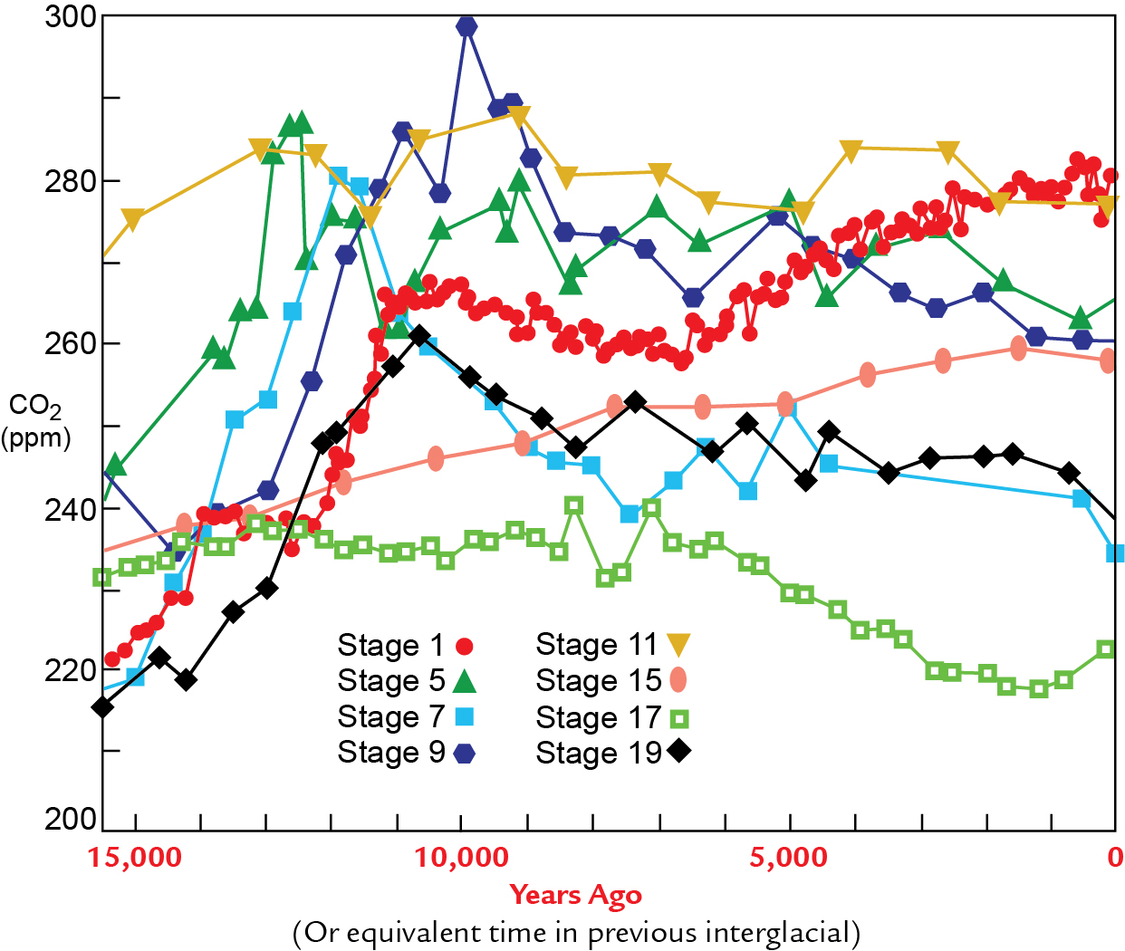

Slide 41
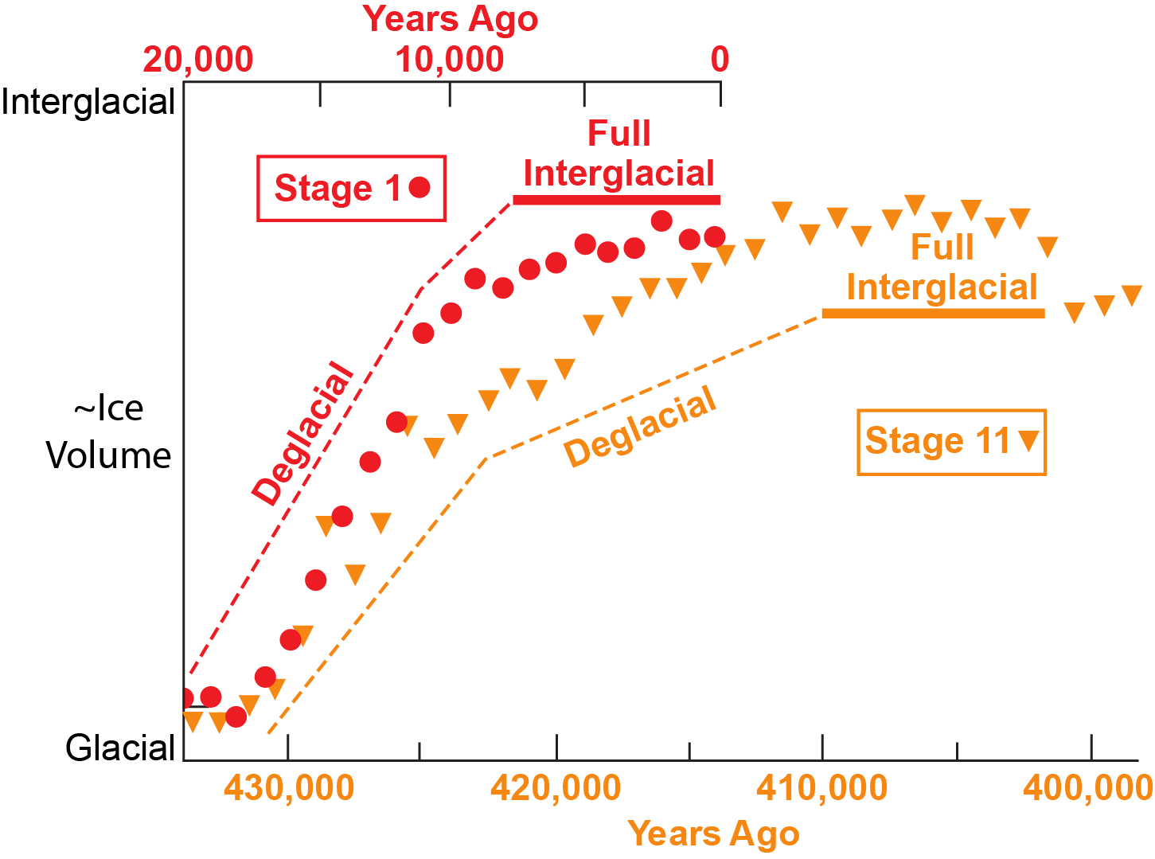

Slide 42
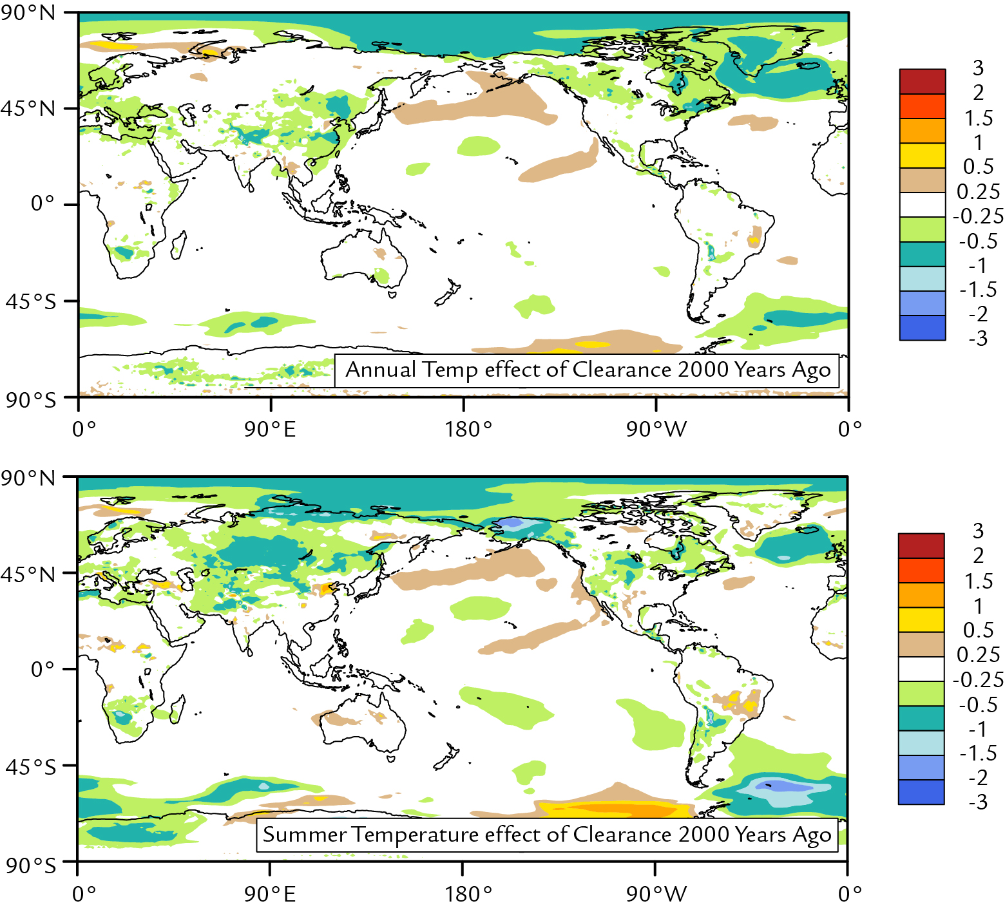

Slide 43
