Slide 1
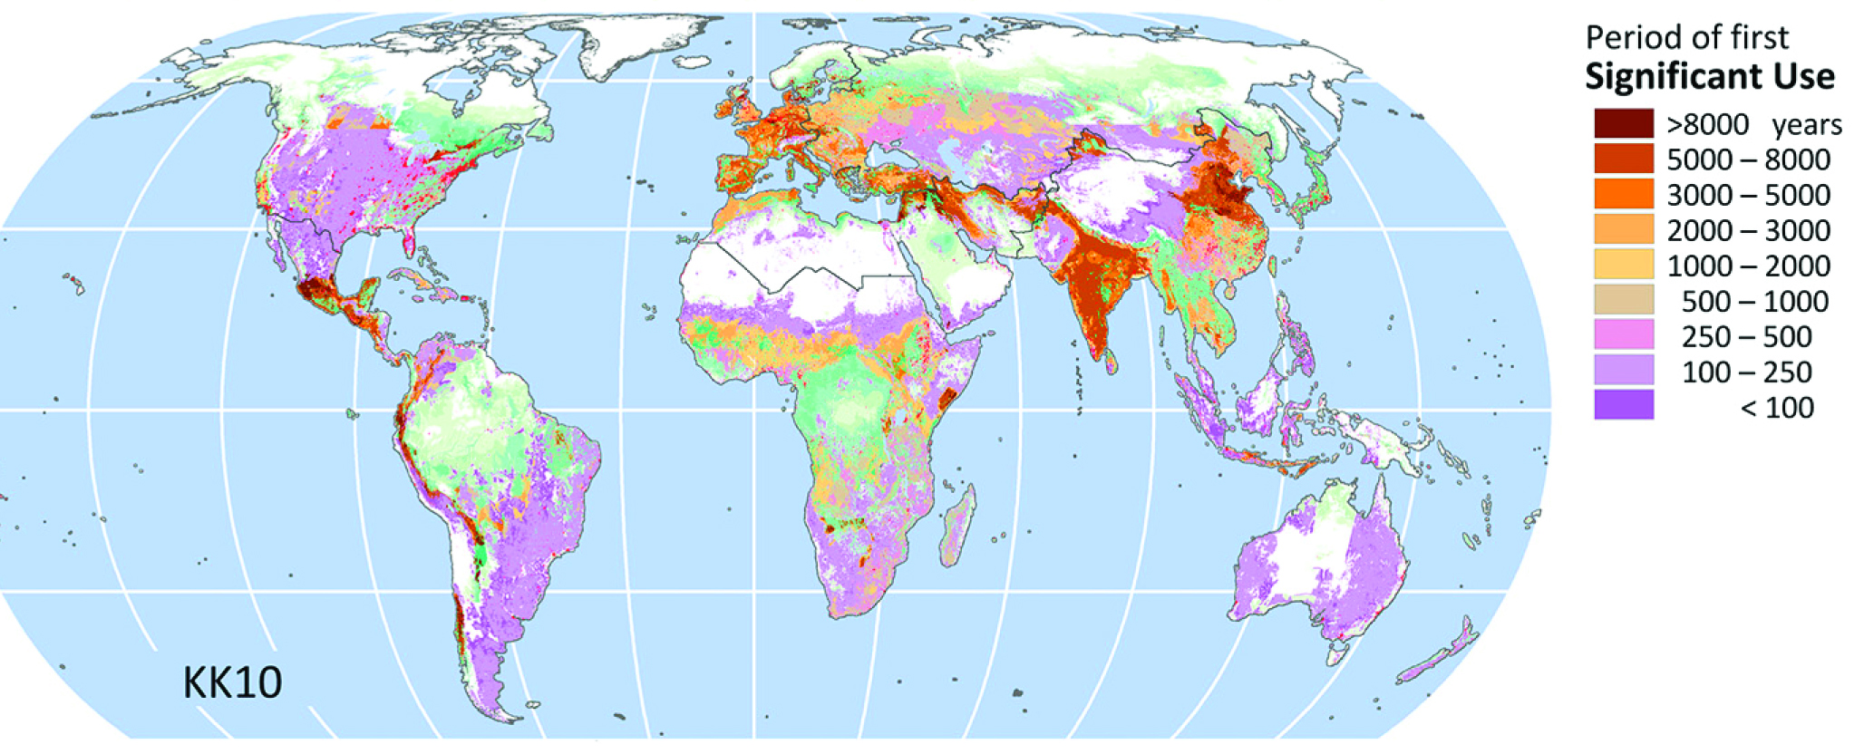
Archaeological approaches to the "Used Planet": the global expansion of agriculture and its methanogenic agriculture component
Professor Dorian Q Fuller
Institute of Archaeology, Univ. College London

Slide 2
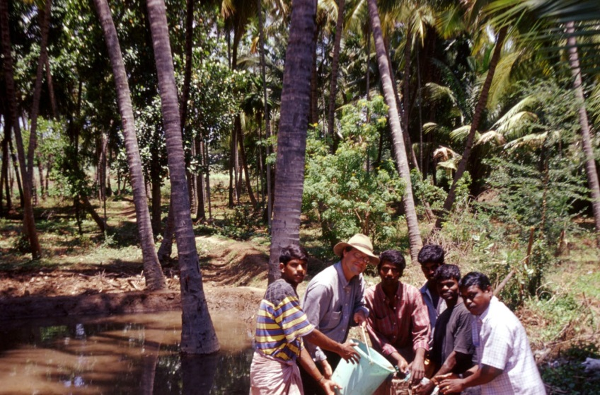
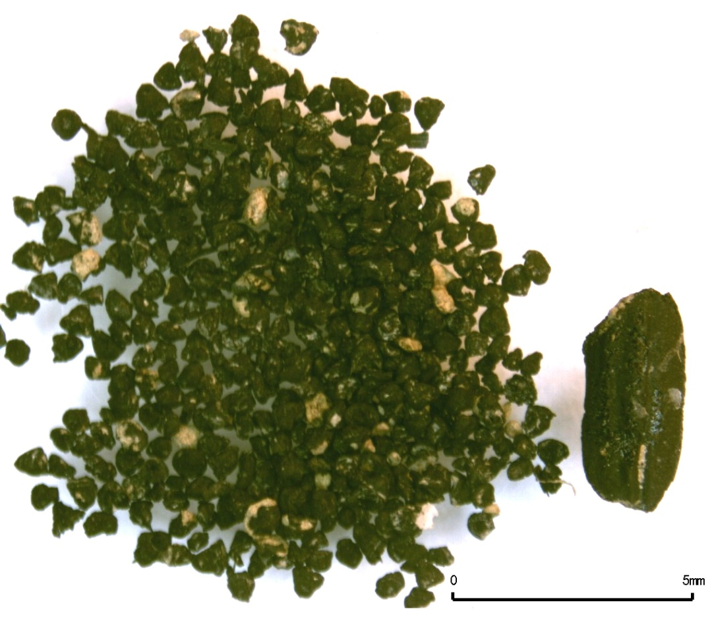
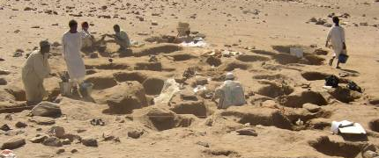
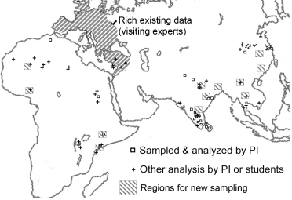
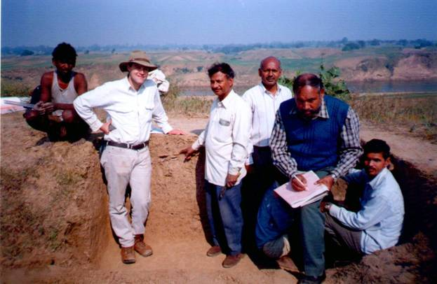
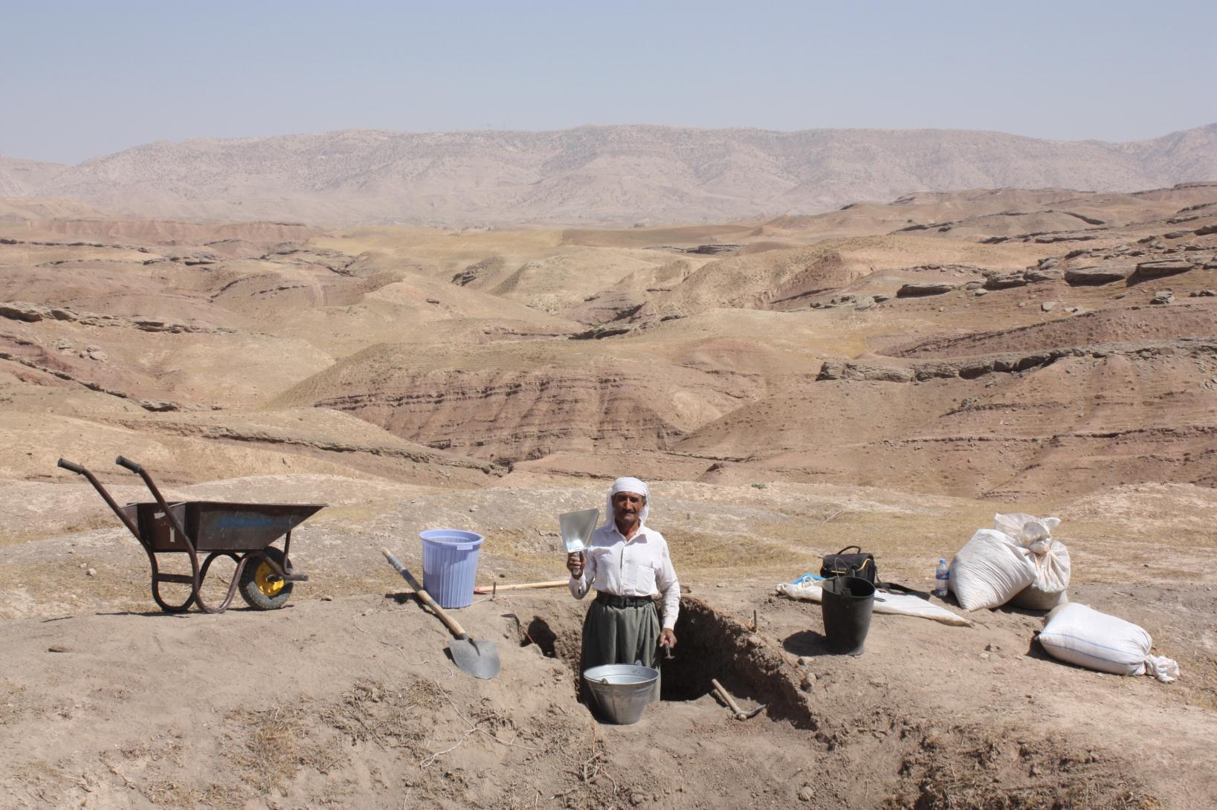
Archaeologist -- archaeobotanist
Directed digs: Sudan,
Iraqi Kurdistan, India
On site
Lab
Umm Melyekta 2004
Koldihwa 2001
NERC
Rice
project
+
+
+
Jarmo 2012
Map for ERC ComPAg project
+
+

Slide 3
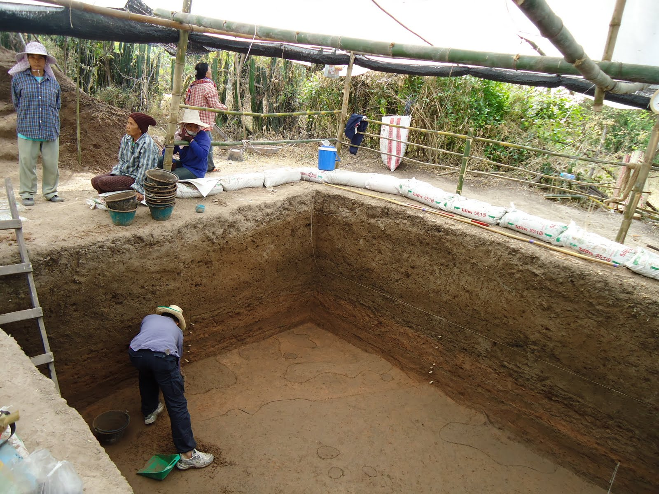
Archaeology = the excavation and study of past site of human activity/ occupation
Archaeobotany = recovery and study of plant remains preserved on those sites
Ban Non Wot, Thailand, Jan. 2011

Slide 4
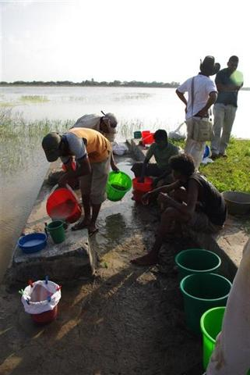
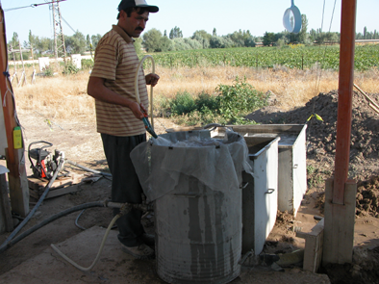
Recovery: FLOTATION of
archaeological sediments
for macro-remains
Manual bucket flotation
Machine
flotation

Slide 5
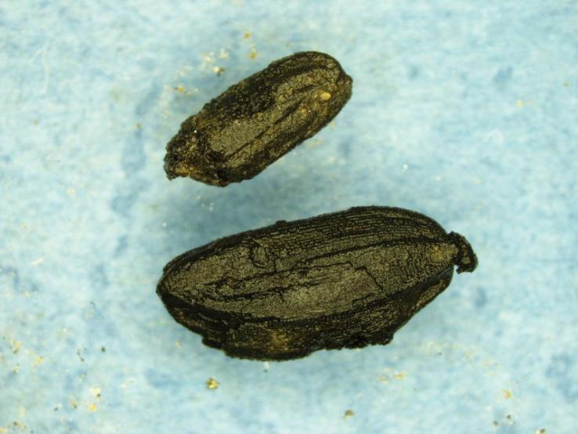
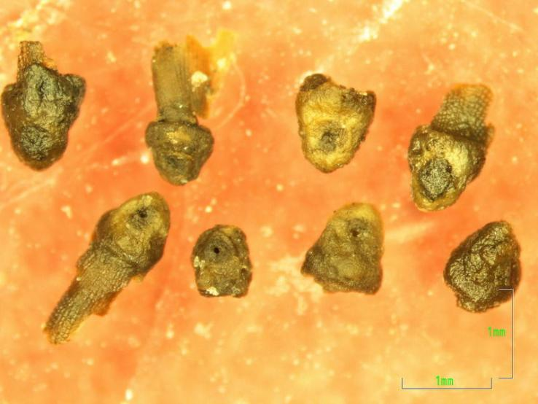
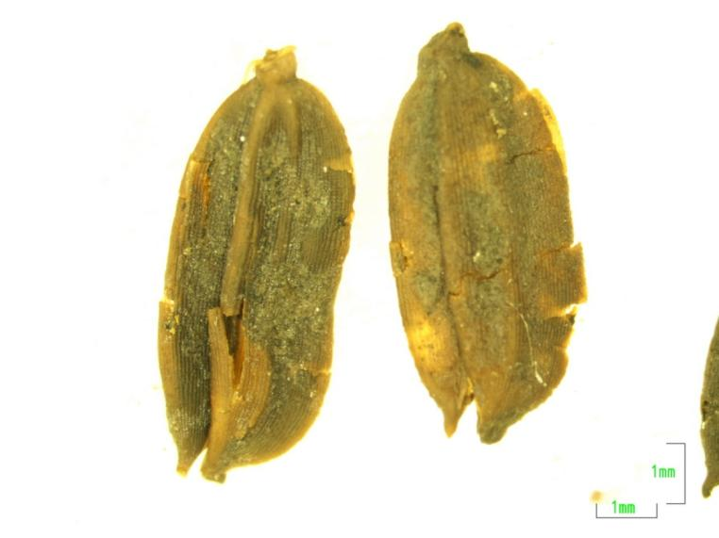
Macro-remains: wood charcoal +
seeds and chaff
Mostly charred
grain
Spikelet bases
waterlogged

Slide 6
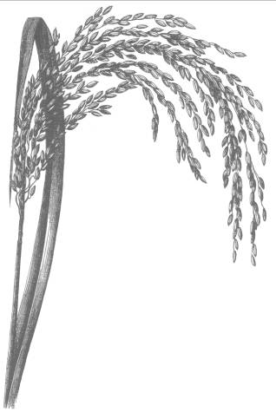
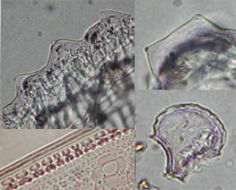
Micro-remains = Phytoliths (plant silica, 10-50 µ)
Relate to plant part and sometimes to species.
Rice diagnostics in leaf & husk
100,000s – 1,000,000s of phytoliths/ litre in archaeological sedmt.
Processing of 800 mg (~5mL) archaeological sediment, and counting of upto ~500 phytoliths per samples.
a
b
d
c

Slide 7

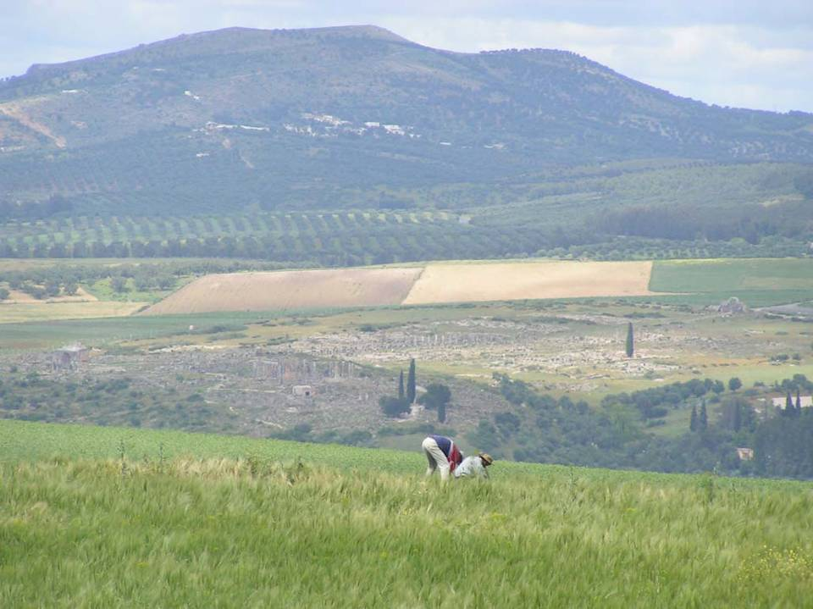
The later Holocene: Anthropogenic landscapes everywhere!
Should an Anthropocene be separated from the Holocene?
When does the Anthropocene start
5000 BP?
300 BP?
March 2011 Royal
Society Journal issue
On
Anthropocene
3 new journals of the Anthropocene started in 2012/ 2013!

Slide 8
Anthropocene Archaeology
Why archaeology?
  Material evidence of past human activities, resource procurement, landuse,
  Past populations dynamics and change
The challenge of archaeology
  Each site is local, time-limited
  Focus on sites, regional cultures, regional expertise non-transferable
    But sciences/ methods are
  Landuse records biased by cultural filters of deposition and preservation

Slide 9
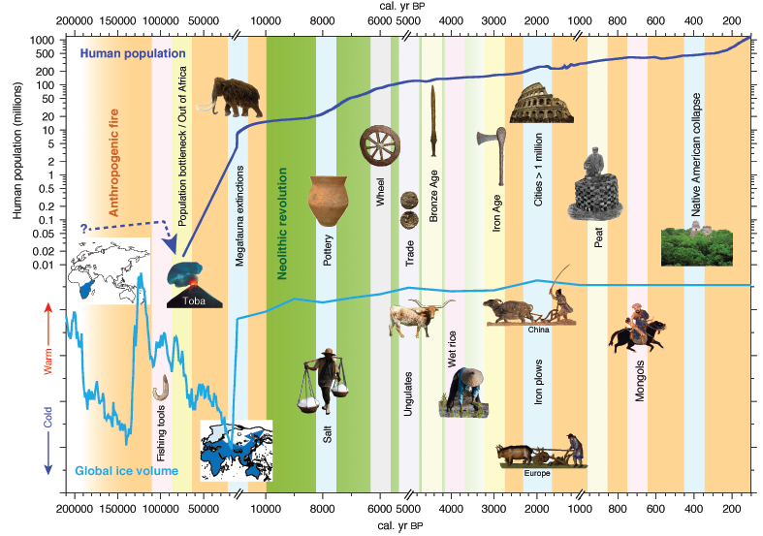
Most human population growth and Niche construction is Holocene
From: Ellis, FULLER, Kaplan & Lutters (2013) Dating the anthropocene:
Elementa: Science of the Anthropocene, vol. 1

Slide 10
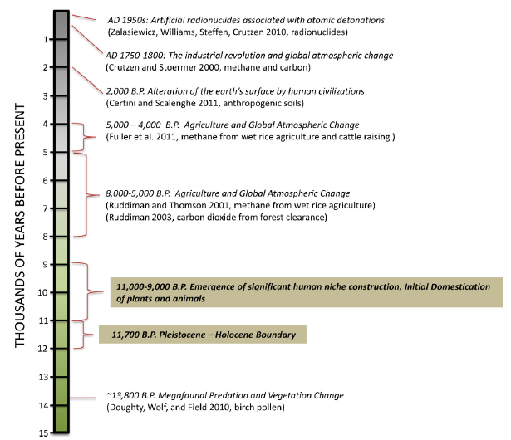
Smith and Zeder (2013) The onset of the Anthropocene
Focus on identifying
The onset of cause
Rather than effect
therefore
“significant niche
Construction”
Domesticates as
“Lever” of
Change
Most domesticates
In narrow Early
Holocene window.

Slide 11
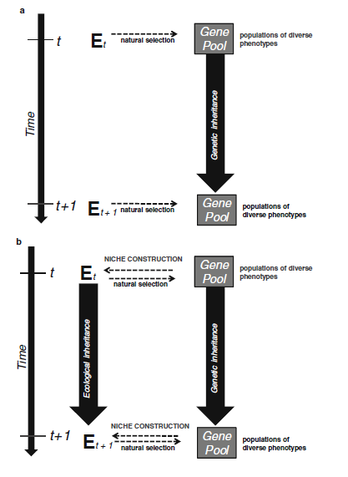
Human Niche Construction
Wollstonecroft 2011,
“Investigating the role of food
processing in human evolution:
a niche construction approach”
Archaeological and
Anthropological Sciences
Vol 3(1)

Slide 12
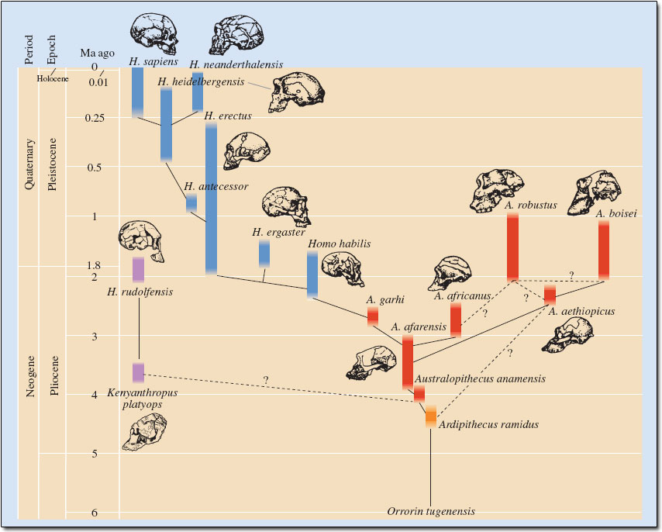
Niche Construction
Regime changes
Fire/ cooking: more efficient
Nutrient extraction →
Smaller guts, bigger brains
(R. Wrangham Catching Fire)
First stone tools

Slide 13
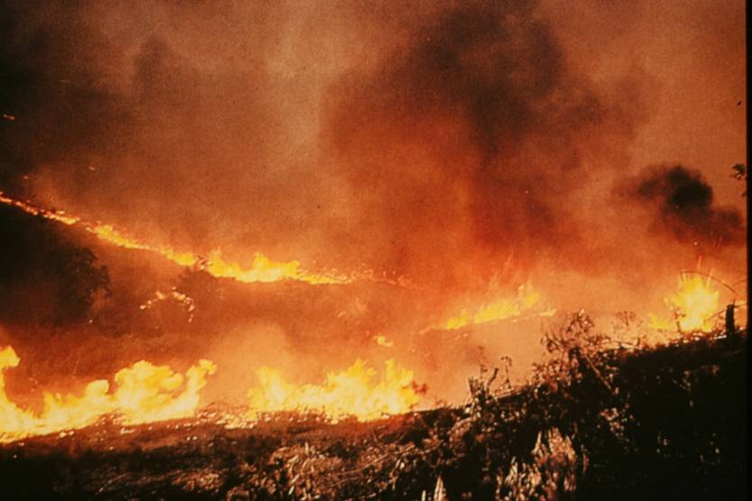
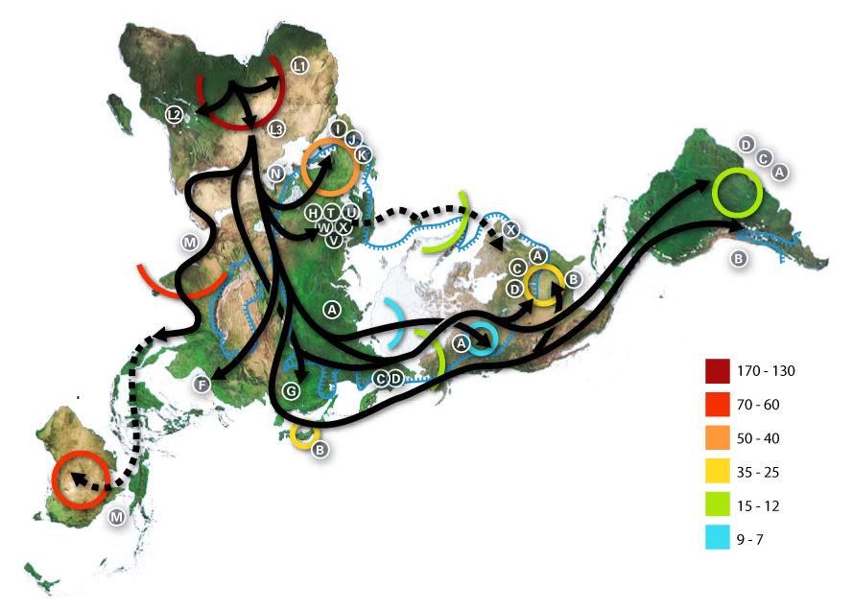
Vegetation burning:
Homo sapiens sapiens or Homo arsonensis

Slide 14
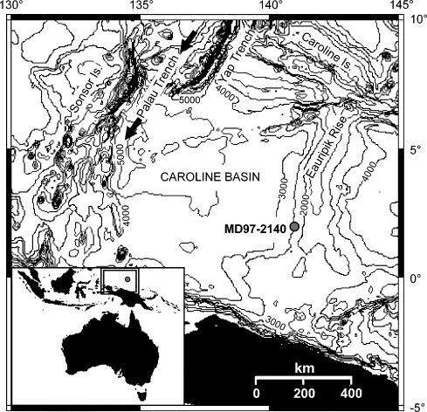
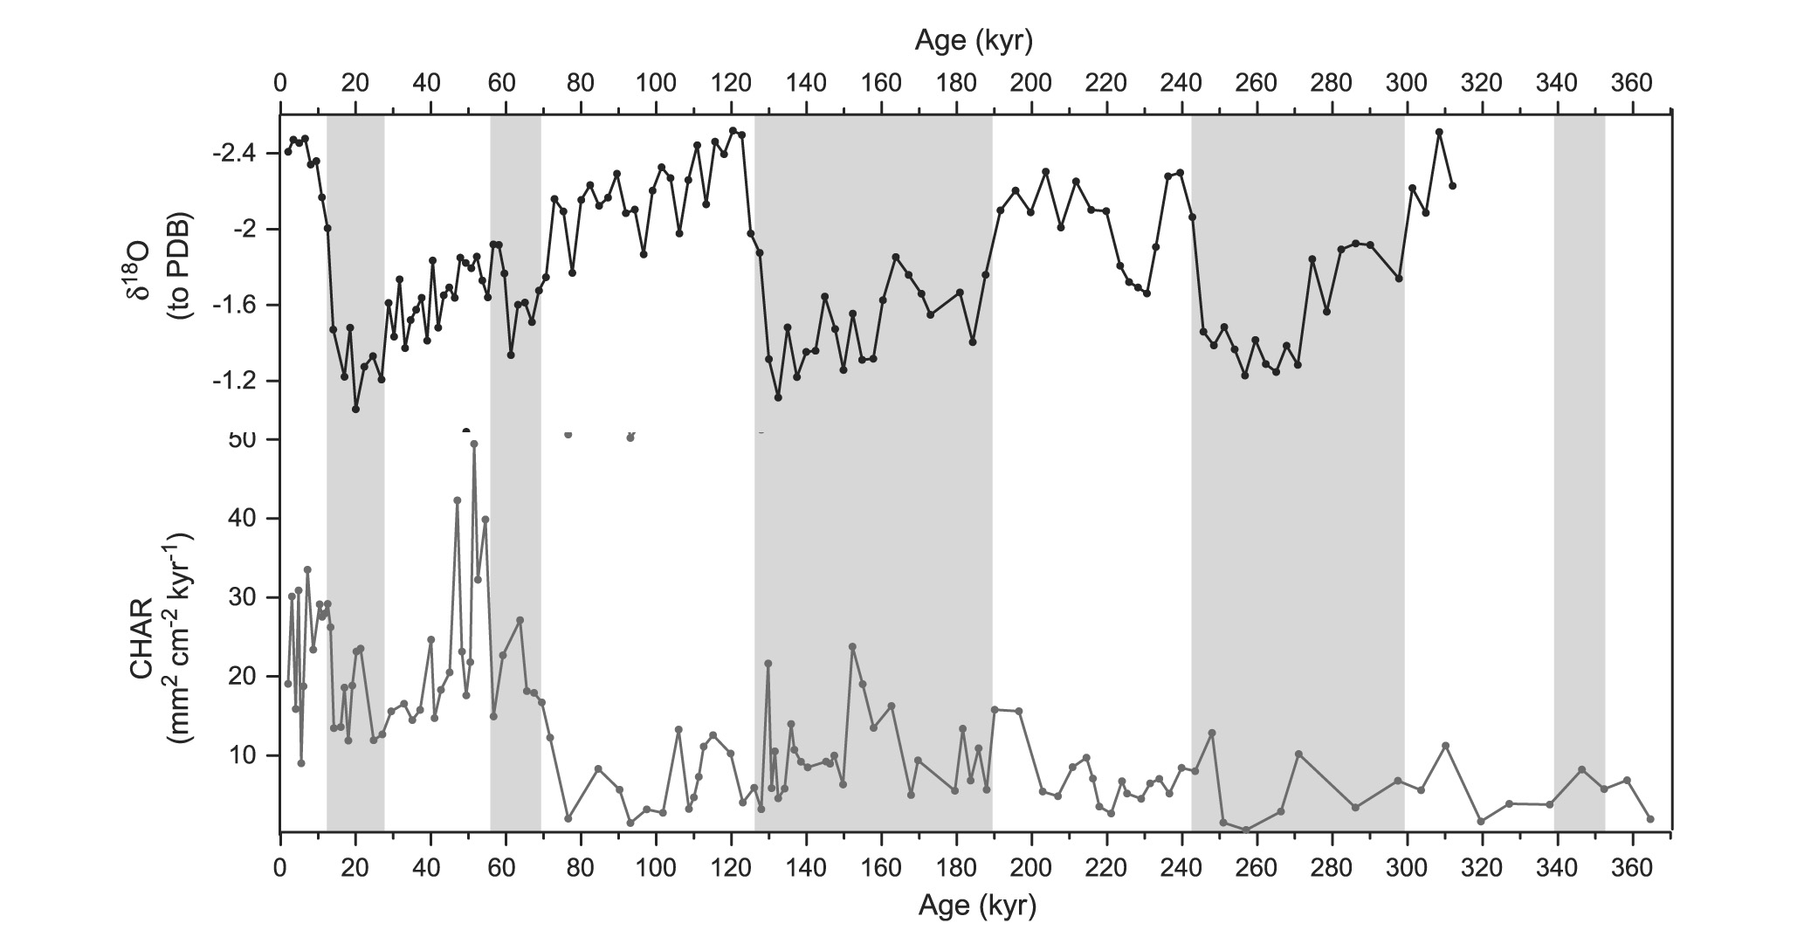
Were people adapting the environment to them
rather than just adapting to the environment?
δ¹⁸O
60 ka
Microcharcoal
W. Pacific
Thevonon & al. 2004
Palaeog. Palaeoclim.
Palaeoec. 213
(entry to SE Asia)
CHAR

Slide 15
ODP 820, NW Australia
Reduction
Of rainforest
Increasingly open
Enviroments
-attract game
-attract forest edge
Plans, e.g. yams

Slide 16
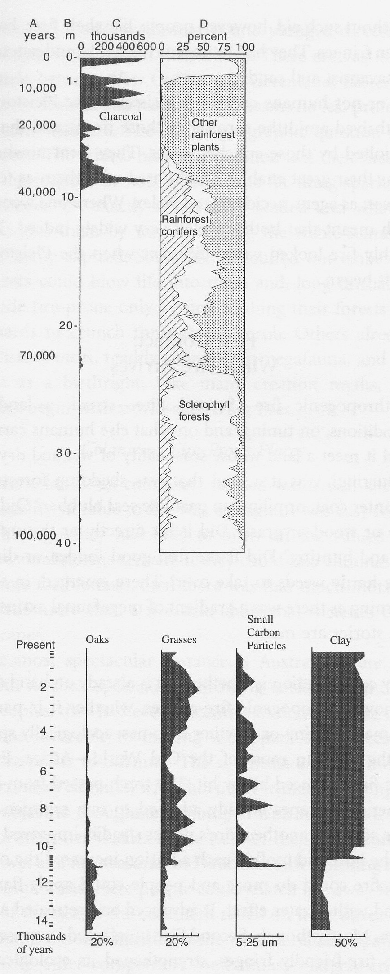
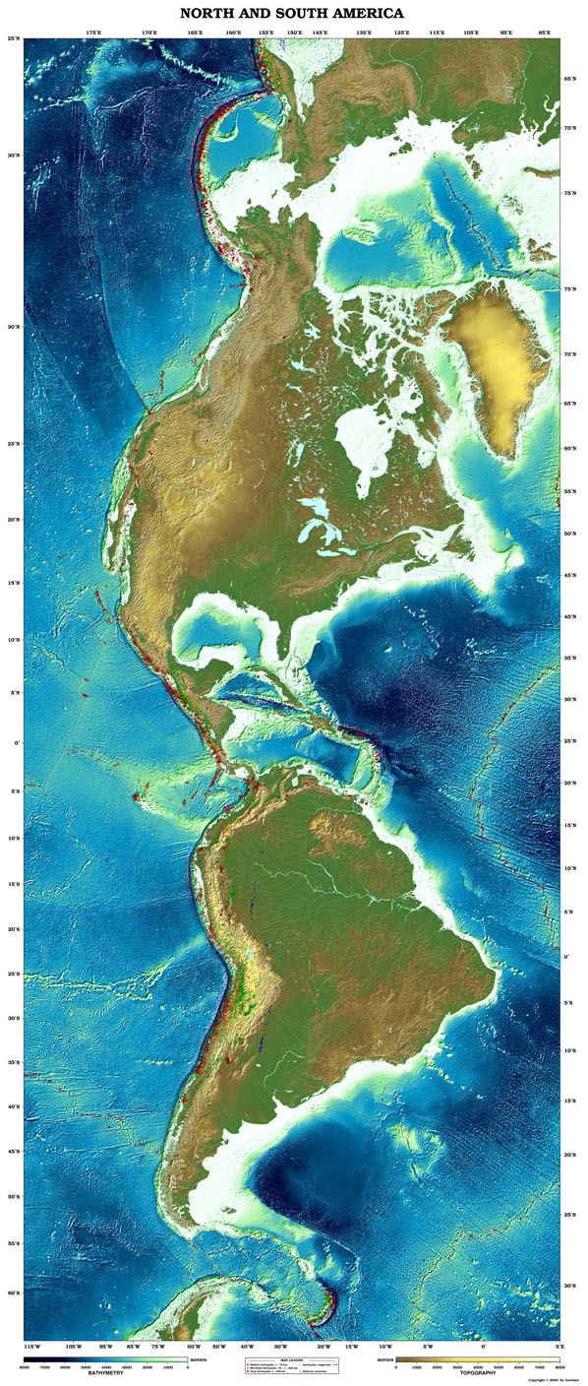
Lake La Yuguada core, Panama

Slide 17
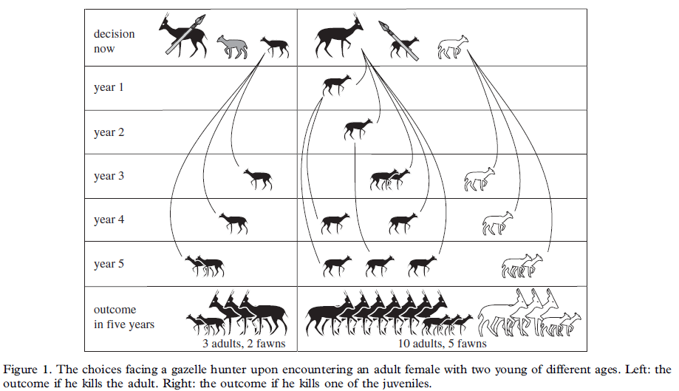
Niche Construction & Hunting
Game management → domestication
Rowley-Conwy & Layton 2011

Slide 18
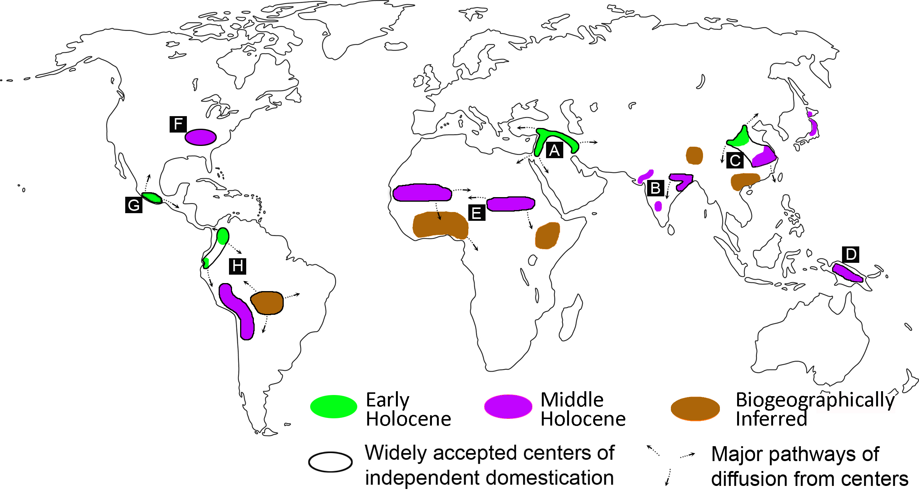
Current conscensus on agricultural origins:
20 centres of origins, minimum 11 independent
(Larson, Piperno et al. & Fuller [in press] PNAS)
Only 4-5 demonstrably Early Holocene

Slide 19
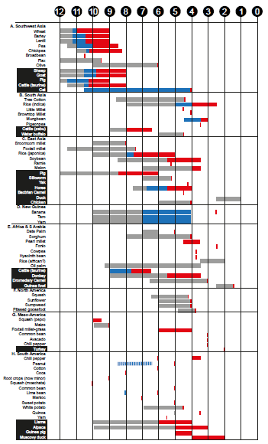
More domestications
Mid Holocene
(8-4 KA) than earlier
Domestication
before Agriculture
Dispersal over wider
Areas is later still
Near East China
India Africa
PNG
N C S
Americas

Slide 20
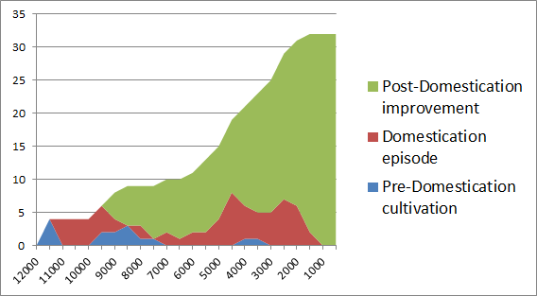
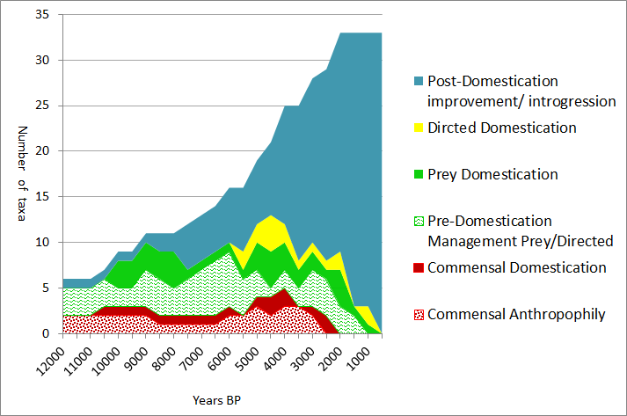
agriculture accumulating: domesticates
Cereal domesticates
Animal domesticates
By pathway
BP
(with data)

Slide 21
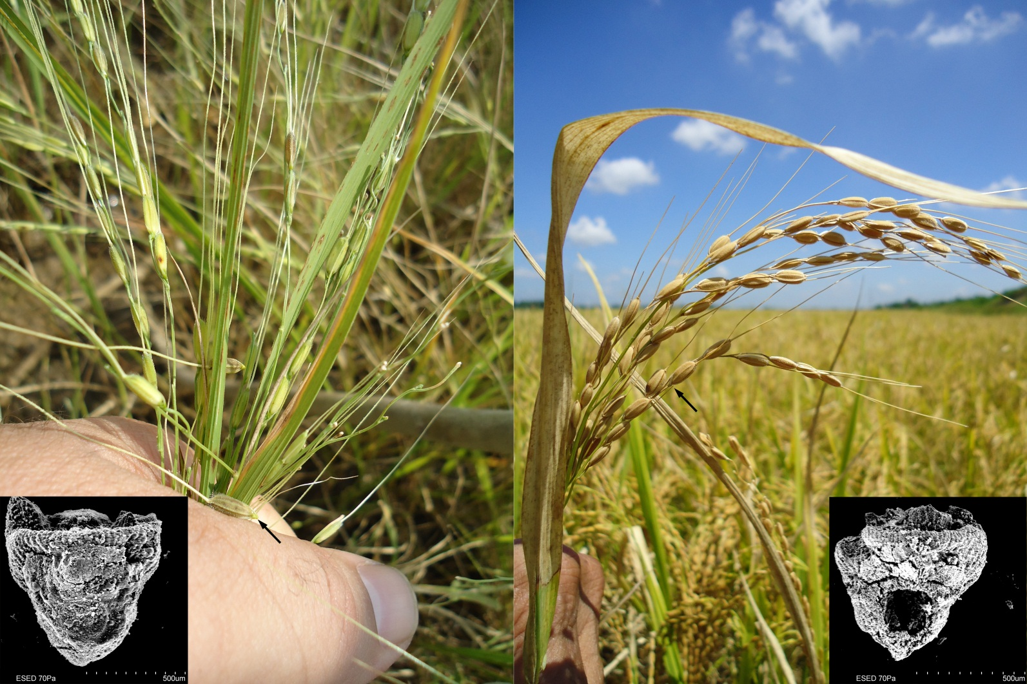
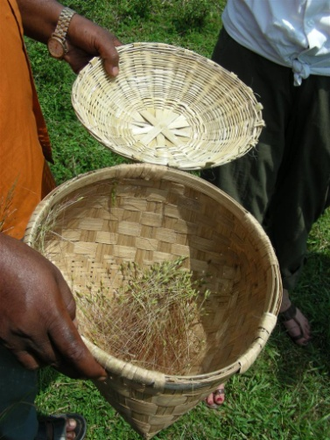
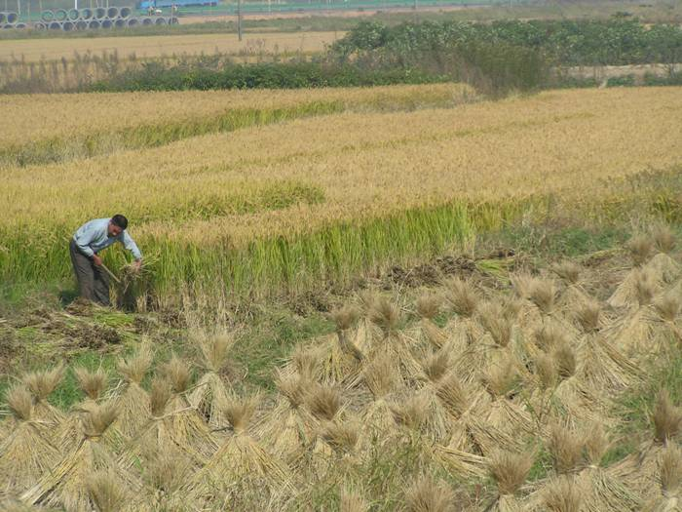
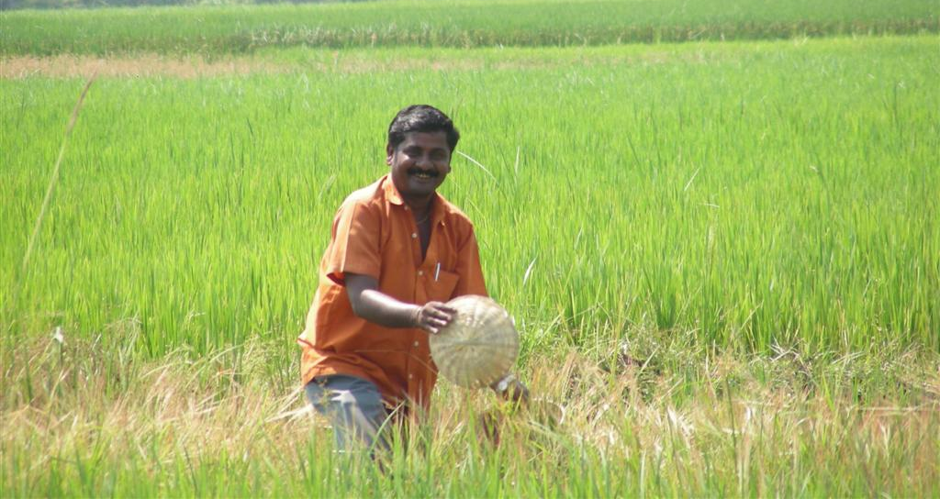
Domesticated
(non-shattering)
Wild
Experimental
wild rice
harvest India
(Oct. 2010)
Notes:
Differing in shattering versus non-shattering require different harvesting methods to be efficient. Wild type harvesting also collects a proportion of green spikelets with immature grains.

Slide 22
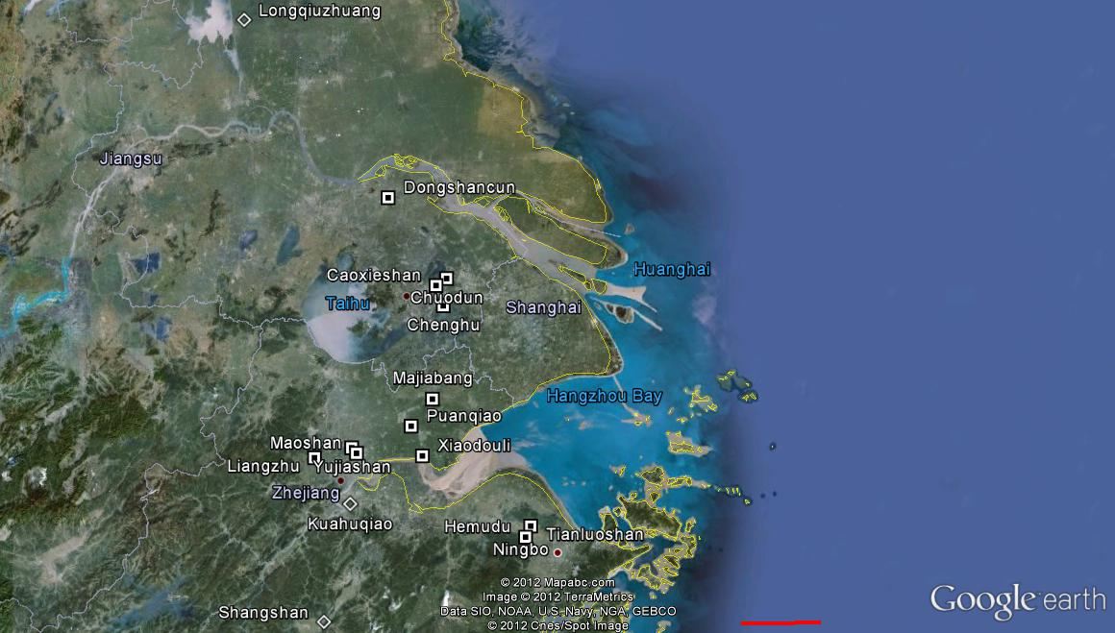
Timeline
Lower Yangtze: rice
Domestication to
agriculture sequence
2000 BC
Large-scale
intensive
Liangzhu
Maoshan
Yujiashan
3000 BC
Xiaodouli
Puanqiao
Agriculture w/
Domesticates
Caoxieshan
Chuodun
4000 BC
D
Tianluoshan
Hemudu
Majiabang
First flotation/
Wet sieving
2006
5000 BC
Pre-domestication
Cultivation
Kuahuqiao
6000 BC
50 km

Slide 23
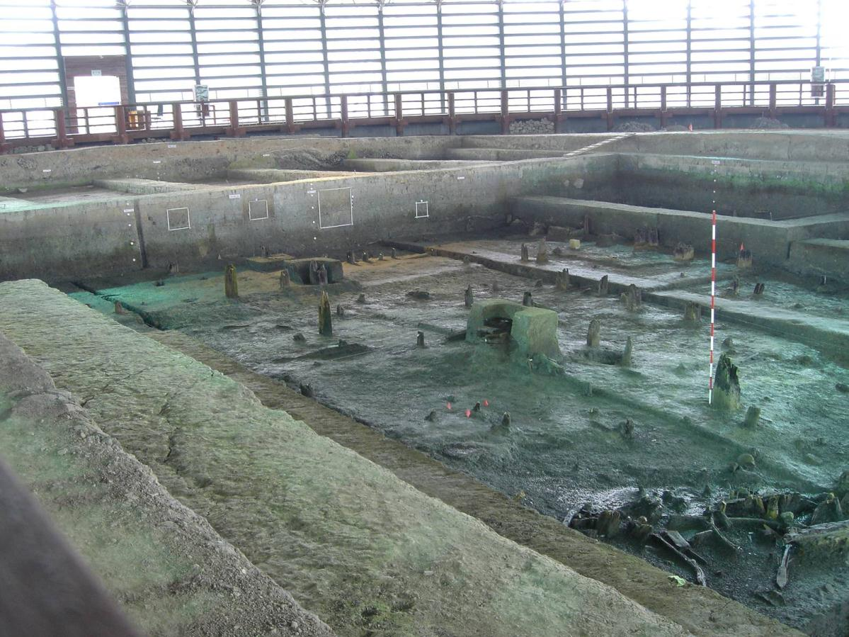
Tianluoshan, 5000-4300 BC:
The tipping point in rice domestication
Excavations of Zhejiang province institute,
In collaboration with Peking University

Slide 24
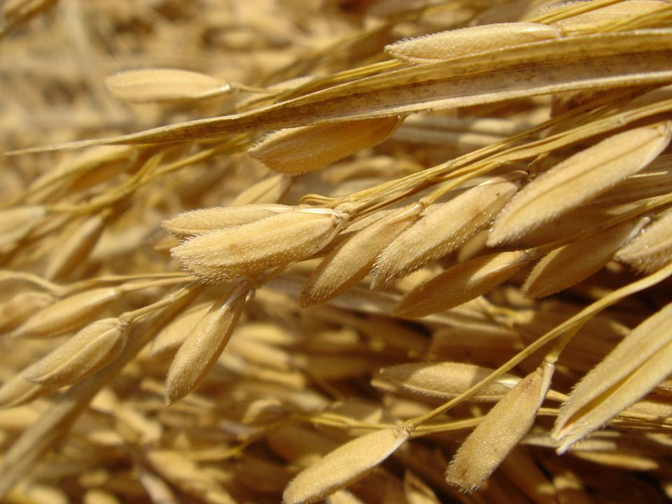
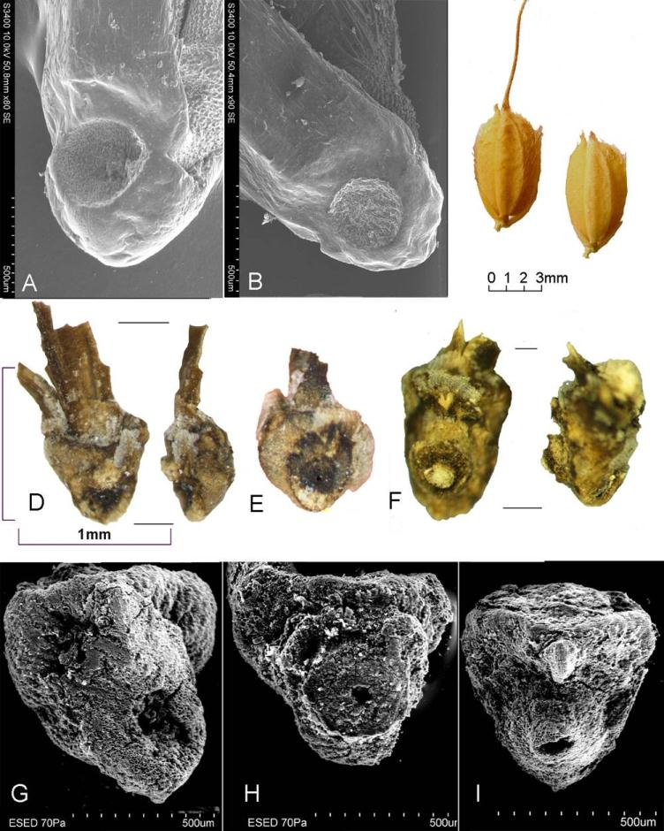
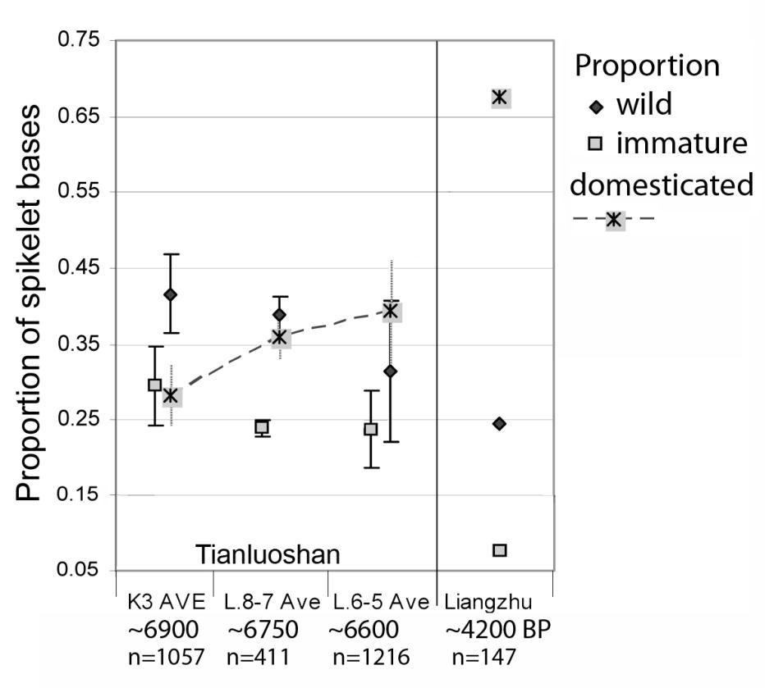
Rice spikelet base Scars
domesticated wild immature
Rice spikelet base
scars
Modern
Archaeological
Fuller & al. (2009) Domestication process and domestication rate in rice: spikelet bases from the Lower Yangtze. Science v.323
From Tianluoshan, n=2641

Slide 25
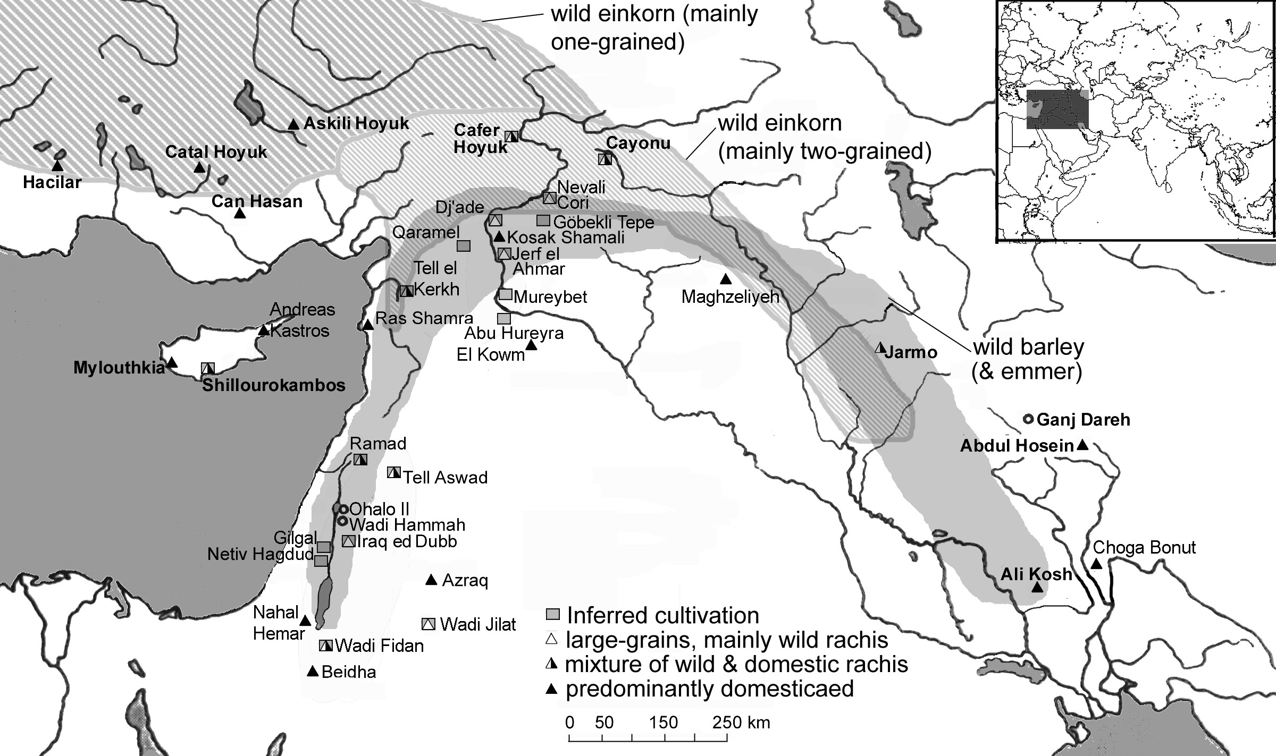
Progress chart: Allaby,
Brown & Fuller (2010)
Map from Fuller (2007)
Annals of Botany

Slide 26
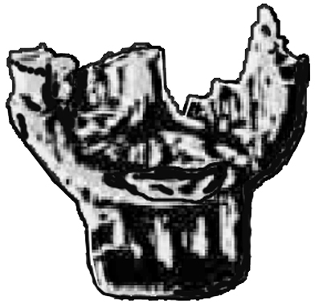
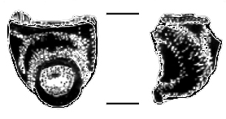
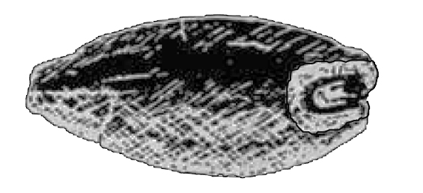

Domestication rate of rice, wheat and barley
Einkorn wheat
barley
Rice
Non-shattering Grain size
Fuller & al (2014) Convergent evolution and parallelism in plant domestication revealed by an expanding archaeological record. PNAS
[in press]

Slide 27
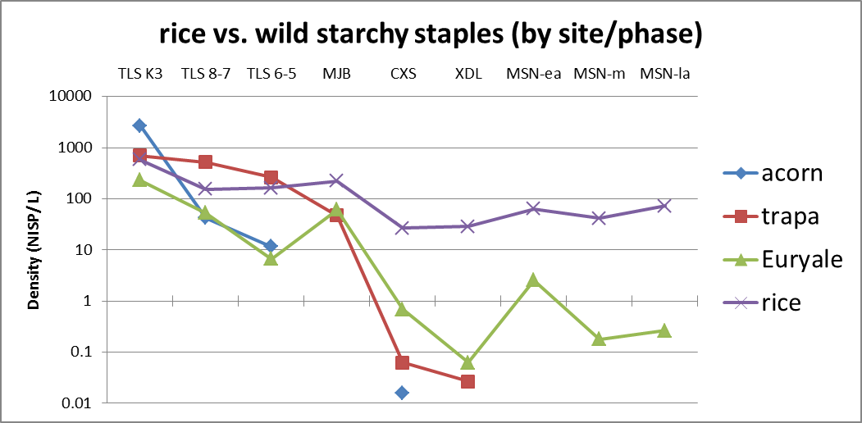

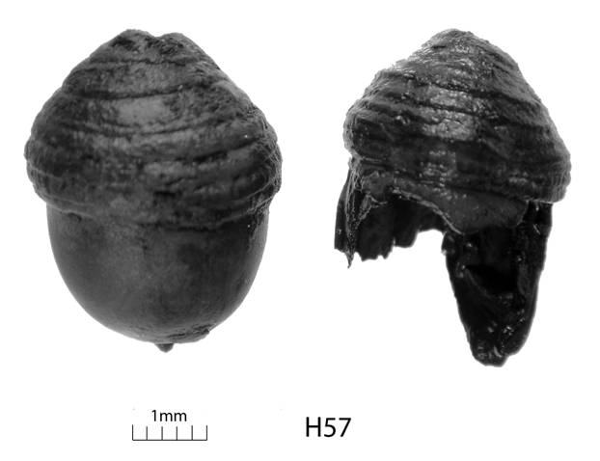
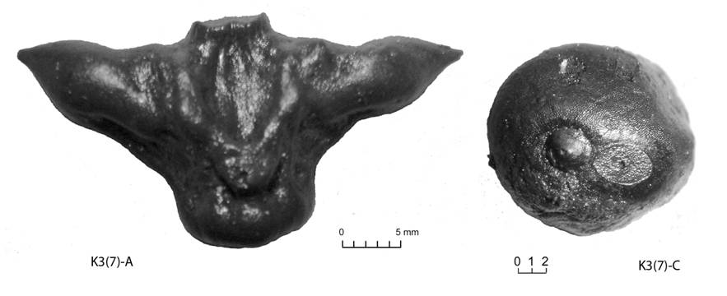
Lower Yangtze Rice rises to dominance:
Acorns disappear, followed by Trapa water chestnuts
N=14290 2776 6549 13038 1936 3336 1954 6012 8108
Total >53,000
Seeds from
Sieved samples
(Fuller & al., n.d.)
~4900 BC
~4250 BC
~3600 BC
~3400 BC
~2400 BC
~4750 BC
~4600 BC
~4000 BC
~2800 BC
Majia-
bang
Caoxie
shan
Xiao
douli
Maoshan
Tianluoshan

Slide 28
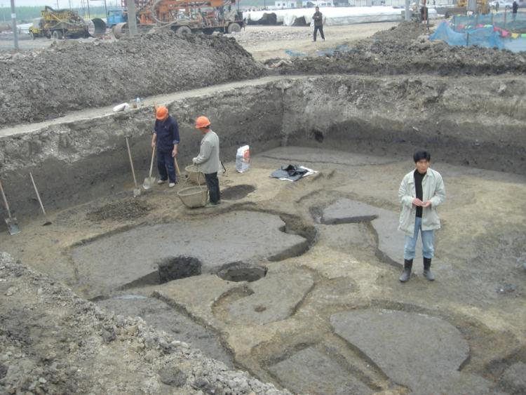
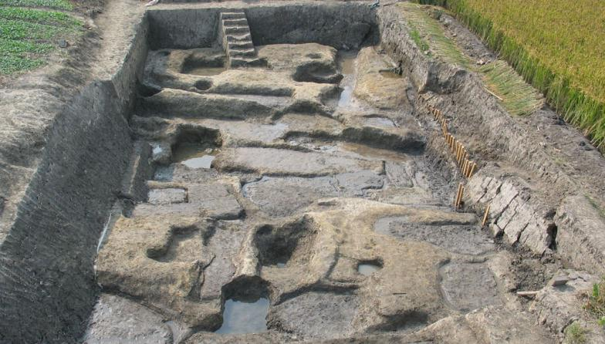
Late Majiabang paddy field systems at
Chuodun and Caoxieshan. Max. field size 0.004 acres
Summary results of Caoxieshan
small, intensive cultivation systems
Rice grains fatter
High prop. Domesticated spikelet
bases >70%
Few wild nut resources
Notes:
28

Slide 29
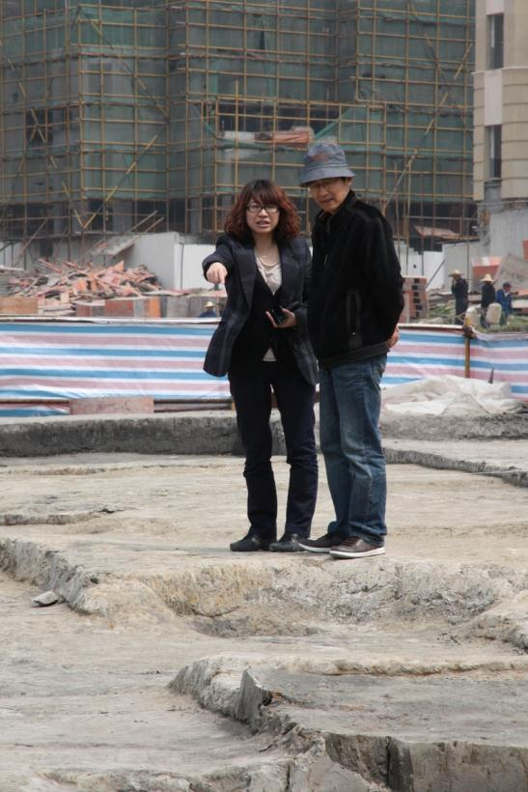

Maoshan and the development of paddy fields in the Lower Yangtze
Zhejiang Province Institute of Archaeology and Cultural Heritage
3000-2300 BC

Slide 30


Late Laingzhu
(2500-2300 BC)
~0.5 acre fields
(upto 1 acre)

Slide 31


INCREASE in SITE NUMBERS AND POPULATION
Ca. 4000 BC (Majiabang) (ca. 2500 BC (Liangzhu)
Chen et al (2008) Quaternary Research 70: 301-314

Slide 33

Maximum
Site sizes
Image from Moore
& al (2000)
Abu Hureyra monograph
Pottery Neolithic. A “re-start”(?) Disappearance of wild food. Smaller sites
L.PPNB. Fully domesticated package = megasites (7500-6000 BC)
  Early ceramics
  → Period of dispersal into Europe, East to Indus
M.PPNB. Full domesticates dominate. Many wild foods. Domesticated fauna widespread, but still ~30% hunted meat
E.PPNB. Domesticates minority; cultivation widespread; first domesticated animals
PPNA. Pre-domestication cultivation. Only hunting(??)

Slide 34

Late PPNB: mega site, Catal Hoyuk, 7400-6000 BC
Excavations, July 2012
~10 Hecatres, 5000-6000 people at it height (ca. 6500 BC)

Slide 35


Early agricultural impacts are localized
→ targetted environments and site locations
e.g. in Near East = the alluvial fan
Vita-Finzi model
(Brothwell and Higgs 1963)

Slide 37

Global spread of agriculture movie
Courtesy of Jed Kaplan, ARVE research project, University of Geneva

Slide 38

Prehistoric Rice & Global Warming?
Ruddiman (2003) Hypothesis

Slide 39

The Ruddiman Hypothesis: anthropogenic greenhouse gases since the Neolithic
Red- Holocene
General book Ruddiman (2012)
Earth Transformed.
Ruddiman & al. (2011)
The Holocene [August, 2011]

Slide 40

How was rice cultivated?

Slide 41




How was rice cultivated?
Weeds of different rice systems are different
Upland, rainfed rice in Western India: Very weedy with Amarnthaceae, Compositae,
grasses
(weeds reported in
Indian rice based on
IRRI books)
Deep flooded rice in
Orissa: shrubby weeds,
Floating aquatics,
tall sedges, millet-grasses,
Festucoid grasses
Lowland irrigated rice in Zhejiang, China: Short sedges, panicoids

Slide 42

Phytolith examples from rice weeds reference collection
Weisskopf, A. & al. (i2013) Archaeobotanical implications of phytolith assemblages from cultivated rice systems, wild rice stands and macro-regional patterns. J. Archaeological Science

Slide 43

>400 sites.
Those with adequate data assessed for evidence
For wet vs. dry rice
From Fuller et al. (2010)
Archaeological & Anthro. Sciences 2
Updated in: Fuller et al
(2011), The Holocene

Slide 44

The spread of rice. GIS model
Archaeological data + environmental potential
What about wet rice subset?
Fuller et al. (2011) The Holocene

Slide 45

Time-lag between first rice and first wet rice = regions of initial
Dry rice (rainfed/ upland)

Slide 46


GIS Model:
Spread of Wet
Rice (paddy):
% of modern
wet rice area

Slide 47
Methane from ungulate livestock?

Slide 48


Another methane source?
The spread of sheep, goat & cattle
Fuller et al (2011) The Holocene, Aug 2011

Slide 49

Fuller et al (2011)
The Holocene,

Slide 50
Limitations of existing model
Need to take into account proportion of rice vs. other/dry crops
Need to fill in gaps in rice and weed flora
Need an empirical basis for connecting land area under rice with systems
Livestock: need to estimate herd population sizes

Slide 51
Conclusions
Niche construction: begins ~50,000 BP
Regime shift with domestication ~11,000 BP
Agriculture and domestications increase and expand in Mid-Holocene
  Intensification through regime shifts
Need for more quantitative syntheses
  Integration with palaeoenvironmental records

Slide 52

The Holocene:
Recurring cycles of
Land-use
Intensification and
Regime shifts
Overall trend of
growing
Population,
but with Local cycles
of growth
and collapse
(“Used Plant: A Global History” by
Ellis, Kaplan, Fuller, Vavrus, Klien Goldewijk, abnd Verberg)

Slide 53



