Slide 1


BIPOC Listening Sessions - A Geoscience for Us!
BIPOC URGE Leaders: Gabriel Duran, Onjalé Scott Price, Vashan Wright and Carlene Burton

Slide 2

Today’s Session Agenda:
4:00 - 4:15 pm - Welcome and Words from URGE BIPOC Leaders.
4:15 - 5:15 pm - Participants will be divided into breakout sessions, assigned a Jamboard and given Discussion Questions.
5:15 - 5:30 pm - Everyone will gather and share summary notes and comments.
Time Warnings will be shared 10 and 5 minutes before the next agenda item. Use this time to wrap up your notes.

Slide 3
Welcome Back!
Provide a space for participants to share and support each other with mental and emotional self care tips when working in BeAJEDI initiatives like URGE.
Create opportunities for BIPOC geoscientists to network and meet other BIPOC geoscientists who are working in DEI and URGE.
Receive opinions and critiques of URGE deliverables and what are some “Dos and Don’ts” that pods should be aware of in the refinement of their deliverables. As well as feedback on general URGE programming.
Read more on our official Summary and Rationale Document at urgeoscience.org/bipoc

Slide 4
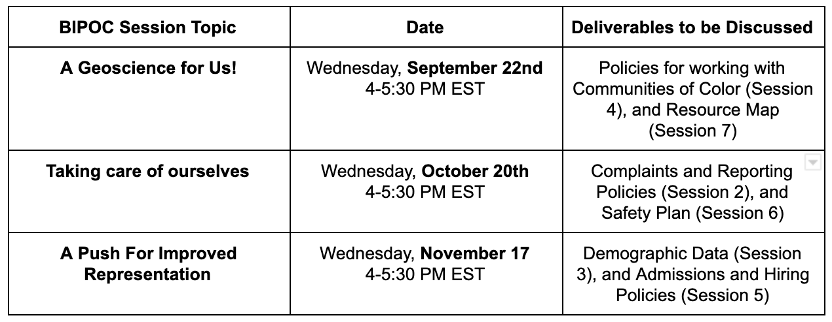
BIPOC Listening Session Schedule!

Slide 5
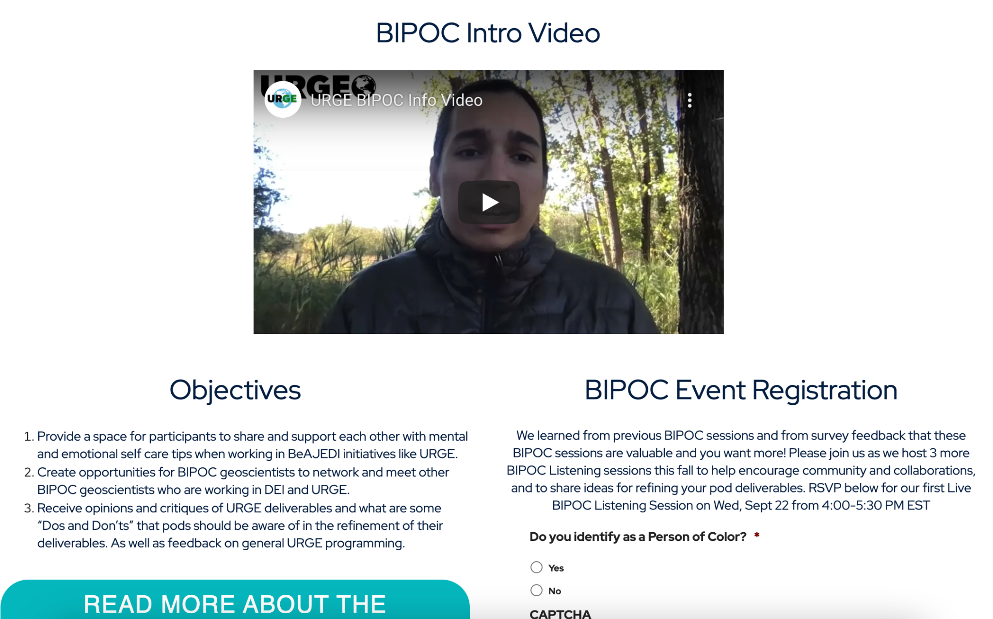
What’s New:
Opportunities to hear from experts in the field of mental health
Network with other BIPOC led BeAJEDI initiatives in Geoscience
Brand new BIPOC webpage on the URGE website at urgeoscience.org/bipoc
BIPOC specific resources
Beta version of the BIPOC moderated Discussion board (coming in October)
Notes:
On the webpage, you can access registration links for future Listening Sessions, information on past and future Sessions (like summary notes, discussion questions, flyers/posters and videos)
BIPOC specific resources, like crowdsourced readings, videos, organizations, and mental health awareness tips and practices.

Slide 6
Today’s Questions:
Have you been able to find a safe space to share your thoughts and ideas in geoscience? In your pod? In your lab? In your organization? Elsewhere? If so, can you add them to our resource list?
What obstacles have you faced in this anti-racist work?
Since the completion of URGE Stage 1 in May, has your pod/organization made progress in generating an anti-racist workplace? Do you feel the work you or your pod has done during URGE has made any real impact on your organization?
Where do you think your organizational leadership stands on URGE deliverables after having met with your pod?
Do you think racism has been decentralized in this work and efforts have been broadened, especially in the development of deliverables (i.e. Complaints and Reporting Policies, and Resource Map)? How would you like URGE Leaders to address this?
What do you want URGE pods to be aware of when refining their Resource Maps and Complaints and Reporting Policies?
What do you want to see from these BIPOC Listening Sessions? How can URGE realistically further support you?

