Slide 1
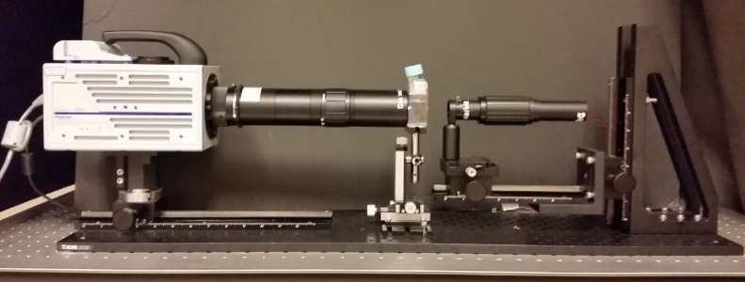
Effects of microplastics on (micro)zooplankton feeding and swimming Houshuo Jiang, WHOI
A cell of the ciliate Strombidium sp. captures a 3μm polystyrene particle.
A cell of the tintinnid ciliate Amphorides sp. captures and rejects 3μm polystyrene particles.
A cell of the ciliate Mesodinium rubrum jumps in a zigzag way in a suspension of 3μm polystyrene particles.
High Speed Microscale Imaging System (HSMIS)

