Slide 1
Imaging microbial communities in the “Plastisphere” using a Laser Scanning Confocal Microsocope
Cathleen Schlundt, Jessica L. Mark Welch, Erik R. Zettler, Linda A. Amaral-Zettler
Bay Paul Center for Comparative Molecular Biology and Evolution
Marine Biological Laboratory
Woods Hole

Slide 2
Bacterial community compositions on marine plastic of different ages
Incubation Experiment
1 week
5 most abundant taxa within their taxonomic level
Actinobacteria
Cyanobacteria
Verrucomicrobia
Bacteroidetes
Bacteroidetes
Vibrionaceae
Cyano-
bacteria
Rhodobac.
Sphingobacteriia
Flavobacteriia
Gammaproteobacteria
Gammaproteobacteria
2 weeks
Alteromona-daceae
Proteo-
bacteria
Alteromona-daceae
Alpha-
proteo-
bacteria
Alpha-
proteo-
bacteria
Rhodobacteraceae
Rhodobacteraceae
Rhodobac.
Average of 98 plastic pieces sampled in the North Sea, Pacific and Atlantic Ocean
Amplicon sequencing of V3-V4 and V6 of the 16S rRNA using Illumina or 454
Notes:
Verrucomicrobia
Actionbacteria
Phylum 2 week Verrucomicrobia Planctomycetes
Family 2 weeks Phyllobacteriaceae Flavobacteriaceae

Slide 3
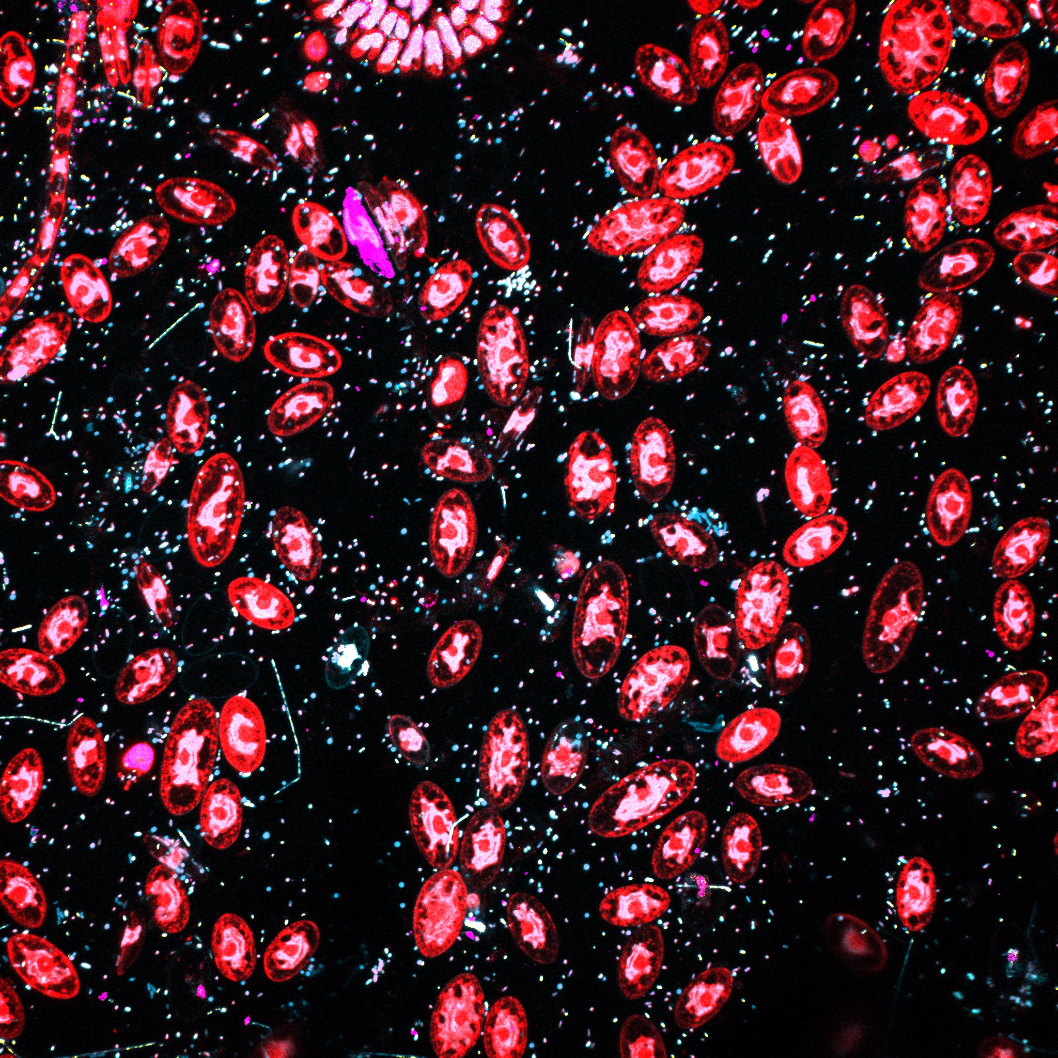
Biofilm after 1 week incubation at the Woods Hole Dock 5
2 µm
Notes:
T1 S1 image6 all together

Slide 4
week1

Slide 5
Biofilm after 1 week incubation at the Woods Hole Dock 5
2 µm
Notes:
T1 S1 image6 all together

Slide 6
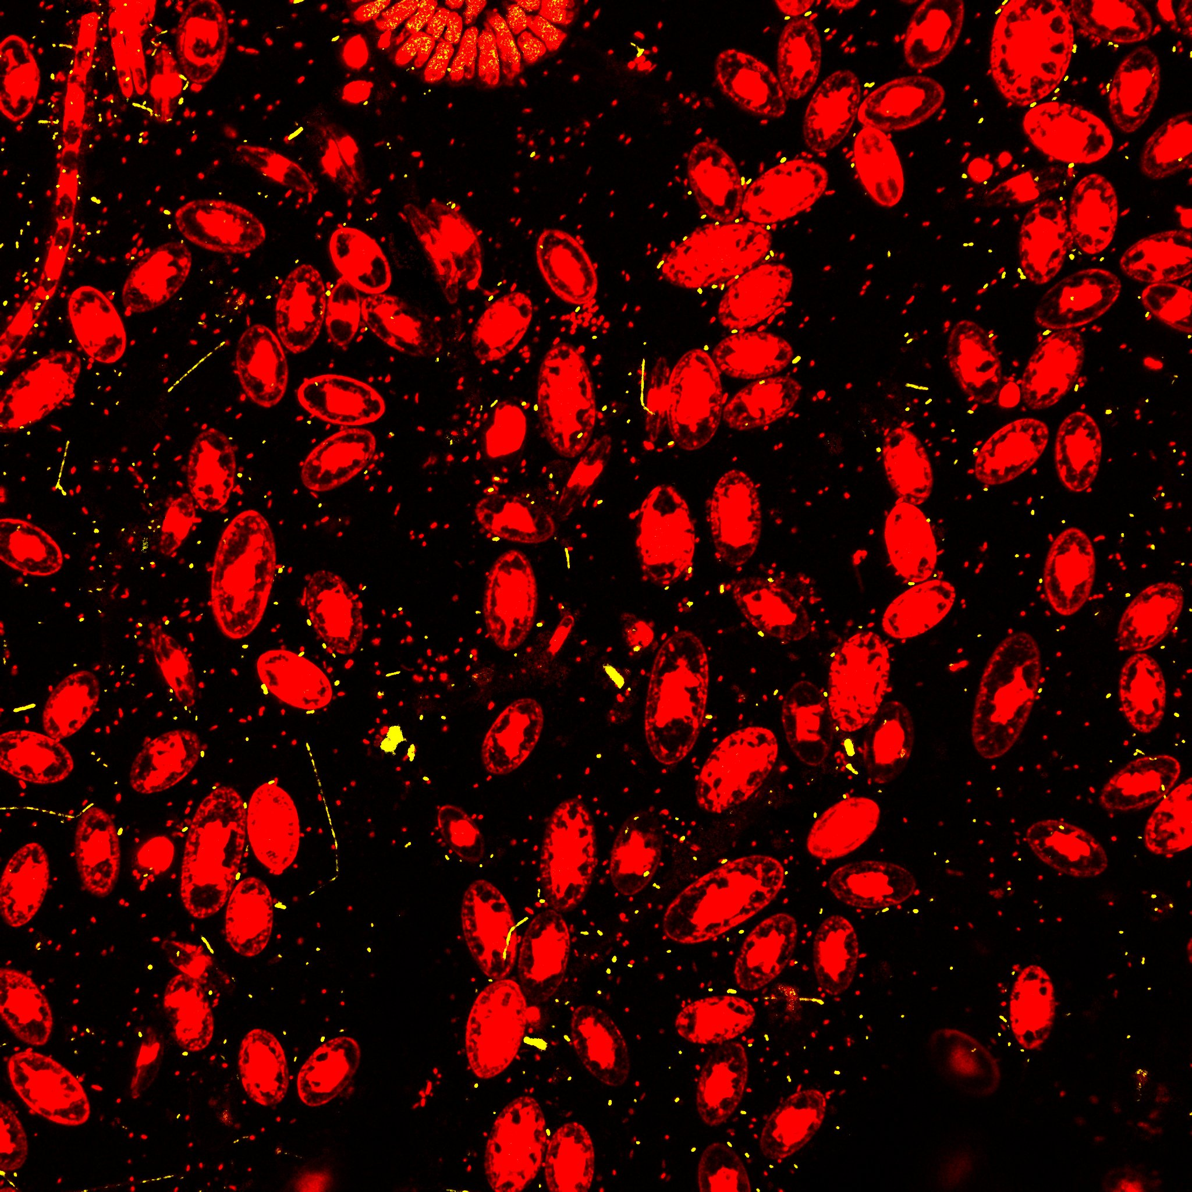
Alphaproteobacteria
Bacteroidetes
2 µm

Slide 7
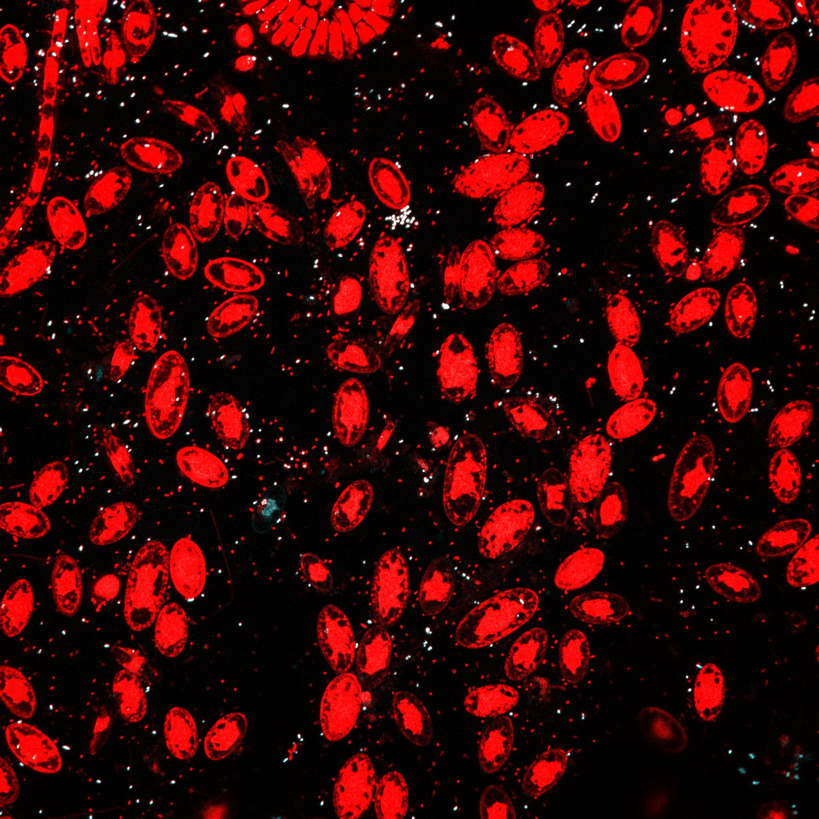
Alphaproteobacteria
Rhodobacteriaceae
2 µm

Slide 8
Rhodobacteraceae in the neighborhood of diatoms and Bryozoans
in a 1 week biofilm
T1S1 image9
T1S1 image7
T1S1 image10
T1S1 image7

Slide 9
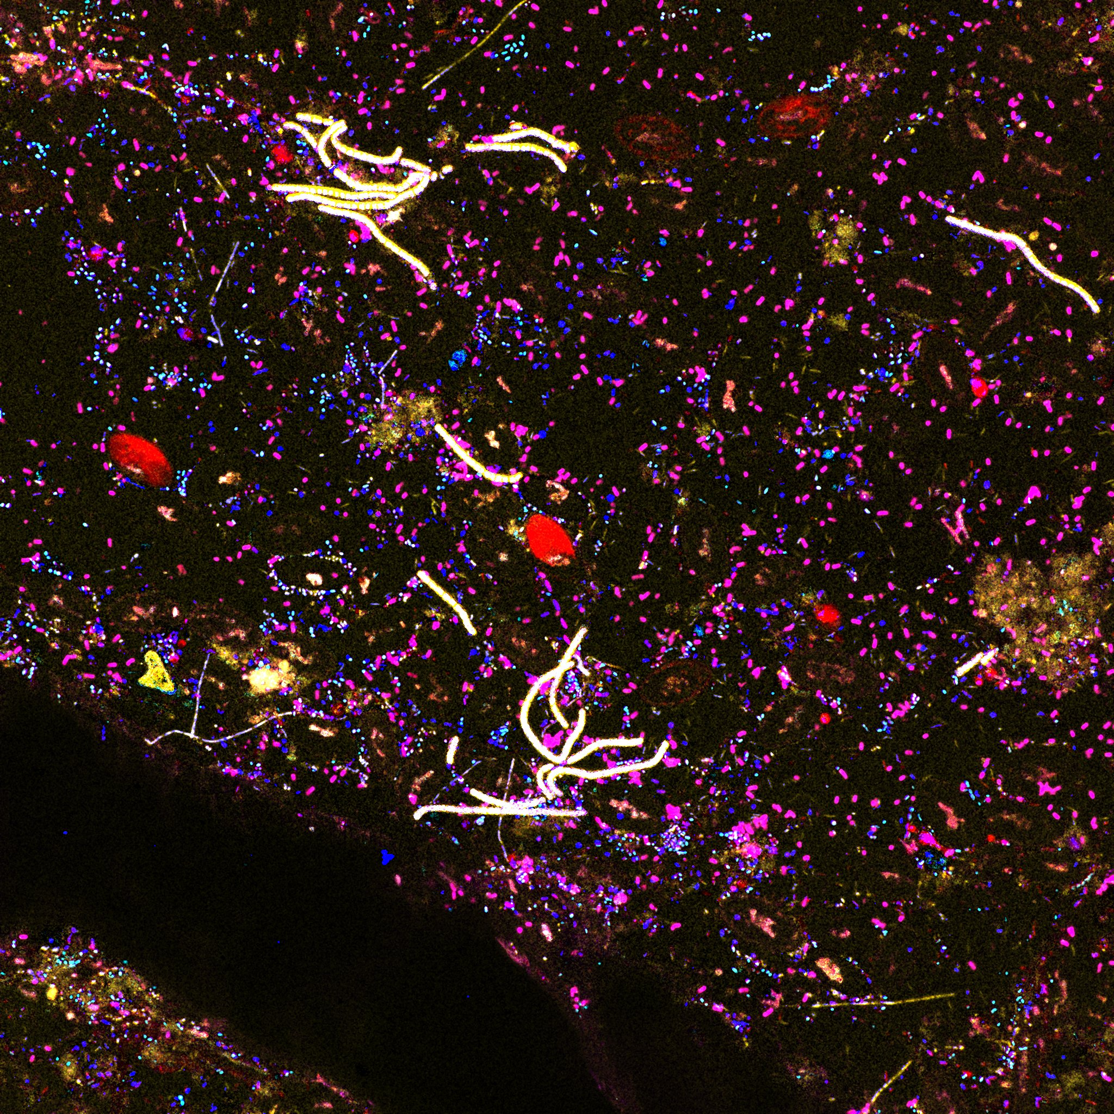
Biofilm after 2 weeks incubation in the coastal Atlantic Ocean

Slide 10
Rhodobacteraceae and Gammaproteobacteria in the neighborhood of diatoms in a 2 week biofilm
T2S1 image7
T2S2 image2
Diatoms start to disappear
in the second week of experiment
T2 S1 image6
T2 S2 image2

Slide 11
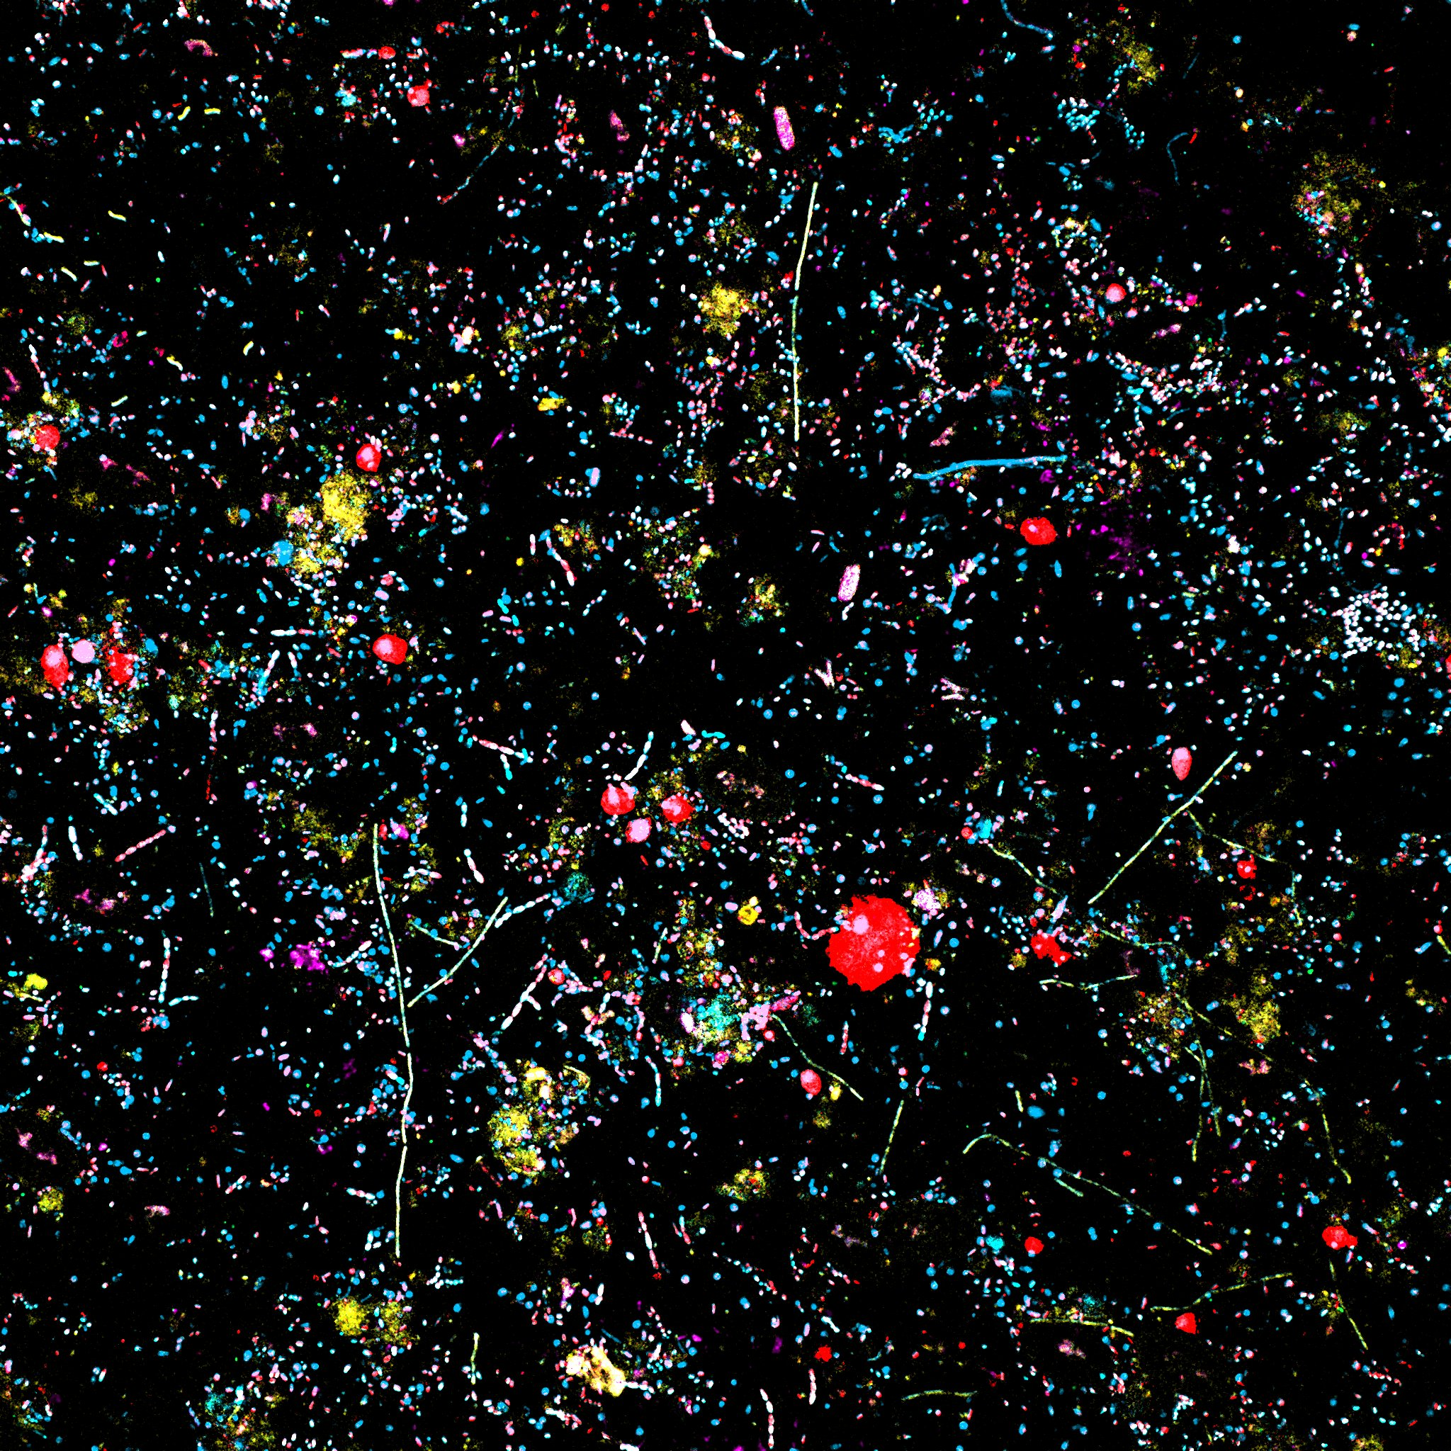
2 week biofilm
T2S1
image 5
Side 1

Slide 12
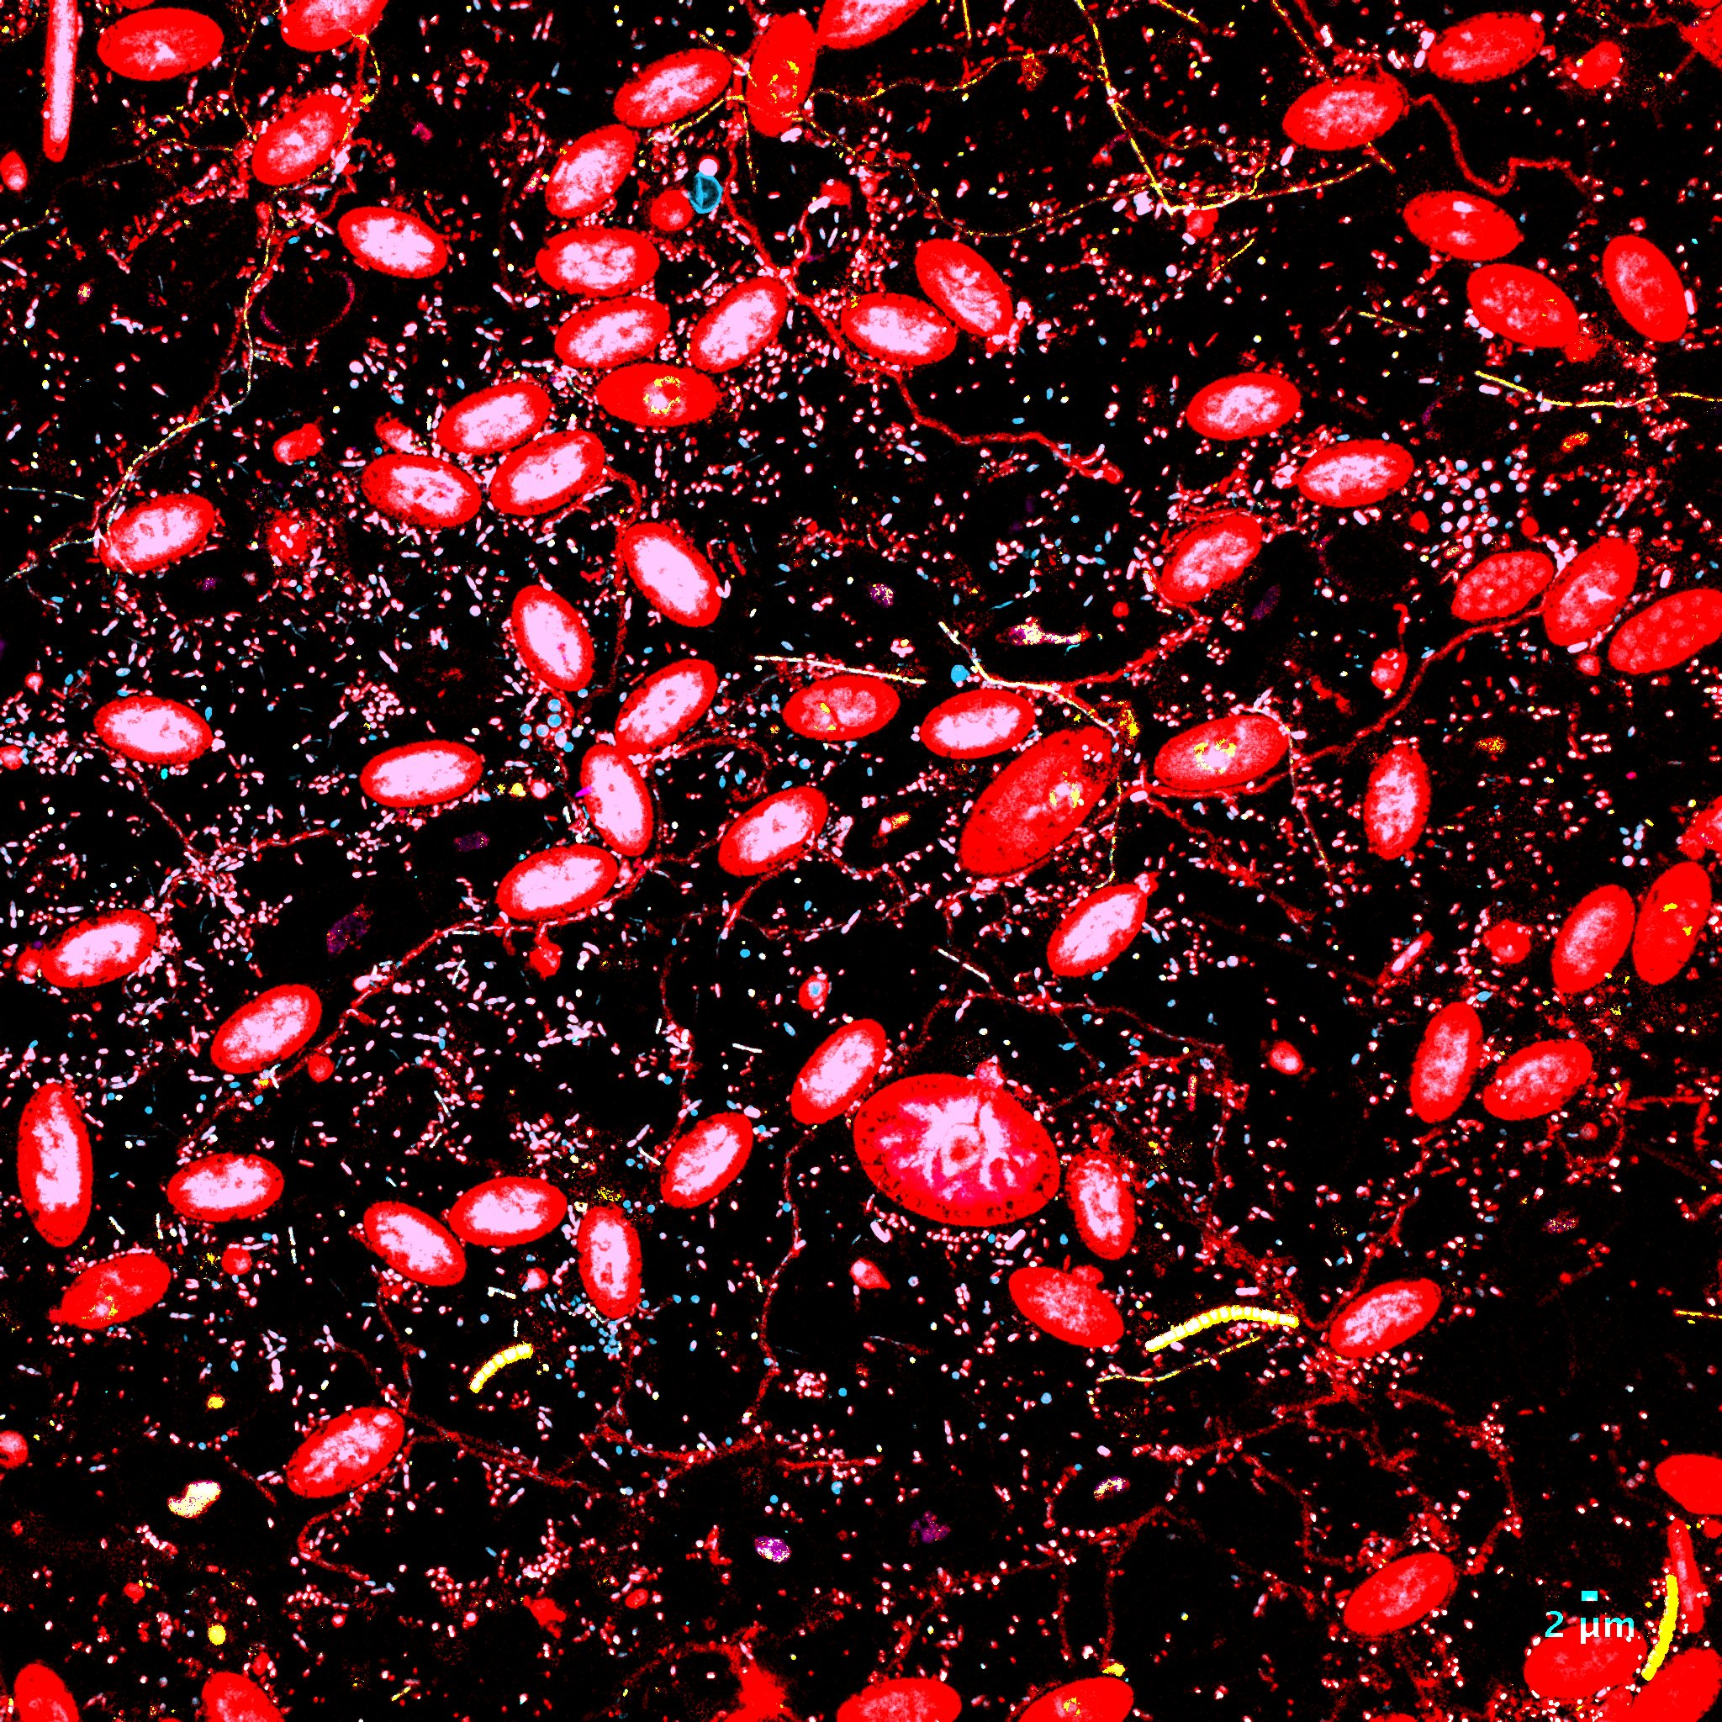
2 week biofilm
T2S2 image 5
Side 2

Slide 13
week2

Slide 14
Average abundance of bacteria on 1 and 2 week marine biofilm on Polyethylene plastic pieces
(mean (± standard deviation) of 20 fields of view)
1 week incubation
 | Prokaryotes Eub338 I II III | Alphapro-teobacteria | Rhodobac-teraceae | Bacteroi-detes | Gamma-proteo-bacteria | Vibriona-ceae | Alteromona-daceae
FISH | 8400 cells/mm² | 56% ± 11% | 40% ± 16% | 24% ± 12% | 7% ± 4% | 0.03% ± 0.05% | 0%
Sequen-cing |  | 58% | 37% | 12% | 13% | 0.2% | 1%
2 weeks incubation
 | Prokaryotes Eub338 I II III | Alphapro-teobacteria | Rhodobac-teraceae | Bacteroi-detes | Gamma-proteo-bacteria | Vibriona-ceae | Alteromona-daceae
FISH | 20 000 cells/mm² | 50% ± 14% | 22% ± 6% | 10% ± 6% | 7% ± 9% | 0.02% ± 0.03% | 0%
Sequen-cing |  | 55% | 31% | 11% | 14% | 0.7% | 2%

Slide 15
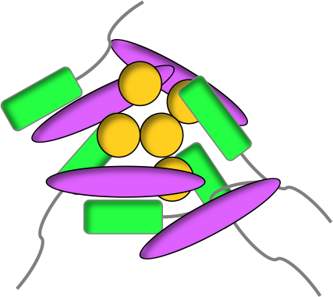
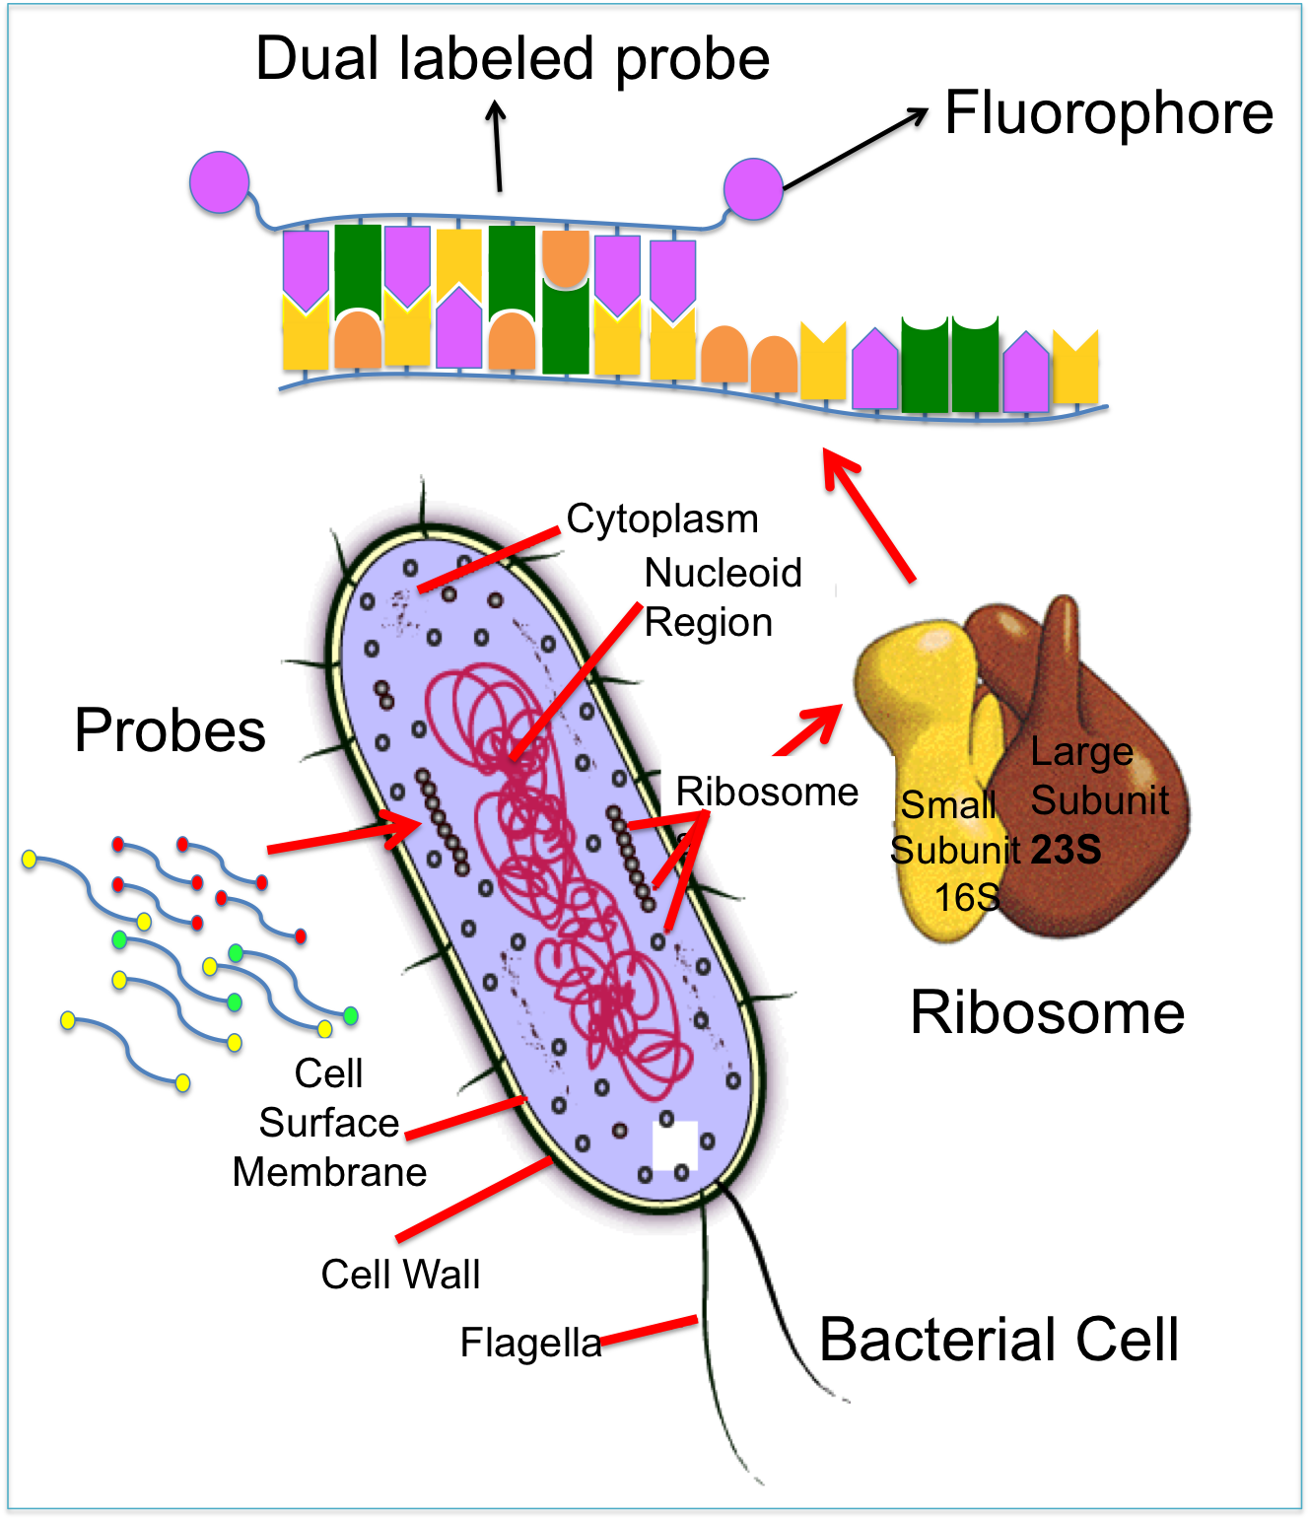
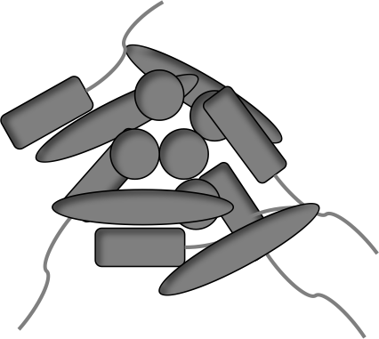
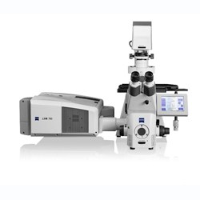
CLASI-FISH
Combinatorial Labeling and Spectral Imaging - Fluorescence In Situ Hybridization
Probes = oligonucleotides specifically targeting rRNA
Unknown bacterial
community on plastic
LSM 780
Laser scanning Confocal Microscope
nm

Slide 16
Fluorescence spectral imaging
emission spectrum of 7 different fluorophores and 2 auto-fluorescences, which can be separated using linear unmixing
nm
Laser 405
Laser 488
Laser 594
Auto-fluorescence
spectra
Gam42a Cy5
for Gammaproteobacteria
Alt811 DY505
for Alteromonadaceae
Eub338 I, II, III DY415
for all Prokaryotes
Vib2300 TRX
Vibrionaceae
Rho1682 DY490
Rhodobacteraceae
Bac1058 Rhodamin RedX
Bacteroidetes
Alf968 Atto620
for Alphaproteobacteria

